Slide 1
Gender affirming Health and Mental health care in youth
Preserving Best Practices

Slide 2
Panel Introductions

Slide 3
What is gender affirming health care?
Health care that supports a person's desire to transition to a gender that aligns with their gender identity (social, hormonal, surgical)
Health care that affirms a patient's gender identity through policies and procedures, regardless of what the pt is being seen for
Care that reduces or alleviates gender dysphoria
Patient centered and medically necessary
Collaborative with the patient, their guardians, the medical team and in many cases the community mental health provider
Evidence based
Age appropriate
Interdisciplinary approach
Follows specific guidelines set by the Endocrine Society and WPATH

Slide 4
What gender affirming care is
The premise of the gender affirming care model:
No gender identity or expression is wrong.
Gender presentations are diverse and vary across cultures.
Gender identity development involves a combination of biology, development, socialization, culture, and context.
Gender may be fluid and is not binary.
Mental health conditions are more often caused by negative cultural reactions to gender diversity than by gender identity or expression itself.

Slide 5
Panel
What does gender affirming care mean to you?
What do you consider gender affirming when it comes to medical care?
How difficult is it to access gender affirming medical and mental health care?

Slide 6
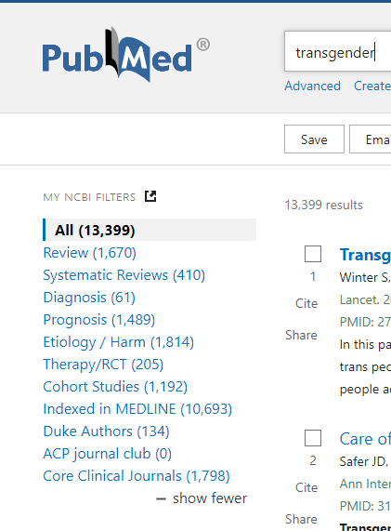
What Gender Affirming care is not
Experimental (a basic PubMed search found 13, 399 studies dating back to the 1940's)
Initiated prior to onset of puberty in minors
Causes people to become gender diverse
Providing care that is inappropriate (given a patient's presentation, circumstances, medical and social history, goals of treatment, parent consent, patient consent, mental and emotional stability, lab work, co-morbid conditions etc..)
Initiated without parent consent
About "performing surgeries on children"
A trend

Slide 7
Panel
What other misinformation or myths you have encountered about gender affirming care in children and adolescents?
What else would you like to share about gender affirming care to this audience?

Slide 8
Why gender affirming care?
Do physicians and mental health professionals hesitate to treat other conditions with evidence-based practices?
Medical necessity
Consider the alternative- Wait we already have! (conversion "therapies")
Research confirms that GAC leads to better health and mental health outcomes! (American Psychological Association, American Academy of Child and Adolescent Psychiatry, the Endocrine Society, American Medical Association, American Academy of Pediatrics, National Association of Social Workers call this care evidence based and medically necessary)
High risk population requires informed and compassionate care: subst use, eating disorders, depression, anxiety, suicidal ideation, suicide attempt, self-harm behaviors...

Slide 9
2023 Trevor Project National Survey

Slide 10
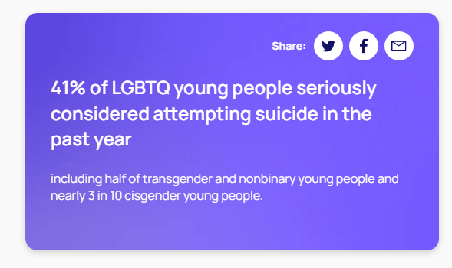
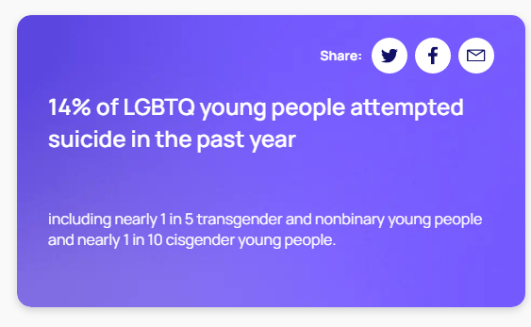
Why gender affirming care?
Trevor Project 2023 US National Survey

Slide 11
Panel
What do you want those working in health care and public health to know about why gender affirming care is so important?
If this care had not been available to you, what would the impact have been?

Slide 12
A changing landscape

Slide 13
LANDSCAPE OF GENDER AFFIRMING CARE IN THE U.S. (updated 9/19/23)
Map and data produced by Southern Equality Campaign, 2023
Notes:
10 states currently have laws that ban gender affirming care for youth with 6 others set to take effect. Nearly half of the states in our union have, will have or are considering bans on evidence based medical care to minors

Slide 14
what hb 808 does
H808 prohibits the initiation of any gender-affirming care in NC for people under the age of 18, including puberty blockers, gender-affirming hormone therapy, and surgery.
H808 prohibits state funds from being directly or indirectly used toward gender-affirming care for you
H808 prohibits Medicaid from covering these services after August 1st 2023.

Slide 15
What HB 808 Does not do
It does not restrict care for youth who have begun a
“course of treatment” before August 1st, 2023.
It does not prohibit gender-affirming care for anyone
over the age of 18.
It does not prohibit the State Employees’ Health Plan
from covering gender-affirming care.
It does not prohibit minors from receiving gender-affirming care from outside of NC.
It does not restrict affirming mental health care for transgender and nonbinary minors.

Slide 16
Panel
How are these laws impacting you, either directly or indirectly?
What do you wish people understood about the impact of these laws on not just trans and non-binary youth, but the entire LGBTQ+ community?

Slide 17
What can I do?
Show Up!
Pay attention
Give your time and money
Do no additional harm

Slide 18
Panel
How can we help support gender affirming care for you and others?

Slide 19
Cheat sheet
Do this
Not that
Once you know a person's pronouns- use them
Create safe spaces in your spaces
Get training and educate yourself (especially if you are in a health care profession)
Speak up when misgendering or discrimination is observed
If you're not sure how to address someone, just ask
Treat all human beings with dignity, compassion and respect
If you accidently misgender someone apologize and correct yourself
Don't make assumptions about a person's gender and pronouns
Avoid demeaning or "othering" language
The terms transgender and non-binary are adjectives , not nouns. For example "he's a transgender" or "she is transgendered" or "I think that person is a non-binary" is not appropriate.
Don't ask about gender affirmation surgeries
Especially with youth, be mindful not to "out" someone inadvertently

Slide 20
Acknowledgement of who is not represented here Today
BIPOC who are transgender or non-binary were not intentionally excluded from the panel.
Transmen or transmasculine individuals also were not intentionally excluded from the panel

Slide 21
Resources
Equality NC: https://equalitync.org/
Campaign for Southern Equality: https://southernequality.org/
GLSEN: https://glsen.org/
PFLAG: https://pflag.org/
Trevor Project: https://www.thetrevorproject.org/
It Gets Better Project: https://itgetsbetter.org/

