Slide 1
R
V
C
H
I
“Empowering Healthy Lifestyles”
Roanoke Valley Community Health Initiative
Halifax County

Slide 2
How Did We Get Here?
The awareness of the need to shift models of health care initiatives to be proactive as opposed to reactive.
Initial collaborations amongst health care providers within the Roanoke Valley were limited.
The “SHOCKING” statistics according to county health rankings for the Roanoke Valley.
The realization that opportunities are limited for recreation.
Limited access and value of healthy fruits and vegetables.
Rural Area vs. Fast Food “Alley”
Generation Difference

Slide 3
Who
or what
is the
Community
Health
Initiative?

Slide 4
WHY?
THE DATA For Halifax County is
DISTURBING!
Halifax ranked #99/100 in 2012
& again in 2013
County Health Rankings

Slide 5
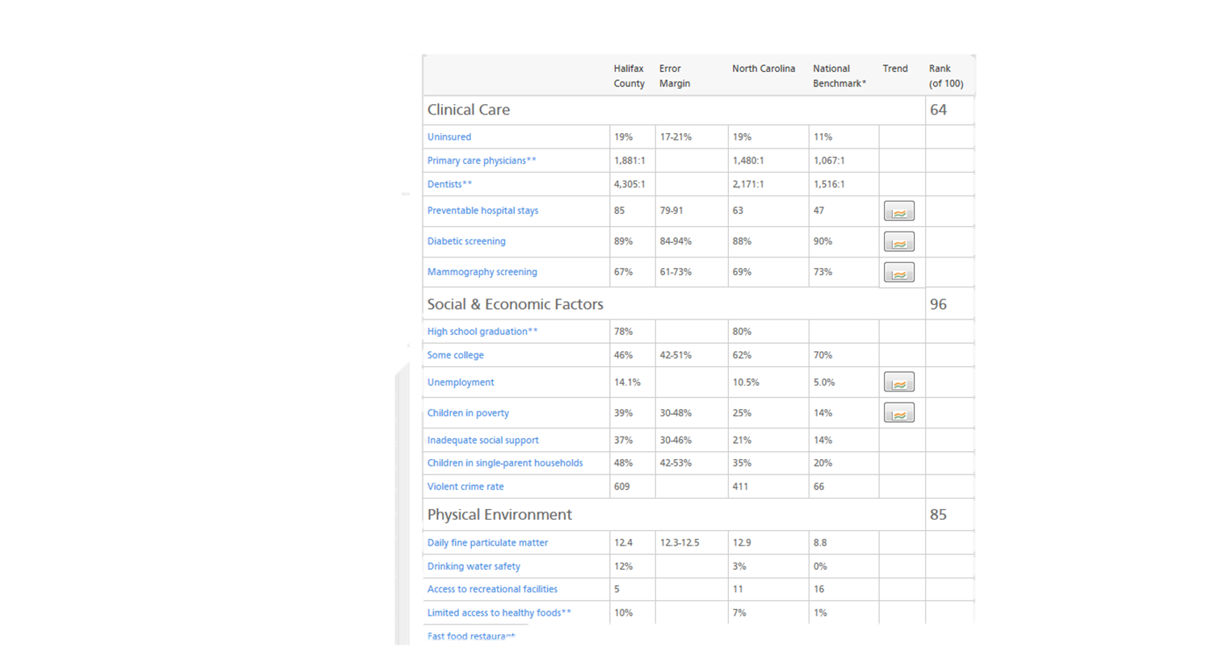
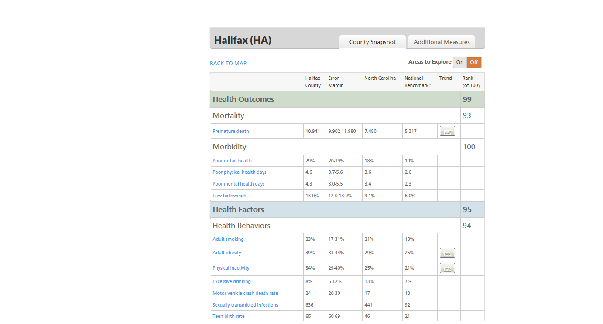
http://www.countyhealthrankings.org/app/#/north-carolina/2013/halifax/county/outcomes/overall/snapshot/by-rank

Slide 6
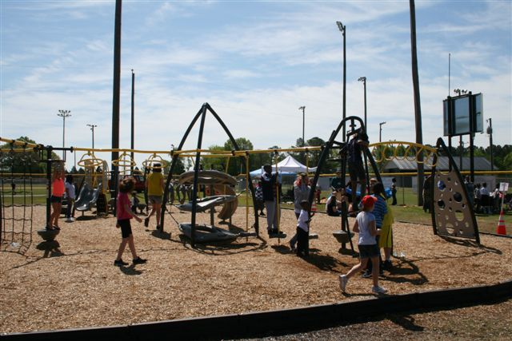
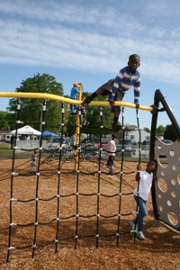
We are determined to make changing our results a reality!

Slide 7
ROLE OF THE RV-CHI
Implement effective program, policy and infrastructure options based on the mission of the RV-CHI.
Identify and help solve barriers to service delivery.
Discover and develop new strategies to maximize the effectiveness of limited services.
Identify ways to coordinate and pool resources within and across county lines.
Identify administrative rules and policies that create barriers to service delivery.

Slide 8
5-8-14
RV-CHI PARTNERS
Youth Empowered Solutions | Boys and Girls Club of Halifax County
Halifax Regional | North Carolina Child
Poe Center for Health Education | Halifax Community College
Haliwa-Saponi Tribe | Chris Wicker
Gregory B. Davis Foundation | Park Avenue Pediatrics
Halifax County Public Health System | Halifax County Cooperative Extension
Northampton County Health Department | Town of Garysburg
Halifax County Schools | Our Community Hospital
Northampton County Schools | Professional Resources Organization
Roanoke Rapids Graded Schools | Regeneration Development Group
Weldon City Schools | Rev. Danny Ellis
Roanoke Rapids Parks and Recreation | Rev. Robert Sessoms
Kate B. Reynolds Charitable Trust | Rie Boone
Rural Health Group | New Day Fitness
Northampton County Cultural and Wellness Center | Northampton Healthy Carolinians
Halifax-Warren Smart Start Partnership for Children | Nurse Family Partnership
Halifax County Department of Social Services | Roanoke Valley Chamber of Commerce
Valley Community Church | Halifax Leadership Equity Project
Northampton County Cooperative Extension | First Christian Church
C.A. R. E. The John 3:16 Center | Lake Gaston Chamber of Commerce

Slide 9
GOAL
Empower residents in the Roanoke Valley to adopt healthier lifestyles, access preventative services, and take positive actions to improve health in our communities.
Notes:
O

Slide 10
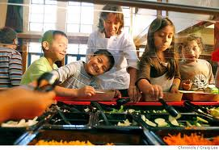
Strategies To Achieve Goal
Applied Research & Data
Policy Change
Program Implementation
Coordination and Communication
Community Awareness

Slide 11
Mission & Vision
RV-CHI MISSION: to promote healthy living through education, empowerment, and healthcare access in the Roanoke Valley.
RV-CHI VISION: Roanoke Valley families and individuals are empowered to lead healthy lifestyles.

Slide 12
Results we want to achieve?

Slide 13
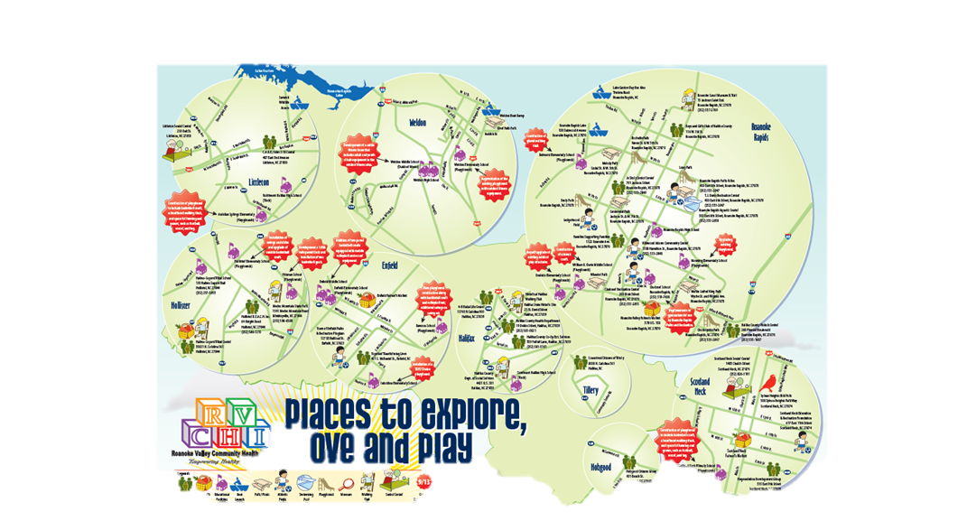
Community Awareness Campaign

Slide 14
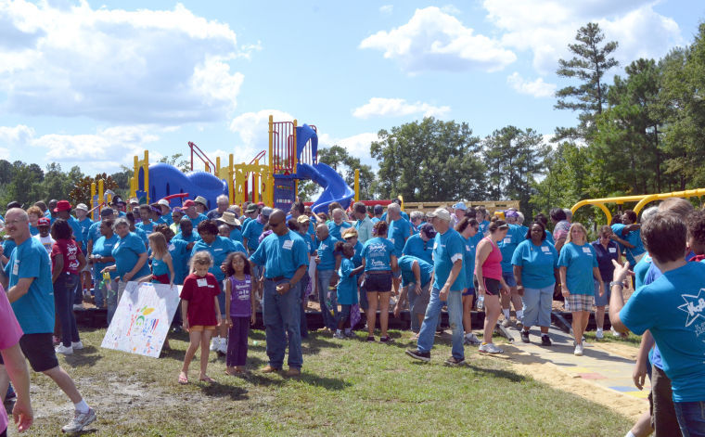
Moving Forward..

Slide 15
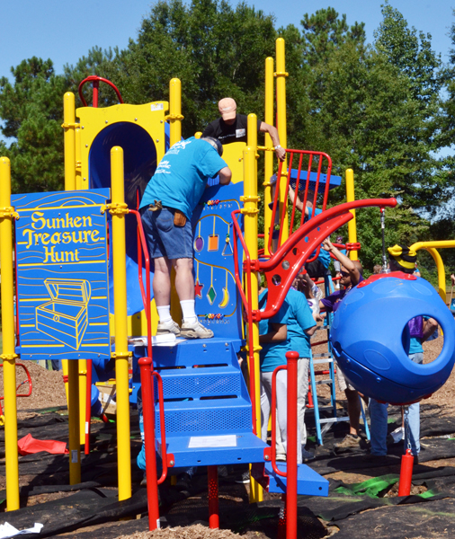

Slide 16
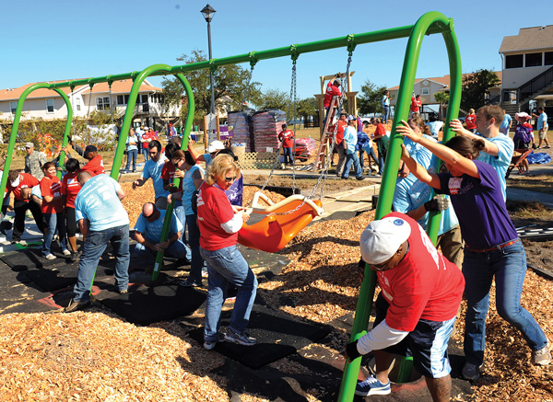
Return Of KaBOOM! To Enfield

Slide 17
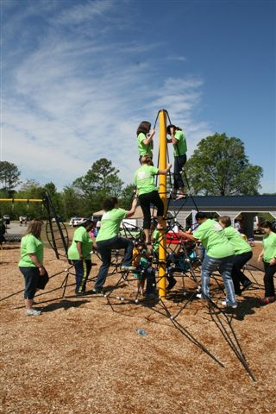
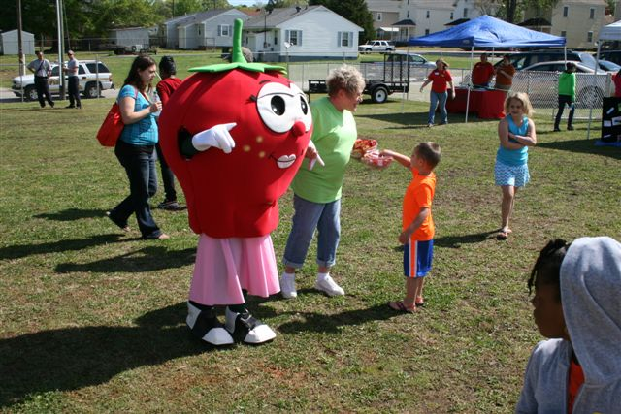

Slide 18
Education Initiatives
Fitness Activities
School Based Health Centers
Fitness Playground Equipment
All Elementary Schools in Halifax County
Fitness Centers
School Health Advisory Committee
CATCH (Coordinated Approach to Child Health)
Walking Trail
Manning
Belmont
Halifax Community College
John 3:16
Kaboom – John 3:16

Slide 19
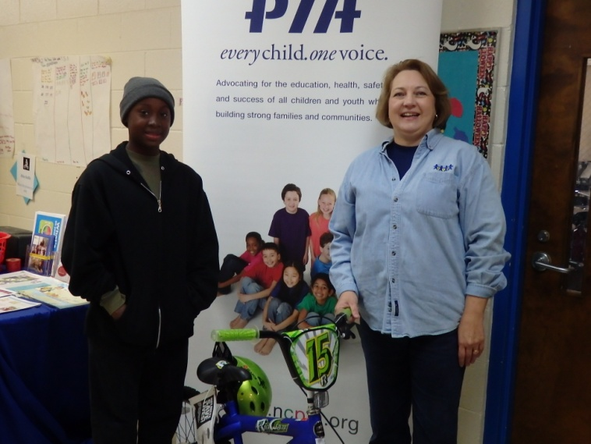
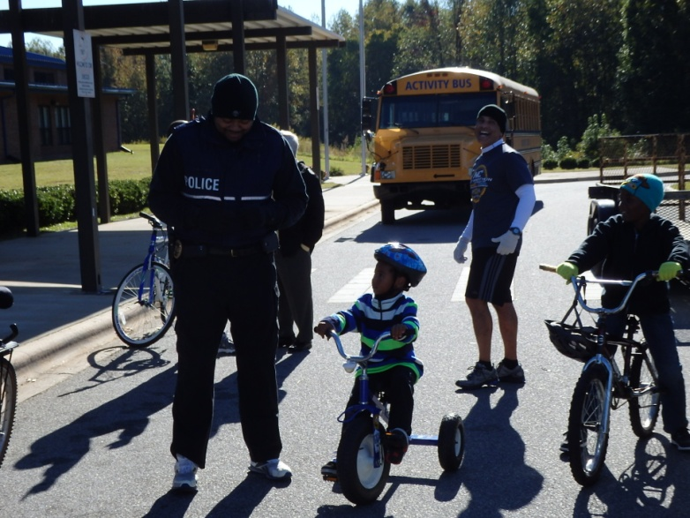
Race to fitness

Slide 20
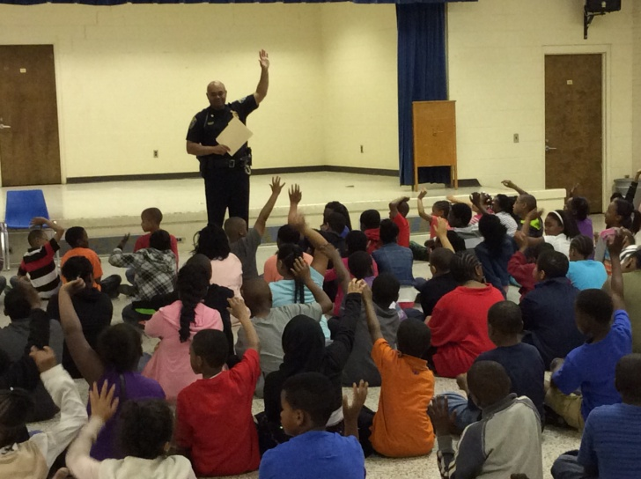
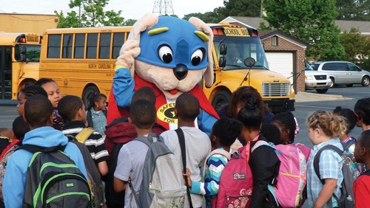
Walk/Bike to School

Slide 21
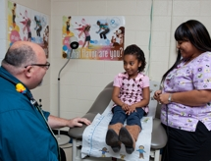
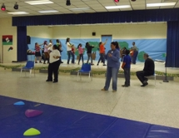
School based health center
Wellness checks
Boot Camp - Exercise

Slide 22
School Health Advisory Committee
Implementation of local policies
Consists of district level administration, principals, physical education teachers, nurses, teachers, cafeteria workers, parents, and community organizations
Partnership with local health agencies
C.A.T.C.H. Grant with Halifax County Public Health Systems (The CATCH Program brings schools, families, and communities together to teach children how to be healthy for a lifetime. CATCH is effective because healthy behaviors are reinforced through a coordinated approach - in the classroom, in the cafeteria, in physical education, at home and after school.)

Slide 23
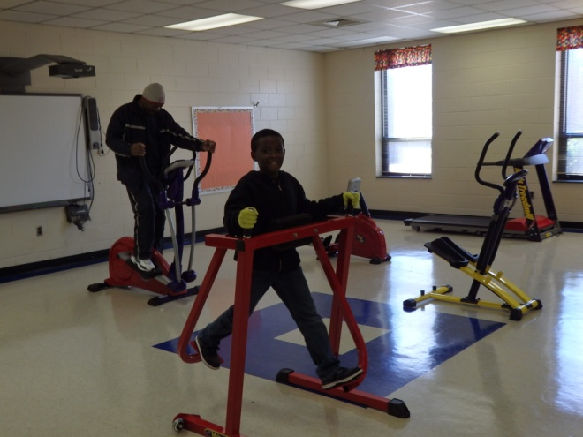
Fitness Equipment

Slide 24
County – wide improvements
Walking Trails
Belmont
Manning
Halifax Community College
John 3:16
Canal
Kaboom - Fitness Equipment
John 3:16
Enfield

Slide 25
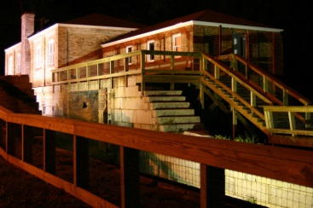
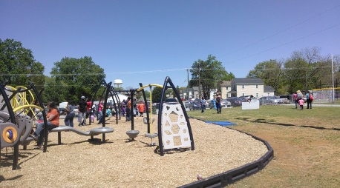
Halifax County Recreation Network
The Halifax County Recreation Network is a collaboration between community stakeholders from across the county
Halifax Leadership Equity Project (HLEP), Halifax County Convention and Visitors Bureau, Kate B. Reynolds Charitable Trust and others who have convened to discuss, plan and implement a recreation agenda. This includes identifying and subsequently addressing policy, program and infrastructure needs. A theme that resonated from these meetings was the need for a countywide recreation plan to ensure that the unique needs of all residents are accurately identified and addressed.

Slide 26
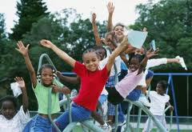
Partnerships & Collaborations
Recreation Network: A voluntary collaborative with citizens from all over Halifax County representing a wide variety of concerns & interest.
Halifax County Parks and Recreation Master Plan: A collaborative and cooperative effort to develop 5 – 10 year plans for facilities and programs to enhance and complement RV- CHI efforts.

Slide 27
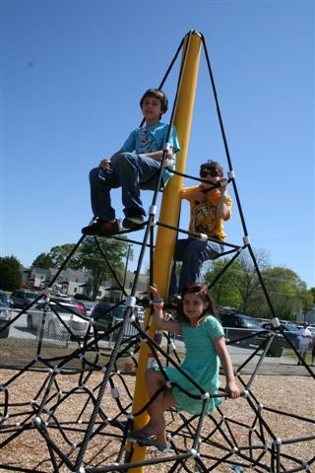
QUESTIONS?

Slide 28
For more information contact
Terry D. Alston
Weldon City Schools
alstont@weldoncityschools.k12.nc.us
Audrey Hardy
Halifax Regional Hospital
ahardy@halifaxrmc.org
Michelle Puckett
Roanoke Rapids Graded School District
puckettm.co@rrgsd.org
Chris Wicker
Halifax County Recreational Network
cpwicker@gmail.com

