Slide 1
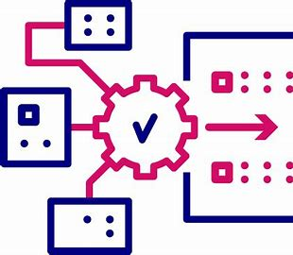
2025 Data Modernization Planning: Communicable Disease Branch
Erika Samoff, Data Modernization Strategy Lead, Jennifer Stewart, Surveillance Systems Lead, Shima Idries, Data Modernization Coordinator
2025 NC Public Health Data Summit
Notes:
If group is small enough, get everyone to introduce themselves

Slide 2
Data Modernization: how to co-create?
“Data Modernization” is named for a CDC strategy and funding stream
A big chunk is for things in the NC DPH epi section (communicable diseases, immunization, syndromic surveillance)
The rest is for overall infrastructure to the state
More broadly, we are all trying to learn the lessons of the pandemic and take advantage of software advances
Despite all our silos, we are working on the same project. So, how do we arrive at co-creating?

Slide 3
Outline
Co-creating
Big picture
CDC and NC goals
Some CDB modernization that serves community and lessons learned
Workshopping data modernization

Slide 4
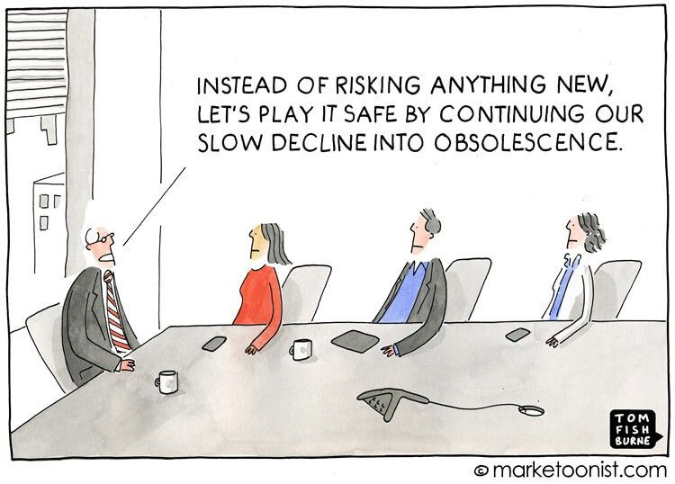
Collaborative Leadership: What are the goals? Notes from discussion
Support the health of NC residents
Streamline data collection
Improve efficiency
Make the most effective use of staff time
Get as much reimbursement as possible
Data goes in and back out
Notes:
Use our staff time as efficiently as possible

Slide 5
Context: National and CDC goals

Slide 6
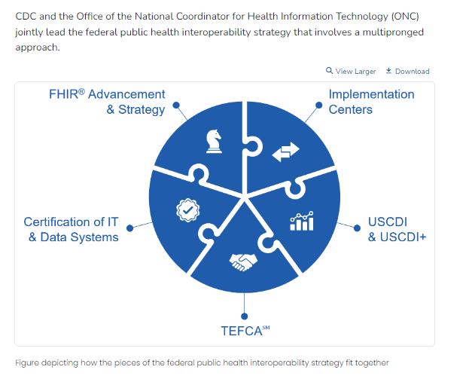
National Health information Strategy
CDC and ONC are working to:
Ensure that public health professionals have greater awareness of, and a seat at the table, when data and technology standards are being developed.
Provide public health professionals access to richer and more timely data in ways that put less burden on both data providers and public health agencies.
Establish modern, scalable, cloud-based capabilities for public health professionals to analyze, interpret, and act on data more quickly and securely.
Data exchange: Tools
provide technical assistance to health departments to improve data exchange across public health jurisdictions, healthcare, and other data providers (e.g., laboratories)
Certification of EMRs
HTI-1 “meaningful use”
HTI-2
Standardization of data variables
Data exchange: Organizations
https://www.cdc.gov/data-interoperability/php/public-health-strategy/index.html
Notes:
HTI-2 is part of a larger strategy that wants to create a highly-interoperable network for health information (“Like ATMs”)
It addresses itself in particular to APIs and structured communication frameworks
APIs allow for ongoing or batch data queries, so flow is more immediate and data are more available
FIHR-oriented but not requiring FIHR for PH except for eCR as of Jan 1 2028
Certification is offered for
Healthcare systems
Public health systems
Payer systems??
No carrots/sticks are identified for public health certification and it’s not clear who would offer them, maybe CDC via grants?
Would Conduent pursue certification?
Could accreditation require it?

Slide 7
Responses to National Plan
FHIR: Data message language standard
APIs: Queries or coded data exchanges
Ongoing instead of exchanging static datasets
Support data movement in a network
Anyone implementing FHIR?
Anyone has had conversations about TEFCA?
Anyone moving toward API implementation?

Slide 8
Public Health Data Strategy CDC Milestones and Goals for 2025 and 2026
Goal 1: Strengthen the core of public health data: more sources, more efficient
Goal 2: Accelerate access to analytic and automated solutions to support public health investigations and advance opportunities for all people to attain their highest level of health
More ED, in-patient, and hospital bed capacity data
Electronic case reporting
Modernize case and mortality reporting e.g. via API, FHIR, unify case data standards
Increasing automation of data handling
Modernize CDC’s communicable disease software
Internal central data pool for CDC
Expand non-medical information in data reports
Leverage AI at scale
Improvements to electronic laboratory reporting
https://www.cdc.gov/public-health-data-strategy/php/about/phds-milestones-2025-and-2026.html
Notes:
32 total objectives, below are the ones that are specific to communicable diseases or run through the communicable disease branch in NC
Expand real-time access to emergency department data
Electronic case reporting (eCR) reduces manual reporting from health care
Reportable Conditions Knowledge Management System (RCKMS) for lab data
Sustainable and flexible case data transmission methods
Expanded and timely collection of wastewater results
Expanded public health laboratory data exchange
Modernized integrated disease surveillance system to better receive, use and share data
Combine core data sources to improve integrated surveillance
Sophisticated outbreak analytical tools available to STLT partners
Disseminate integrated data and visualizations - Building upon the success of the Respiratory Illnesses Data Channel, expand public access to dashboards for five of the nation's most urgent public health threats
Reportable Conditions Knowledge Management System (RCKMS) for lab data

Slide 9
Public Health Data Strategy CDC Milestones and Goals for 2025 and 2026
Goal 3: Visualize and share insights to inform public health action: dashboards and models
Goal 4: Advance more open and interoperable public health data: TEFCA, data exchange
Use CDC central data system to share with us to decrease conflicting data
Offer outbreak forecasting tools
Governance for data sharing with Tribal bodies
Align with USCDI where possible
FHIR
Common data sharing agreement across CDC
Establish value of TEFCA

Slide 10
Have you heard about these milestones?
Has your jurisdiction made any changes with this in mind?

Slide 11
Communicable Disease Branch/CDC alignment
Strengthen core of public health data
Accelerate access to analytic and automated solutions
Visualize and share insights
Advance interoperable public health data
CDC
Offer leadership for collaborative vision
Maintain Current Strengths
Improve speed and efficiency of analysis
Improve speed and efficiency of response
Generate new insights via new data combinations
Support whole-person health
Make good data available
Advance interoperable public health data?
NC

Slide 12
Collaborative planning
LHD staff engaged in strategic planning workgroups that generated our first round of priorities and our first data modernization plans
Reps from Mecklenburg, MTW/Pitt, Catawba, Cabarrus, Buncombe
Collaborative planning also engaged SLPH, Immunization
Haven’t done a further round of strategic planning
Ongoing LHD engagement via
Information sharing and engagement at Data Summits
CDB local epidemiologist meetings
Surveys at Communicable Disease Conference

Slide 13
Completed data modernization tasks as of December 2024
Goal 1: Strengthen
Goal 2: Accelerate
Establish ECR for gonorrhea, chlamydia, and measles
Bring new capacities into NC EDSS e.g. texting
Support whole person health by training linkage to care staff to use NCCARE360
Train state linkage counselors and MMP staff
Use CCNC staff for exposed person and case outreach
In LHDs with higher HIV among Latino/a/x community, invite CBOs to join NCCARE360
Onboard 12 additional systems or facilities to send eCR data
Upgrade tracking of outbreaks for foodborne diseases and measles in NC EDSS
Identify overlapping data needs and start to pursue linkages across data systems. Examples: HIV/syphilis with vital records; HAI with Medicaid
Bring new broader data into NC DETECT
Example: Helene
Share and assess NC DETECT data quality reports
Automate interstate notifications for CDs within NCEDSS with SC, Virginia, and Maryland

Slide 14
Completed data modernization tasks as of December 2024
Goal 3: Visualize
Improve completeness of race and ethnicity data in NC EDSS
Develop a dashboard template that can be rapidly adapted within 48 hours of an outbreak
Develop an aberration-detection algorithm to detect changes in disease incidence
Defined updated categories for sex/gender, race/ethnicity, and tribal affiliation
Publish annual immunization compliance data to a public dashboard
Make downloadable annual and quarterly data available in dashboard with added demographics

Slide 15
Some specific advances that serve community and lessons learned

Slide 16
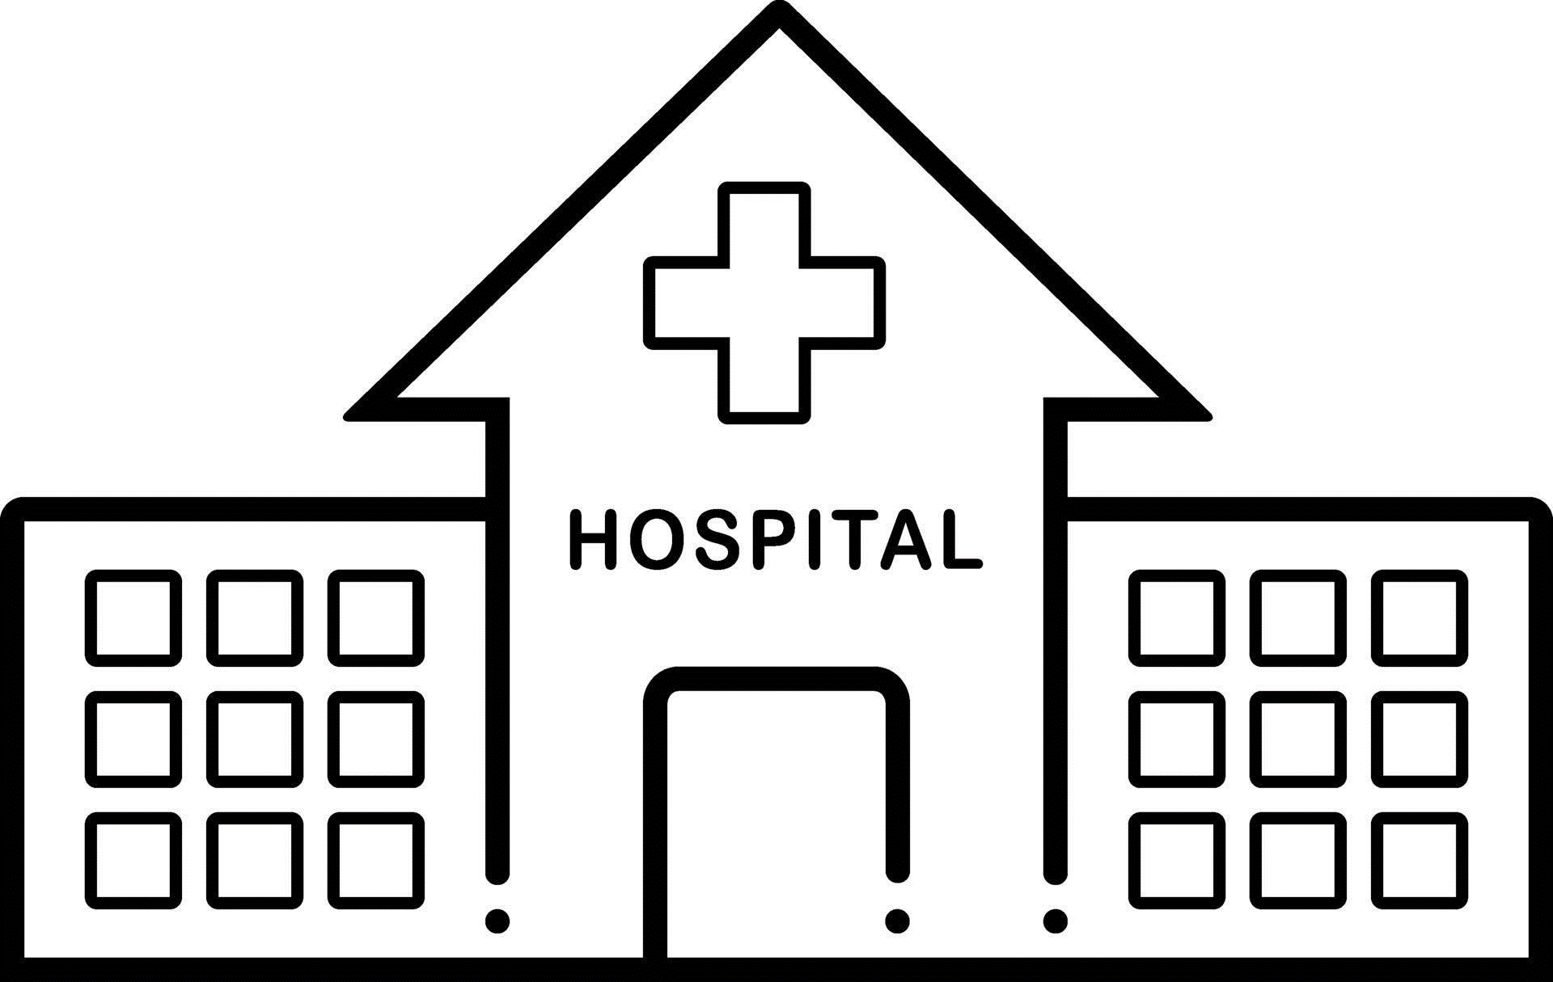
Electronic Case Reporting
Can reduce manual data entry and provide more complete data
Provides critical clinical data from healthcare for better surveillance
Accelerates information transfer and response
eCR and RR
(electronic Case Report and Reportability Response)
eICR
(electronic Initial Case Report)
EMR
NCEDSS
Approximately 65% of NC hospitals, along with thousands of practices and ambulatory clinics, are sending eCR data to the state.

Slide 17
Diseases:
Chlamydia with medication mapping
Gonorrhea with medication mapping
Mpox
Measles
How to use eCR
Information regarding the person will update person and demographic packages
Report Events with eCR Activity can be used to see a list of events
For NC EDSS questions, contact the NC EDSS help desk
For questions about adding facilities for eCR, contact
eCR Core Team: ECR.Support.Services@dhhs.nc.gov
What is included in an eCR?
An eCR typically includes a combination of the following elements:
Demographics | History
Clinical Notes | Results
Reason for Visit | Medications/Treatment
Encounter Details | Vaccine Information

Slide 18
Lessons from NC EDSS improvements
Challenges
Staffing/Money
Prioritizing
Losing funding
Lessons
Take advantage of crises
Temp hiring
Internal IT/developers
Role of business analysts
Identify group goals; everyone in the picture together
!!!
Notes:
Increase in electronic laboratory reporting
Improved race/ethnicity data (may appear as increases among Hispanic/Latino people; compare to unknown)
Electronic case reporting
Automated interstate routing

Slide 19
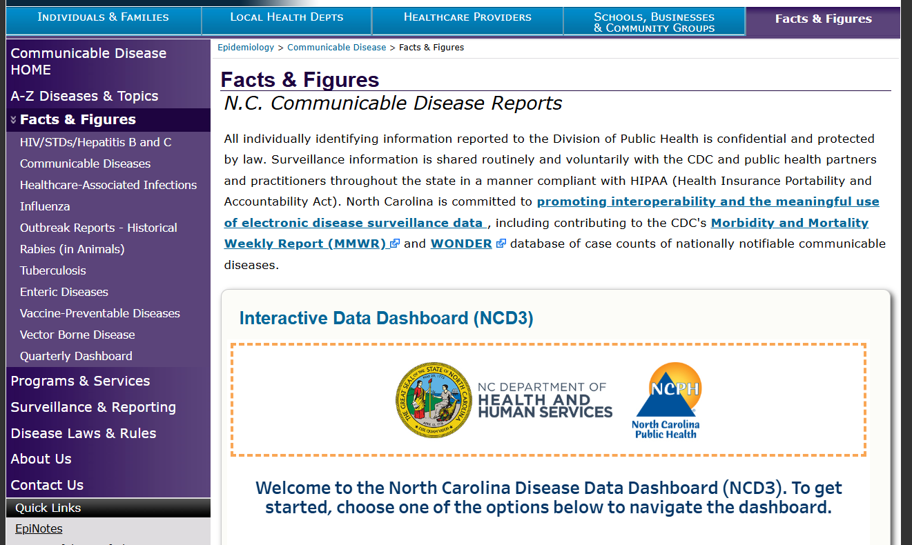
Dashboard
Regions
Demographics
Quarterly data
Preliminary annual data
Notes:
Walk through: annual, quarterly + increase/decrease, prelim annual

Slide 20
Lessons from Dashboard
Challenges
Staffing/Money
User feedback
Lessons
Most dashboarding can be learned by current staff
Big upfront effort, then maintenance is lower
Web support should provide access to click data
User testing
Notes:
Increase in electronic laboratory reporting
Improved race/ethnicity data (may appear as increases among Hispanic/Latino people; compare to unknown)
Electronic case reporting
Automated interstate routing

Slide 21
Texting for communicable disease response
Priority case of disease identified in NC EDSS
Phone number available
Patient accesses information resources including how to access treatment
Eventually hoping to capture patient exposures in NC EDSS
Non-specific automated message sent directing to website
Eventually hoping to send survey with confidential data capture
Anyone doing this locally?

Slide 22
Lessons from Texting
Challenges
Really new technology
Has to integrate
Legal
Communications
Lessons
Move at the speed of trust … and contracts
Move at the speed of development, coordination takes time
Move at the speed of legal advice
Agencies, providers, public
Notes:
Increase in electronic laboratory reporting
Improved race/ethnicity data (may appear as increases among Hispanic/Latino people; compare to unknown)
Electronic case reporting
Automated interstate routing

Slide 23
Workshop: What has blocked software improvements in your setting, and did you fix it? Notes from discussion
Issues | Solutions
Software change not nimble enough | Tracked it on paper Increase developer time/access by moving software
So many changes so fast | Change staff: training, future-oriented conversations, someone with vision
Interoperability | Double documentation API where NC EDSS can receive a call from local software or nightly data download not bounded by disease groups
Getting data out | Double documentation Power automate
 | Use IT resources effectively; ask for what you want

Slide 24
2025: Workshopping data modernization

Slide 25
LHD input: Comments from CDB Conference’25
Key takeaway: Leadership needed to clarify what are local roles in data modernization and what are state.
Barriers to DM named at CD conference:
Availability and siloing of funds
Siloing of data systems
Staff competency
Firewalls/security
Can’t access NCEDSS for surrounding counties if patient treated at LHD
EMRs that are intuitive and function with public health services
Desires
Ability to access hospital records/EHR/access to patient charts (most frequently mentioned request)

Slide 26
Current DMI Funding Resources
Current Funding | End Date
Base ELC | Period 1: ends July 31st, 2025 Next period: Aug 31 – July 31st End: July 31st 2029 5-year cycle
Enhancing Detection (HH) | Ends: July 31st, 2026
Enhancing Detection Expansion (P5) | Ends: July 31st, 2026
CARES (WT) | Ends: July 31st, 2026
DMI1 (8V) | Ends: July 31st, 2026*
DMI2 (N9) | Ends: July 31st, 2027

Slide 27
Opportunities with Health Information Exchange
Strengthens the core of public health data; is a route to interoperability
LHDs can join the HIE for free
Access clinical care information
Support continuity of care for clients/patients
Find information to contribute to public health reporting activities
Can support electronic laboratory reporting

Slide 28
What are we already building together?
Automating communicable disease case record information flow to LHDs and back via NC HealthConnex, NC EDSS
Sharing county-level data via NCD3 quarterly dashboard (required NCALHD buy-in, has NCALHD user feedback group)
Offering whole-person health collaboration via NCCARE360

Slide 29
Workshop: - Identify a goal that involves multiple agencies and could include some kind of co-creation - Identify the first barrier you expect to encounter - Identify what might be a solution

Slide 30
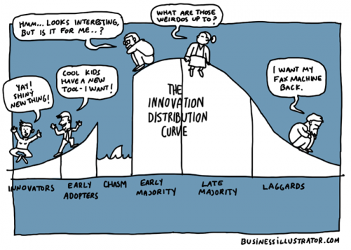
General categories of improving software
Have an AI use policy that requires human review of all products with AI contributions
From perplexity.ai
Modernize Legacy System
Strengthen Security and Compliance
Enhance Data Interoperability
Improve User Interface and Experience
5. Automate Routine Workflows
6. Implement Comprehensive Training Program to maximize system utilization, minimize errors, and boost confidence
7. Leverage Cloud Computing
8. Integrate Advanced Analytics and Reporting
9. Foster Effective Patient-Provider Communication: Enable features such as secure messaging, telehealth, and real-time updates to keep patients engaged and informed, improving satisfaction and outcomes
10. Educate yourself on what’s possible to regularly update and optimize systems

Slide 31
Issues and approaches
Goal | Barrier | Solution

Slide 32
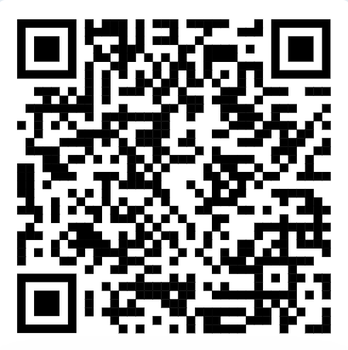
erika.samoff@dhhs.nc.gov
Communicable Disease
Dashboards
Immunization
Dashboards

