Slide 1
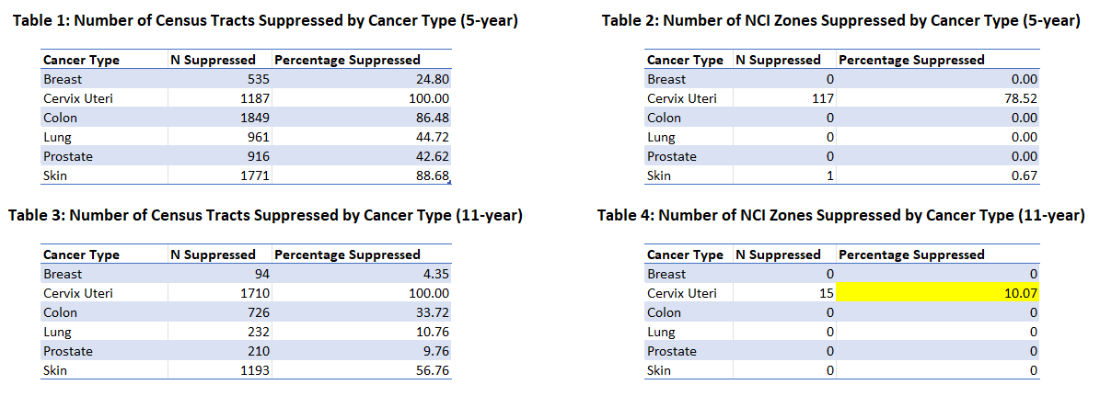
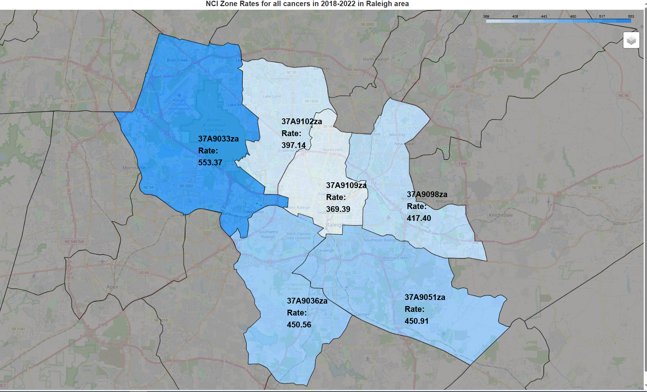
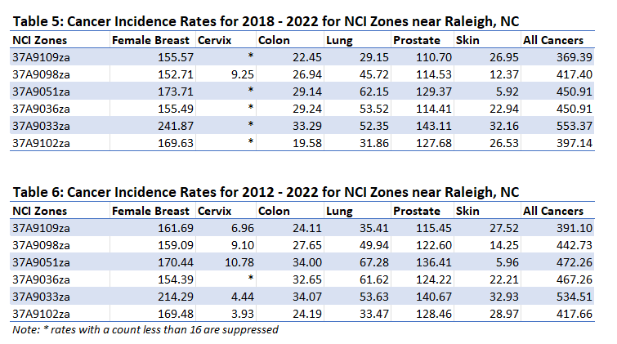
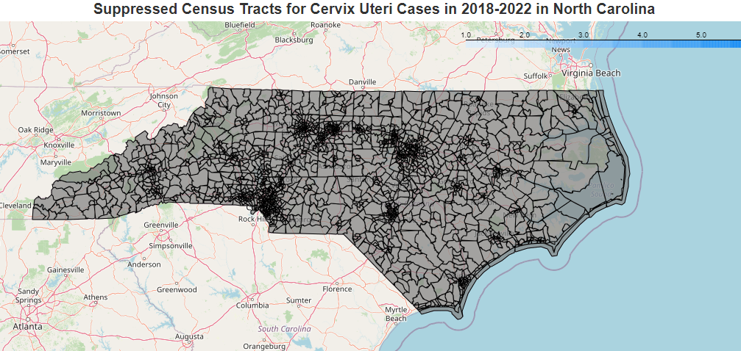
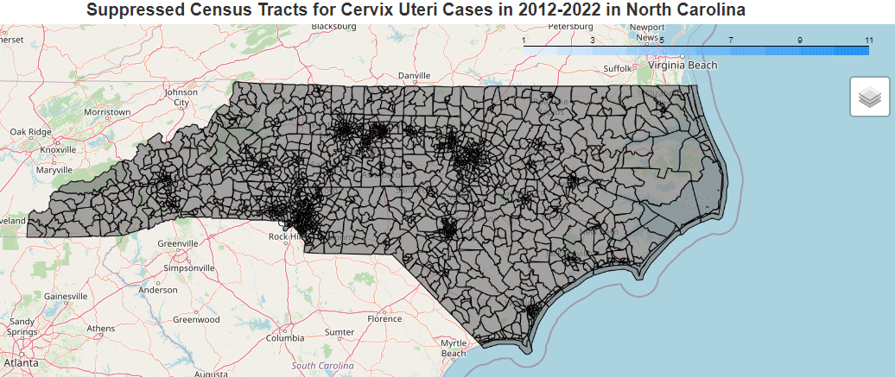
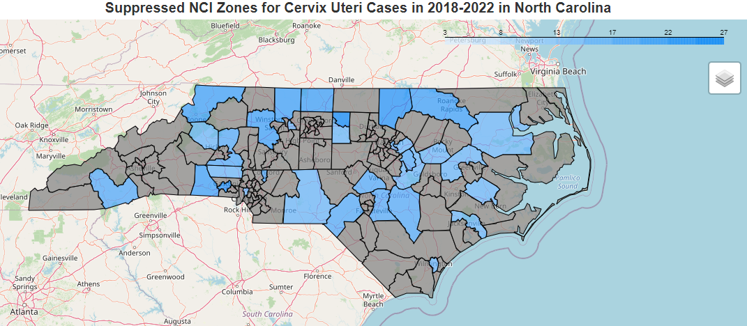
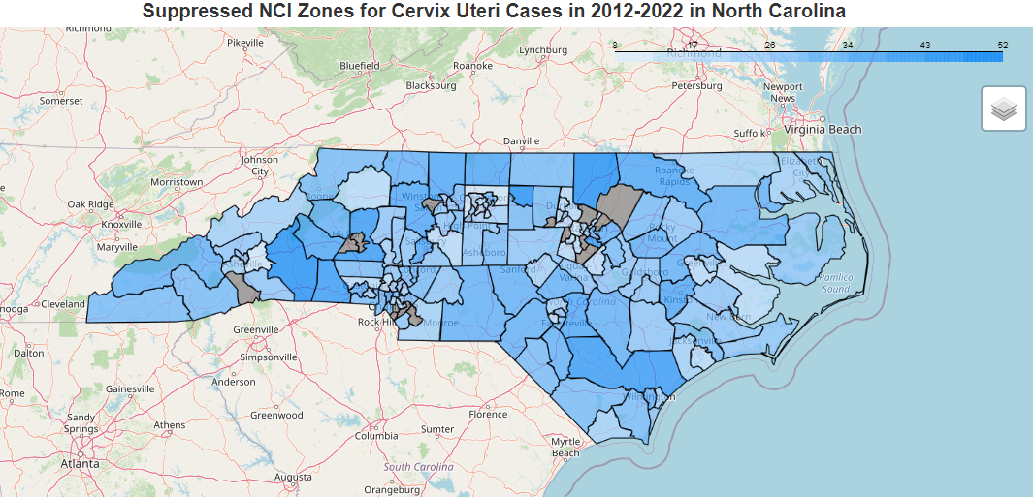
Calculating Cancer Incidence Rates using National Cancer Institute Zones (NCI) in North Carolina
Authors: Ashley Victor, Christian Klaus, Fatma Simsek, Chandrika Rao
Affiliations: North Carolina Department of Health and Human Services, Division of Public Health, State Center for Health Statistics, Central Cancer Registry
1. Introduction
3a. Results – Suppression Analysis
3c. Results - Maps
With North Carolina’s changing demographics, cancer epidemiologists would benefit from analyzing cancer rates at a more granular level than counties, which is the current method used by Central Cancer Registries (CCR). Larger counties have diverse populations, so giving just one overall rate can be misleading. Instead, we use smaller units called census tracts for a more accurate analysis. However, to ensure the data is reliable and to protect patient privacy, we don't share data from areas with very few cancer cases. To provide even greater detail, the National Cancer Institute (NCI) has developed a set of cancer reporting zones that (1) provide a greater level of detail for large counties, (2) reduce the need to suppress data for small counties, and (3) offer more meaningful data for communities and stakeholders. The NCI zones help us better understand and address the variations within the populations and make it easier to compare cancer rates across smaller geographic areas. We propose that utilizing NCI Zones as the geographic unit will produce less suppression compared to developing rates at the census tract level.
For this analysis, we focused on more granular geographic boundaries within Wake County, which is divided into 15 NCI Zones. For 6 of the zones, we computed more detailed cancer rates for the Wake County area, broken down by primary site (as shown in Tables 5 and 6). This approach provides a more specific understanding of cancer rates compared to using county-level data.
Figure 5: NCI Zone rates for the Raleigh area for all cancers in 2018-2022
When utilizing NCI Zones, the percentage of suppression is 0% for 4 of the 6 cancers of interest at the 5-year analysis, and 5 of the 6 cancers for the 11-year analysis.
3b. Results - Maps
2. Methods
Census Tract Suppression
Data: We are using the North Carolina CCR cancer incidence data at the Census Tract Level from 2012 – 2022. As the population denominator, we are using U.S. census tract population estimates produced by Woods & Poole Economics Inc and NCI¹. The NCI assigned NC Census Tracts to the zones. We merged NCI Zone information to our population and incidence files by Census Tract.
Analysis: In our analysis, we calculated age-adjusted rates² for the top six cancers (lung, melanoma, prostate, female breast, colorectal, and cervical cancer) across all Census 2010 Tracts in North Carolina. We developed a Python script to compute these rates in accordance with suppression criteria³, displaying rates only for tracts with a case count of 16 or more after cases are aggregated (cases summed across diagnosis years). To maximize the number of tracts meeting this threshold, we aggregated incidence and population data for a 5-year range (2018 to 2022) and a 11-year range (2012-2022).
We created maps to illustrate areas with suppressed rates, allowing us to compare suppression levels between the Census Tract and NCI Zone methodologies. The Folium Python package was used to generate the maps⁴.
4. Conclusion
Figure 1:Suppressed Census Tracts for Cervix Uteri Cancer in 2018-2022 (5-year)
Figure 3: Suppressed Census Tracts for Cervix Uteri Cancer in 2012-2022 (11-year)
The NC CCR found that NCI Zones method reduces data suppression compared to the Census Tract method. The NC CCR can now compute more granular cancer rates by race, sex, and ethnicity, improving the identification of priority populations for cancer incidence and mortality. By analyzing cancer data at the Zone Level, targeted cancer prevention and control efforts can be implemented to address the specific needs of different communities, effectively addressing the cancer burden across the state and improving outcomes for all.
NCI Zones Suppression
5c. References
1. Populations - Total U.S. (2006-2022), Census Tract Estimates by Race/Origin Controlling to Vintage 2020 <2010 Tract Geographies>, National Cancer Institute, DCCPS, Surveillance Research Program, released October 2024. Source: Woods & Poole Economics, Inc. Washington, D.C. Copyright 2024.
Figure 2: Suppressed NCI Zones for Cervix Uteri Cancer in 2018-2022 (5-year)
Figure 4: Suppressed NCI Zones for Cervix Uteri Cancer in 2012-2022 (11-year)
2. SEER*Stat Tutorials: Calculating Age-adjusted Rates. (2025). SEER. https://seer.cancer.gov/seerstat/tutorials/aarates/definition.html
When analyzing more rare cancers (cervix uteri), we see 100% percent suppression at the Census Tract level for both the 5-year and 11-year ranges. We see much lower suppression at the NCI Zone level.
3. Suppression of rates and counts. (2024, June 13). United States Cancer Statistics. https://www.cdc.gov/united-states-cancer-statistics/technical-notes/suppression.html
4. Python Folium package (2021). Folium: Python Data. Retrieved from https://github.com/python-visualization/folium.

