Slide 1
Division of Public Health
Occupational and Environmental Epidemiology Branch
Public health actions to address extreme heat in North Carolina
Nikhil Kothegal, MPH, PhD Candidate
Climate and Health Program Lead
nikhil.kothegal@dhhs.nc.gov
Autumn Locklear, MSPH
Climate and Health Epidemiologist
autumn.locklear@dhhs.nc.gov
Public Health Leaders Conference 2025
Surveillance & Assessment
March 13, 2025
Notes:
-Hello, thank you for inviting us to speak today. My name is Nikhil Kothegal, and I am the new Climate and Health Program Lead in the Occupation and Environmental Epidemiology Branch in the Division of Public Health. Presenting with me is Autumn Locklear, our Climate and Health Epidemiologist. I’m sure she is a familiar face to some of you in the audience.
-We are going to speak today about extreme heat in North Carolina, its impacts on health, and how our Climate and Health Program is working to address these issues.

Slide 2
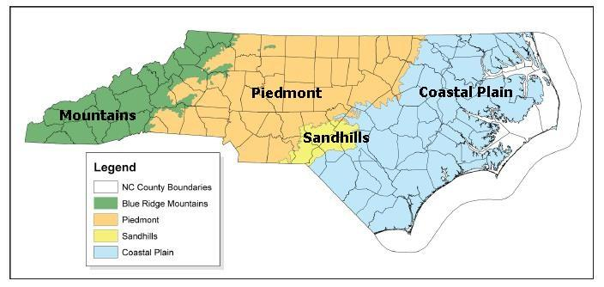
Extreme Heat in North Carolina – past and present
1. How is extreme heat impacting your region of NC?
2. What heat-related health issues is your community or region experiencing?
Source: https://www.ncwildlife.org/wildlife-habitat/habitats
Notes:
-We want to start our presentation by asking for your participation before we delve into the main content of our program’s work.
-Working with the person(s) sitting beside you, we would like you to take three minutes to discuss these two questions:
1. How is extreme heat impacting your region of NC?
2. And second, what heat-related health issues is your community or region experiencing?
We will ask a few people to share what you discussed.

Slide 3
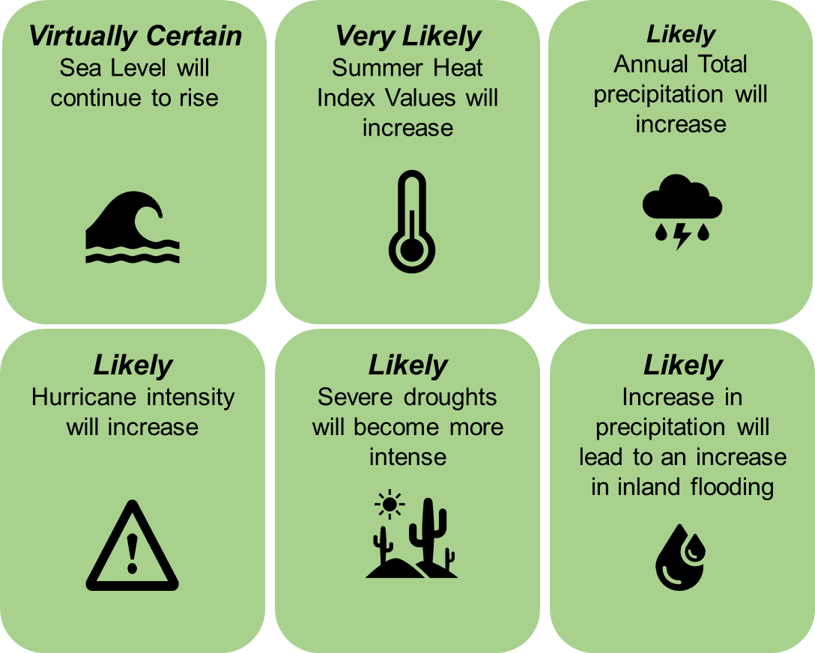
Climate Change Projections for North Carolina
SOURCE: North Carolina Climate Science Report (2020); North Carolina Climate Risk Assessment and Resilience Plan (2020)
Notes:
-Thank you for sharing how extreme heat is affecting your region. Before I delve into how our program is working to address extreme heat specifically, I want to first touch briefly on climate change projections for other climate hazards in the state.
-According to the North Carolina State Climate Office, it is virtually certain we will have continued sea level rise and very likely summer heat index values will increase.
-We also expect increases in total annual precipitation and increases in flooding, more intense hurricane, and more severe droughts.
-We are already observing some of these climate changes in the state, and we need to continue to assess how they can affect human health and what actions can be taken to mitigate their impacts on public health.

Slide 4
Extreme heat does not affect all communities equally
Vulnerability to the health effects of climate change
Adapted from: https://health2016.globalchange.gov/populations-concern
Notes:
-I want to note that climate change does not affect all communities equally. A community’s vulnerability to the health impacts of climate change is determined by more than just the climate hazard itself. I’ll use the example of extreme heat to illustrate this point.
---
https://health2016.globalchange.gov/populations-concern

Slide 5
Extreme heat does not affect all communities equally
Exposure
Occupation
Geography and land use
Sensitivity
Adaptive Capacity
Housing
Vulnerability to the health effects of climate change
Adapted from: https://health2016.globalchange.gov/populations-concern
Notes:
-Individual exposure to this hazard is determined by factors such as occupation, geographic location, and access to housing and housing quality. For example, individuals who work outside may have more intense and longer exposures to extreme heat than those who work indoors in air-conditioned climates.
---
https://health2016.globalchange.gov/populations-concern

Slide 6
Extreme heat does not affect all communities equally
Exposure
Occupation
Geography and land use
Sensitivity
Life stage
Health conditions
Adaptive Capacity
Housing
Vulnerability to the health effects of climate change
Adapted from: https://health2016.globalchange.gov/populations-concern
Notes:
-Sensitivity is the degree to which exposure to a climate hazard affects a person or community. For example, older adults generally experience health effects of extreme heat faster than healthy middle-aged adults, and people with certain health conditions may take medications that affect their body’s ability to cool down when exposed to extreme heat.
---
https://health2016.globalchange.gov/populations-concern

Slide 7
Extreme heat does not affect all communities equally
Exposure
Occupation
Geography and land use
Sensitivity
Life stage
Health conditions
Adaptive Capacity
Healthcare access
Housing
Language
Social cohesion
Vulnerability to the health effects of climate change
Adapted from: https://health2016.globalchange.gov/populations-concern
Notes:
-Adaptive capacity refers to the ability of individuals and communities to adapt to climate change. For example, access to healthcare affects whether a person can be treated for heat related illness before it becomes severe.
[next slide]
---
https://health2016.globalchange.gov/populations-concern

Slide 8
Extreme heat does not affect all communities equally
Target Populations
Exposure
Occupation
Geography and land use
Sensitivity
Life stage
Health conditions
Adaptive Capacity
Healthcare access
Housing
Language
Social cohesion
High
Vulnerability to the health effects of climate change
High
Low
Adapted from: https://health2016.globalchange.gov/populations-concern
Notes:
-Our team’s work, in collaboration with internal NCDHHS and external partners, has a focus on climate adaptation efforts, specifically for communities experiencing higher exposures, higher sensitivities, and lower adaptive capacity to climate hazards like extreme heat.
---
https://health2016.globalchange.gov/populations-concern

Slide 9
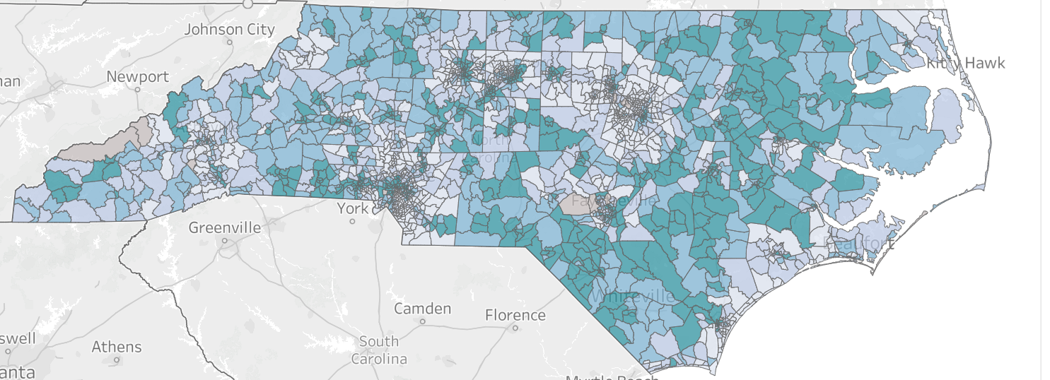
An estimate of vulnerability to effects of climate change
NC Environmental Public Health Tracking Program: https://epi.dph.ncdhhs.gov/oee/programs/EnvPubHealthTracking.html
Notes:
-Another way to look at increased exposure, sensitivity, and adaptive capacity is using tools like an Environmental Justice Index, or EJI. The Environmental Justice Index combines data from 36 environmental, social, and health factors to rank the potential cumulative impacts of these factors. Areas with darker colors have the highest scores, indicating the community has more environmental burdens.
-Because this index considers the existing environmental, social, and health conditions in an area, this score identifies the areas most at risk for health impacts of current and additional environmental burdens, including those caused by climate change.

Slide 10
NCDHHS Climate and Health Team
Nikhil Kothegal, MPH, Climate and Health Program Lead
Autumn Locklear, MSPH, Climate and Health Epidemiologist
Courtney Williams, MPH, Program Analyst
Dee Lipumano, Eastern NC Climate Adaptation Coordinator
New Website Coming Soon!
https://epi.dph.ncdhhs.gov/oee/programs/climate.html
Image (top): https://web.lib.unc.edu/nc-maps/browse_location.php;
Notes:
-Now that I’ve provided some background, I want to discuss our Climate and Health program and how we implement our work.
-I recently joined the state health department as the lead of the Climate and Health team in the Occupational and Environmental Epidemiology Branch.
-Our team consists of Autumn, our epidemiologist, our program analyst Courtney, and a new Climate Adaptation Coordinator Dee Lipumano who is based in the Sandhills region.
- Maybe share some background on myself (see below)
-To provide some background on myself, I am a doctoral student at UNC-CH in the Department of Environmental Sciences and Engineering, with a minor in Epidemiology. For my dissertation research, I have been involved in two research projects related to impacts of extreme weather events, particularly hurricanes and flooding on NC:
-First, to assess the impact of Hurricane Florence on water quality in areas of dense food animal agriculture in eastern NC.
-Second, I worked on a survey on the NC Coast and the Outer Banks assessing how communities planned for, were impacted by, and recovered from Hurricanes Dorian and Florence.

Slide 11
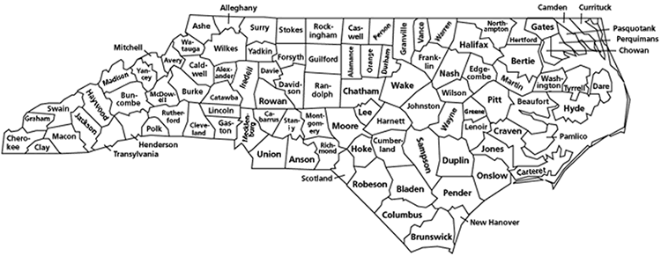
NCDHHS Climate and Health Team
Builds community resilience against climate change and its impact on public health
Funded through CDC’s Climate and Health Program:
Building Resilience Against Climate Effects
Climate adaptation efforts have expanded across NC!
Partnerships with NCDHHS, other state agencies, academia, non-governmental and community organizations
Image (top): https://web.lib.unc.edu/nc-maps/browse_location.php;
Notes:
-The Climate and Health team aims to build community resilience against climate change and its impacts on health.
-We’ve been funded through the CDC’s Climate and Health Program, Building Resilience Against Climate Effects, since 2010. Historically, our activities were more focused on Eastern North Carolina, but we have expanded our purview to a wider region of the state. The map on the right shows the counties in North Carolina where our current grantees have projects.
-We also collaborate with other divisions within NCDHHS, with other state agencies like the NC Office of Recovery and Resiliency and State Climate Office, with academic partners, including the UNC Institute for Environment’s Center for Public Engagement with Science and Duke University Nicholas Institute’s Heat Policy Innovation Hub, and with non-governmental and community organizations like Sustainable Sandhills and the Western NC Health Network.
-Through these partnerships, our program is working to improve our surveillance systems and conduct programmatic activities in different regions of the state to mitigate the effects of climate change on health and promote health equity and environmental justice.

Slide 12
Building Resilience Against Climate Effects (BRACE)
https://www.cdc.gov/climate-health/index.html
Designed to support public health action to protect & promote human health from impacts of climate change
Six elements to guide public health officials, community partners taking action to improve health/well-being
Image (top): https://web.lib.unc.edu/nc-maps/browse_location.php;
https://www.cdc.gov/climate-health/index.html
Notes:
-The CDC’s Climate and Health Program uses the Building Resilience Against Climate Effects, or BRACE, framework to support the activities of state, Tribal, local, and territorial health departments to protect human health from climate change.
-The newly updated framework includes three cross-cutting activities: collaboration, communication, and evaluation, and is comprised of six key elements that guide public health ofﬁcials and community partners through a collaborative process to improve health and wellbeing through climate action.
Source: https://www.umassmed.edu/prc/brace/

Slide 13
Adaptation Actions: Implementation & Evaluation
“Intervention implemented to build health resilience to the effects of climate change among a specified population using one or more activities.”
Population-facing
Advance health equity by addressing health disparities
Programs, interventions, resources
Image (top): https://web.lib.unc.edu/nc-maps/browse_location.php;
Notes:
-Our Climate and Health team uses this framework to implement our adaptation actions, which are interventions to build health resilience to climate change in a population. They are designed to improve health equity by addressing health disparities.
-These actions can consist of programs, interventions, and supply of resources to community and organizational partners.
-As we move through the rest of the presentation, we will review data on the impacts of extreme heat on NC populations and the actions we are taking to address the downstream health effects.

Slide 14
Extreme heat in North Carolina
Increases in:
Temperature throughout all seasons
Summer heat index values
Number of hot and very hot days
Number of warm and very warm nights
Frequency, duration, and intensity of extreme heat events
SOURCE: North Carolina Climate Science Report (2020); North Carolina Climate Risk Assessment and Resilience Plan (2020)
Notes:
-According to North Carolina’s Climate Science Report, which is an assessment of historical climate trends and potential future climate change effects in the state, it is projected North Carolina will experience numerous increases in heat-related measures that can be detrimental to population health.
-These include
-higher temperatures across all seasons
-Increased summer heat index values
-More hot and very hot days, and warm and very warm nights
-And an increased frequency, duration, and intensity of extreme heat events.

Slide 15
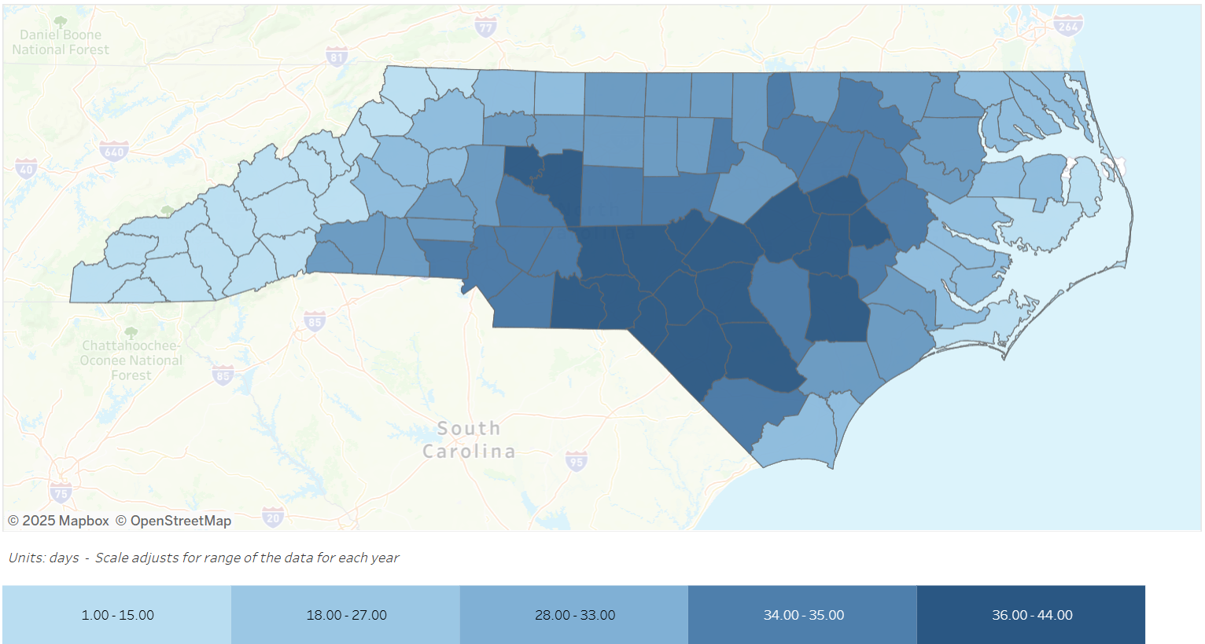
Predicted increases in number of extreme heat days* (high emissions scenario) in 2036-2065
*An extreme heat day is defined by the absolute threshold of 95 degrees F.
Source: Environmental Health Data Dashboard; Data: CDC National Environmental Public Health Tracking
Notes:
-To help illustrate these changes in extreme heat, I will provide an example from our branch’s Environmental Health Data Dashboard.
-This map shows the predicted increases in extreme heat days (those with a temperature above 95 degrees F), under a high emissions scenario (meaning limited curbing of greenhouse gas emissions).
-We see that all counties are projected to experience a higher number of extreme heat days per year; however, the Central, Sandhills, and Eastern regions of the state will be the most severely impacted, with an increase of roughly 40 additional extreme heat days.

Slide 16
Extreme heat’s impacts on our health
Additional health effects:
Other heat related illnesses (e.g., heat cramps, syncope)
Respiratory and cardiovascular issues
Kidney injury
Notes:
What does extreme heat mean for public health?
Extreme heat is associated with a range of negative health outcomes, such as heat cramps, heat exhaustion, and heat stroke.
Heat exhaustion is often the most common diagnosis code in ED visits for heat-related illness. Heat exhaustion is characterized by symptoms of dizziness, thirst, heavy sweating, nausea, and weakness, and can lead to heat stroke if left untreated.
Heat stroke is a medical emergency, and symptoms include confusion, dizziness, and loss of consciousness.
Additional health effects associated with extreme heat include worsening respiratory and cardiovascular conditions, and kidney injury.
-----
Definition of Heat syncope: fainting/dizziness from overheating

Slide 17
Adaptation Action 1: Heat Health Alert System (HHAS)
Notes:
-Now that we have provided a background on extreme heat as a climate hazard in NC, I want to talk about the adaptation actions our Program has implemented to protect health from this hazard.
-First, I will discuss the Heat Health Alert System our program implements in North Carolina. We refer to this as the acronym HHAS.

Slide 18
Heat Health Alert System
Heat alerts sent to subscribers when threshold is met
Sign up for alerts on Climate and Health website
Brief survey about users and usage purposes
Notes:
-Our Program uses the Heat Health Alert System to send out heat alerts via email, when the forecast is projected to reach unhealthy levels.
-Interested people can sign up to receive email alerts via our website.
-In our brief survey, we ask for which counties people want to receive alerts, the user’s affiliation, populations served, and the planned uses of the heat alerts. We also inquire about some characteristics of the user which may impact their motivation to receive the alerts, such as if they are over 65 years of age, live in a mobile home, work in agriculture, live in a rural area, or live in an urban area.
-We analyze the data from these questions during our yearly evaluations to better understand who and how our alerts are used, and then to make improvements.

Slide 19
2024 NCDHHS HHAS expansion and improvements
2022 process evaluation highlighted needs:
Standardize alert messages
More refined Heat thresholds
2023 HHAS issue:
Time intensive
Notes:
-The HHAS operates from May 1-September 30 each year, and sends out alerts when a threshold is exceeded.
-In the past year, we have worked to expand and improve our HHAS. We based changes on a process evaluation conducted in 2022 which highlighted some existing needs, including more standardization in our messaging and distribution, and improved heat thresholds to better protect the health of the NC population during extreme heat events.
-Some of this was addressed in 2023 through work with the NC State Climate Office to identify county and season-specific heat index thresholds using historic climate data. But this was time intensive and required our team epidemiologist checking forecast data for each county and issuing alerts to partners.

Slide 20
2024 NCDHHS HHAS expansion and improvements
Community Health Workers
Mobile Home Park Managers
Nursing Home Administrators
Farmworker Mobile Health Clinics
Farmworkers
Local HD Staff
Youth Sports Coaches
General Public
Other Community Leaders
NC DHHS Climate and Health Team
Anyone who signs up!
Automate forecast check
Health-based thresholds
Notes:
-In 2024, we were able to make huge improvements to our system.
-First, we worked with the NC State Climate Office to automate our forecasting using the National Weather Service application programming interface (or API) to pull in weather indicators of interest.
-Second, we worked with the State Climate Office and Duke University’s Heat Policy Innovation Hub to identify health-based heat index thresholds for the 2024 heat season, and incorporated these new thresholds into our alert system.
-Prior to the changes, we checked the forecasts manually and sent alerts to specific partners in specific counties, including Sustainable Sandhills, Manos Unidas, Hoke County Emergency Management, the Health Departments in Hoke, Robeson, and Scotland Counties, and Coharie tribal leaders.
-These changes drastically improved our efficiency, allowing us to expand the HHAS to all counties statewide, accommodating anyone wanting to sign up.
-Partners then share this information through a variety of communication channels, including social media, WhatsApp, radio announcements, and email. Their goal is to reach people who are themselves vulnerable to, or who work with people who are vulnerable to, heat related illness. These include community health workers, mobile home park managers, farmworker clinic staff, coaches, and others.

Slide 21
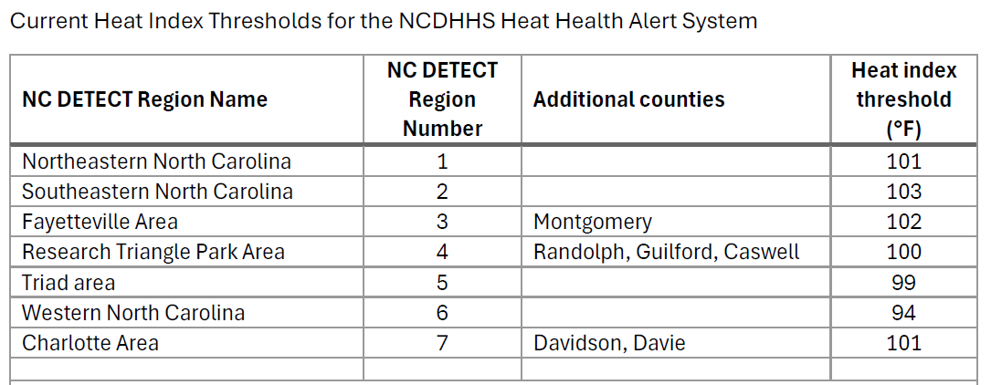
Notes:
-I wanted to briefly share a table showing the different regions we use and the heat index thresholds.
-Our team leveraged the expertise of Dr. Jordan Clark, a climatologist from the Duke Heat Policy Innovation Hub to reclassify some counties to different NC DETECT regions to better capture the health risks associated with extreme heat in those counties by assigning them a different heat index threshold.
-Dr. Clark is currently investigating seasonality for our HHAS, which would entail creating thresholds for different periods of the heat season. This would help account for acclimatization to heat that occurs as the summer progresses.

Slide 22
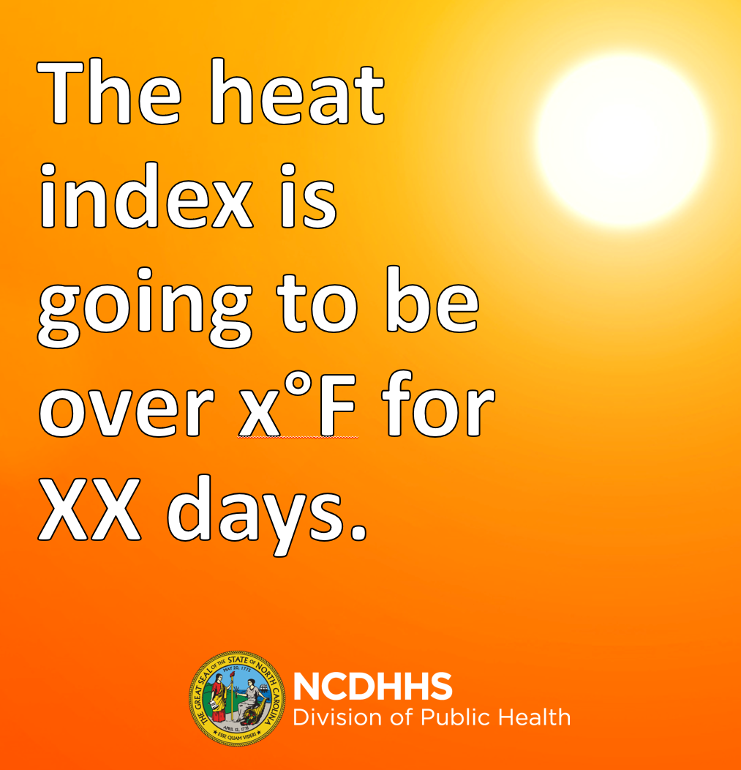
Heat Health Alert Example
Template Image for Social Media
Template Messages for Social Media
Ex. 1: The heat index is going to be over (insert heat index from alert email here)°F (insert day(s) here). Remember to protect yourself! Stay cool and drink plenty of water. For more information call ###-###-####, or visit https://epi.dph.ncdhhs.gov/oee/climate/heat.html.
Notes:
This is an example of the information our partners receive from us when there is a heat alert. We provide social media image templates that they can use, which is shown on the left. We also have template messaging that partners can use in their social media posts. Two examples of these messages are shown on the right. We have most of these messages available in English and Spanish.

Slide 23
Adaptation Action 2: Heat-related illness (HRI) surveillance system
Notes:
Our second adaptation action is the monitoring of heat-related illness during the heat season each year. The goal of this surveillance is to provide timely public health information about HRI statewide, and regionally.

Slide 24
Data Source for heat-related illnesses
NC Disease Event Tracking and Epidemiologic Collection Tool (NC DETECT)
A statewide public health syndromic surveillance system
Includes Emergency Department (ED) visits for all civilian hospitals in NC.
Some NC counties do not have hospitals.
Includes heat-related illness line list data with triage notes, chief complaints, diagnosis codes, and patient demographics (age, sex, race, county and zip code) for all HRI ED visits.

Slide 25
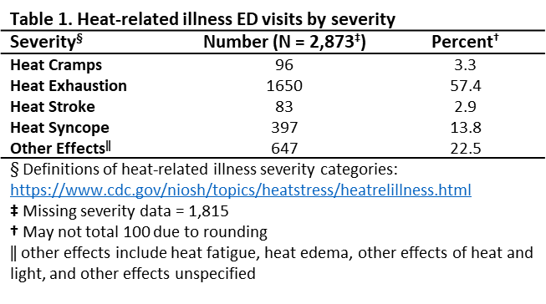
HRI Severity Table/Diagnostic Codes
Notes:
-There were 4,688 heat-related illness ED visits in the summer of 2024, making of 0.22% of total ED visits.
-Of the HRI ED visits, 2,873 had diagnosis codes available to assess severity.

Slide 26
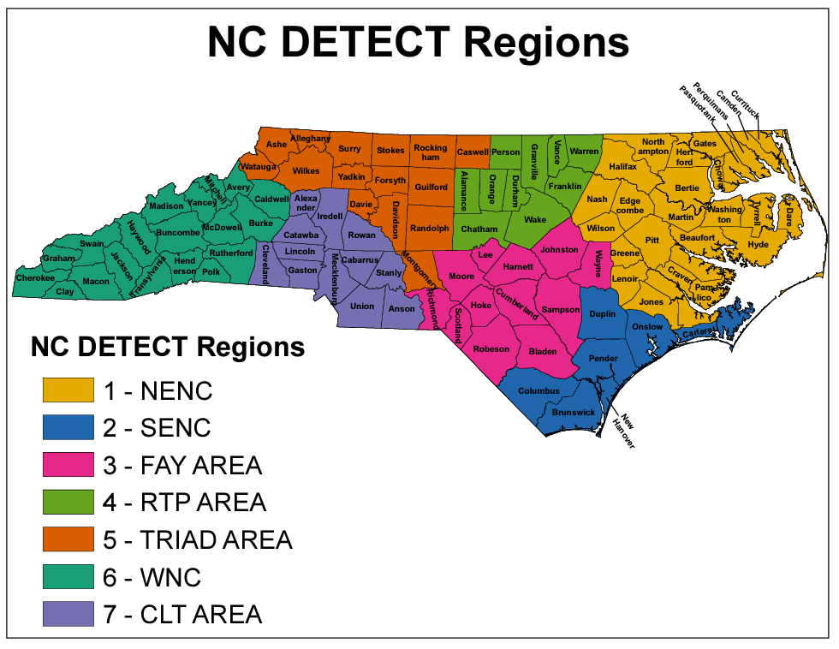
Updates to Heat-related Illness Surveillance System in 2024
Regional HRI surveillance
Using NCDETECT Regions
More granular spatial scale
Adding stratifications by risk groups
Age, Sex, Race
Notes:
-For the latest heat season, we have incorporated feedback from an internal evaluation to make important changes to our surveillance system. This has included stratifying the HRI rate by additional risk groups and by displaying rates at a more granular spatial scale. Our surveillance reports now include data not just at the statewide-level, but also for each of the seven NC DETECT Regions.
-Each week during the heat season, our epidemiologist analyses HRI data, produces a weekly surveillance report, and this is posted to our Climate and Health webpage and shared with partners.

Slide 27
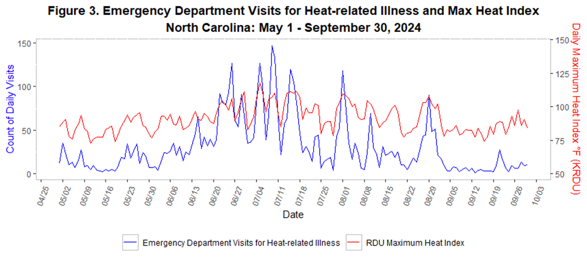
Emergency department (ED) visits for heat related illness (HRI): ​ May 1–September 30, 2024, NC
Source: NC DHHS Heat Report
Notes:
-If you receive our HRI weekly surveillance reports, you’ll recognize graphs like the one here. This figure summarizes emergency department visits for heat related illness during this year’s heat season, from May 1st to September 30, 2024.​ Note that the count of daily ED visits (in blue) is across all NC DETECT Regions, while the daily max temperature (in red) is a reading of the maximum heat index as measured at the RDU airport.
-You can see here that the count of daily ED visits in blue is generally higher when the heat index in red is also higher.

Slide 28
Average weekly rate of HRI ED visits per 100,000 population: May 1–September 30, 2024
Bertie
Avg. weekly HRI ED visit rate of 1.9 per 100,000, statewide
Avg. weekly HRI ED visit rates ranged from a max of 5.37 and 5.14 per 100,000 pop. in Bertie and Richmond counties, respectively, to 0 visits per week in Hyde county
Richmond
Source: NC DHHS Heat Report
Notes:
-Our team has worked to translate these raw counts to average weekly rates of HRI ED visits per 100,000 population. We are using rates as they account for population differences, allowing us to better compare counties with vastly different populations at risk.
-In this map, which covers the entire 2024 heat season, the darker red color signifies an avg. weekly rate above 2.5 HRI ED visits per 100,000 population. We saw our highest weekly rates in Bertie County, at 5.37 per 100,000 and Richmond County at 5.14 per 100,000, while Hyde County did not have any ED visits for HRI this past summer. Note that Mainland Hyde does not have any hospitals, and a population of only 4,600.
-Visits are sorted by patient county of residence instead of the hospital location.

Slide 29
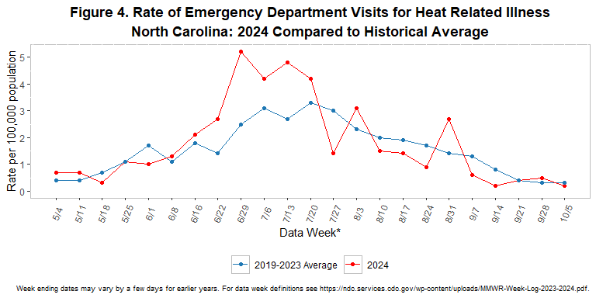
Average weekly rate of ED visits for HRI, May 1- Sept 30, 2024 compared to historical averages
Source: NC DHHS Heat Report
Notes:
-So how did this year’s heat season compare to previous years? Compared to an average of the 2019 to 2023 seasons, depicted in blue, we see that the 2024 heat season (in red) had a higher avg weekly rate in HRI-related ED visits in late June and early July. Additionally, there were some slight peaks in the avg weekly rate in August, but otherwise we have not seen substantial increases.

Slide 30
New projects and collaborations for the Climate and Health Program
Notes:
-Now that you’ve heard about our heat health alert system and our heat-related illness surveillance, I want to share some information about new and upcoming projects our Climate and Health Program has been undertaking to address climate hazards like extreme heat.

Slide 31
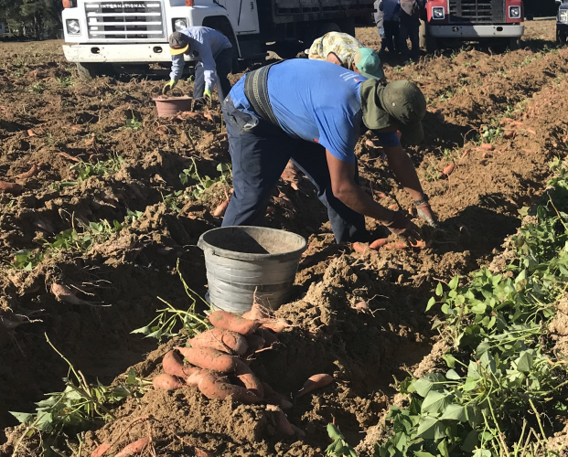
Heat training for clinicians
Partnership with NCDHHS Office of Rural Health’s Farmworker Health Program
Our team is developing educational training on extreme heat preparedness for clinicians
Focused on farmworkers and outdoor work
Providing education and promotional materials
Notes:
-Our program is continuing its partnership with the NCDHHS Office of Rural Health’s Farmworker Health Program and the Rural Health Group, Inc. to protect farmworkers from the impacts of extreme heat. We have developed educational materials for a heat health training for clinicians who provide services to farmworkers.
-The training provides a background on heat-related illnesses and information for clinicians to educate patients on heat risk factors, ways to acclimate to the heat, and preventative strategies.
-We have additionally included information on medications that can increase susceptibility to heat illness, to ensure clinicians are aware of these concerns.
-Finally, we cover the role of community health workers in promoting farmworker health and the diagnosis codes to appropriately report on incidence of HRI so this is recorded in the medical record.
-Once we have finalized the training materials with the Farmworker Health Program, we will work with them to set up trainings with several identified clinics serving this farmworker population.
-We are combining this training with additional resources, including printed educational materials and promotional materials, including water bottles, cooling shirt and towels, and electrolyte packets.
-Last year our program was able to provide high velocity fans for farmworkers to cool their kitchens, bedrooms, and living rooms, and we hope to do so again this year after receiving very positive feedback as to the relief these fans provided during the summer months.

Slide 32
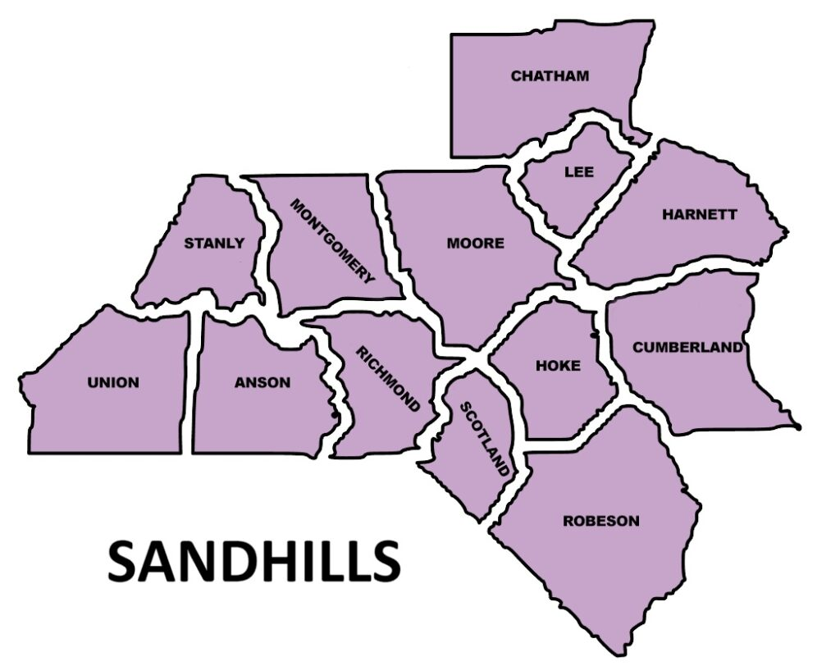
Hired New Eastern NC Climate Adaptation Coordinator
Based in Sandhills region
Supporting program activities in the field:
Expansion and implementation of the heat health alert system
Conducts outreach/education with local health departments, events
Supporting extreme heat training for clinicians
Developing new educational and promotional materials
Notes:
-In November 2024, we brought on a new eastern NC Climate Adaptation Coordinator, Dee Lipumano, as a temporary employee to support on-the-ground efforts of the Climate and Health Program in the Sandhills region of Southeastern NC. The Coordinator has been supporting the implementation of the heat health alert system for the 2025 season by setting up meetings with Local Health Departments and other local agencies.
-Additionally, the Coordinator has been supporting our Program to develop artwork for promotional materials and training materials to be used for our heat health training for clinicians, in partnership with farmworker organizations and clinics
-She will be promoting our program’s work by tabling at Fayetteville’s Earth Day Festival, which is being organized by our partners at Sustainable Sandhills.
-We are planning for the Coordinator to introduce more of our work, including a wildfire smoke and health lesson plan into schools and with community organizations in the region.
-If you are a representative from the Sandhills region and are interested in partnering with us to promote this work, please reach out to our team.

Slide 33
Climate Impact Compendium: Story Maps
Maps and data dashboards
Display current and projected impacts of climate change in NC
Three climate hazards:
Extreme heat, Flooding, Wildfire and air quality
Notes:
-The team has worked with our GIS Analyst from the Environmental Public Health Tracking Program in the Branch to create a Climate Impact Compendium, which includes story maps and an interactive tool to explore local climate hazards including extreme heat, flooding, and wildfire and air quality.
-Within each hazard’s section there are data dashboards, maps, and accompanying text covering climate-related health outcomes, the local burden of climate-sensitive health conditions, and socio-demographic characteristics that contribute to adaptive capacity.
-Our branch is finishing formatting on the Climate Impact Compendium, but we are working to have this publicly available on our branch webpage later in the summer.

Slide 34
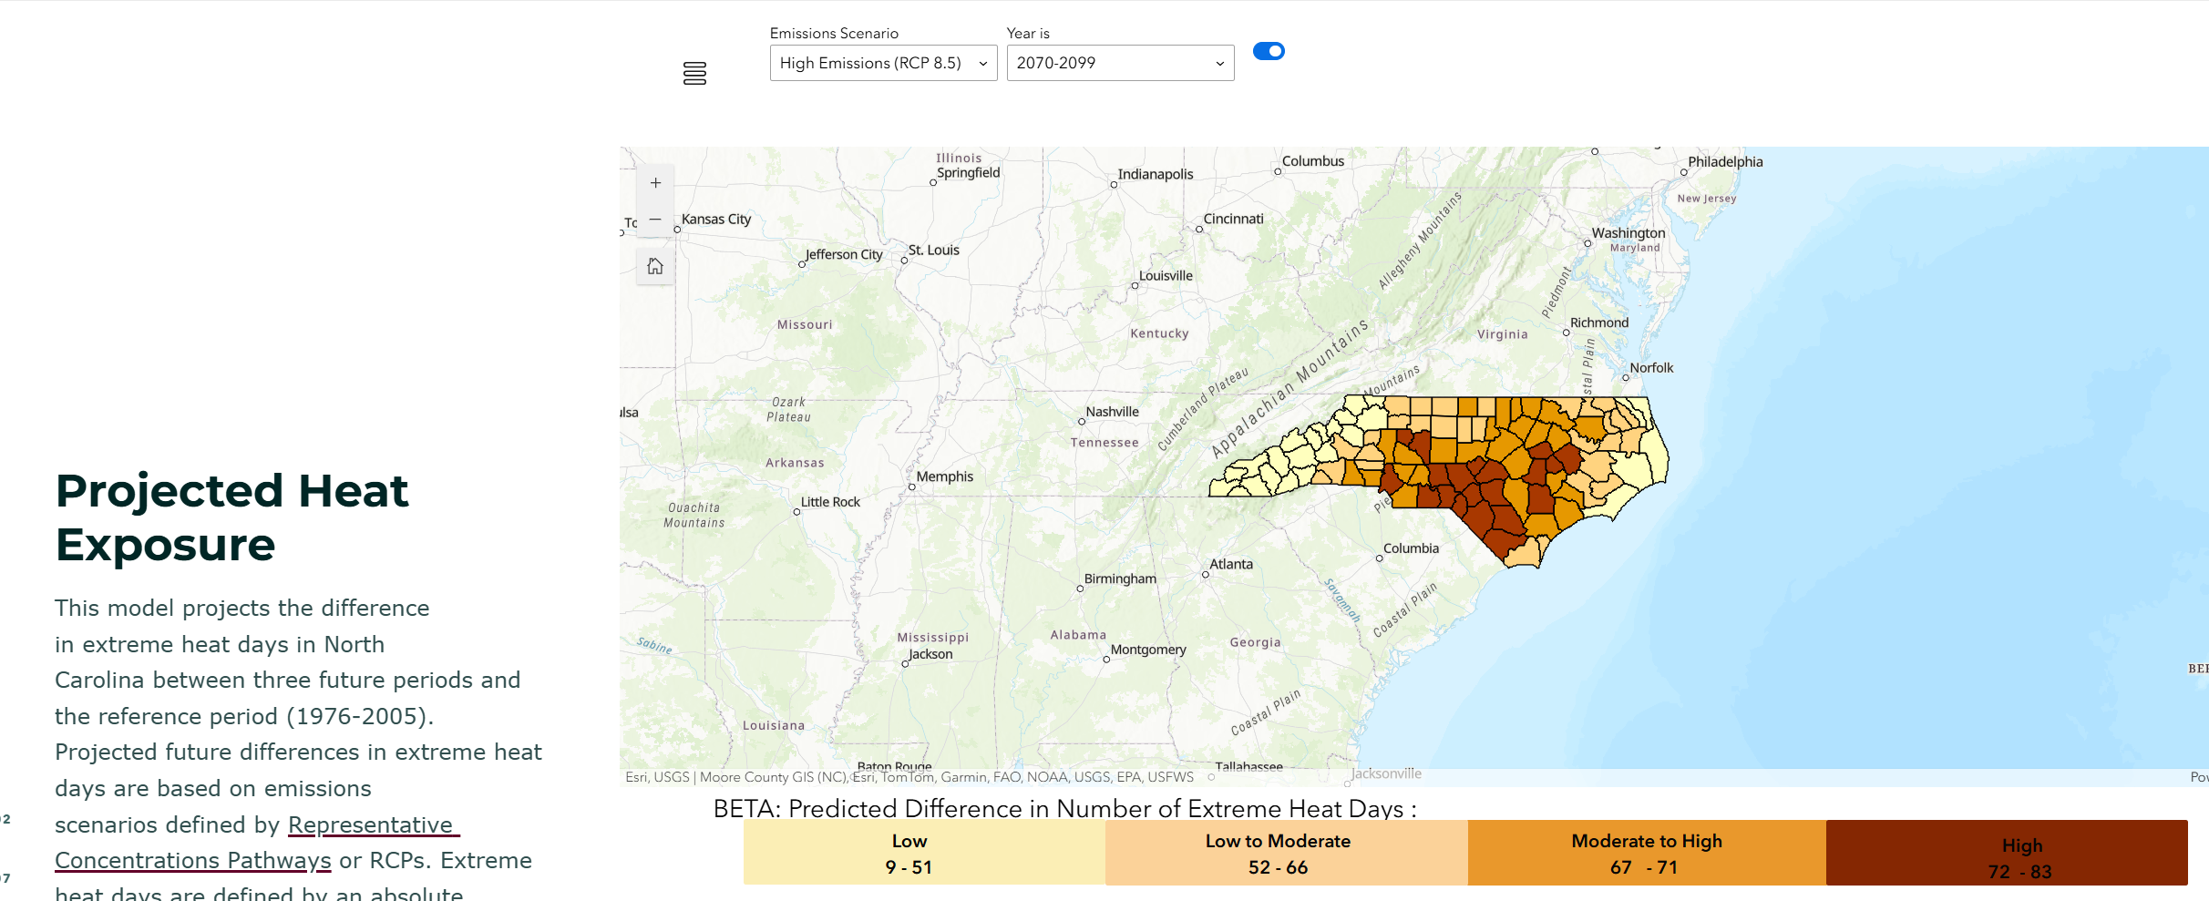
Example: Projected Heat Exposure
Notes:
-Here is an example screenshot of a map from the Climate Impact Compendium dashboard on “projected heat exposure.”
-For this measure, users can select different emission scenarios and projected time periods. Data is displayed at the county level, and users will be able to click on a specific county to receive more detailed information.
-On the left we include the text for our StoryMap. Users can scroll down through the StoryMap and read about the hazards and data while using the dashboards.
-We hope this will be a useful tool for anyone wanting to quickly access data on climate hazards and health impacts in North Carolina.

Slide 35
Acknowledgements
Climate and Health Program team: Autumn Locklear, Courtney Williams, Jahvona Pretty (now with FEMA)
NCDHHS Occupational and Environmental Epidemiology Branch: Virginia Guidry, Alverina Clay, Sarah Hatcher (former Climate and Health lead)
Community/local partners: Sustainable Sandhills; Local Health Departments; UNC Center for
State agency partners: NC Office of Recovery and Resiliency, NC Farmworker Health Program
Scientific partners: NC State Climate Office, National Weather Service (Raleigh), Duke Heat Policy Innovation Hub
This work is supported by the Centers for Disease Control and Prevention Climate-Ready States and Cities Initiative, Building Resilience Against Climate Effects (BRACE) Cooperative Agreement No. 5 NUE1EH001449-03-00
Notes:
I want to say thank you to our team members and the former program lead, our branch, all our community partners, state agency partners, scientific partners, and acknowledge our funding support from the CDC’s Building Resilience Against Climate Effects cooperative agreement.

Slide 36
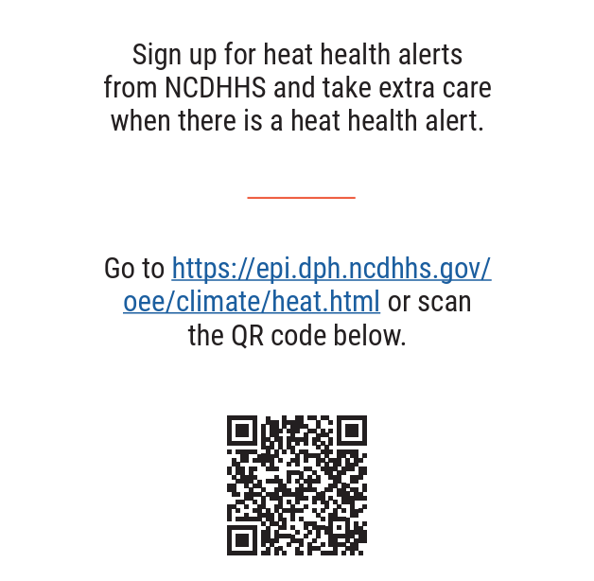
Thank you!
Want to receive heat alerts?
My contact info:
Nikhil Kothegal
Nikhil.Kothegal@dhhs.nc.gov
919-368-1288
Notes:
Thank you, and please feel free to reach out to our Climate and Health Program.

Slide 37
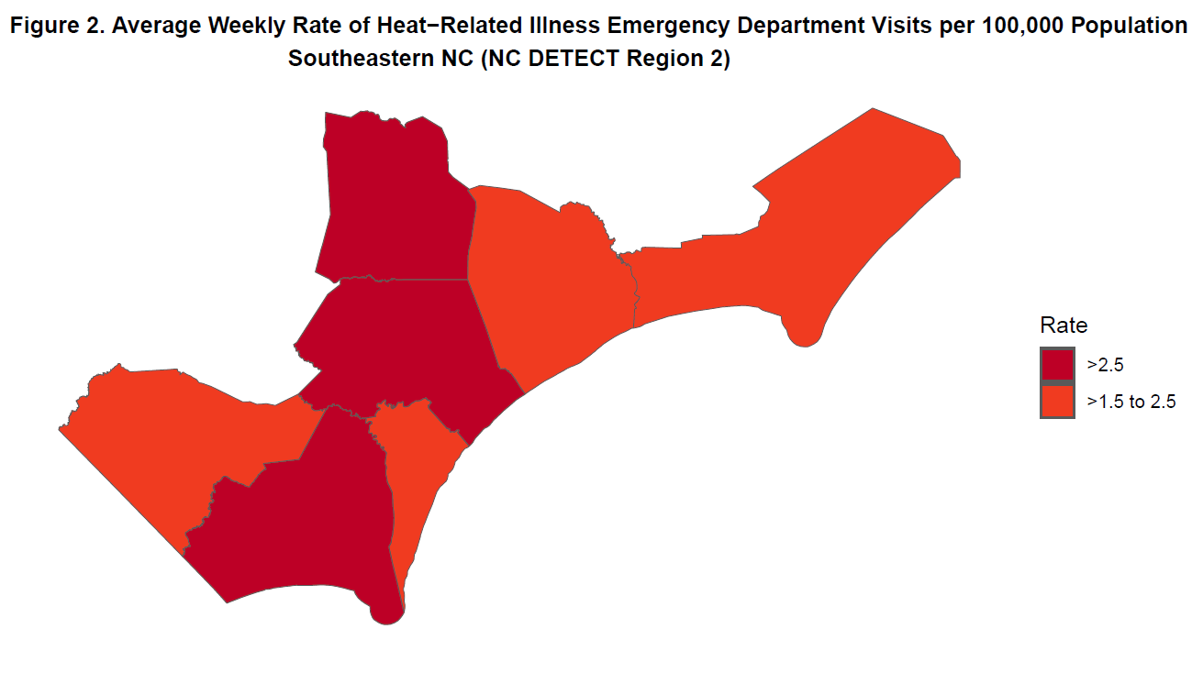
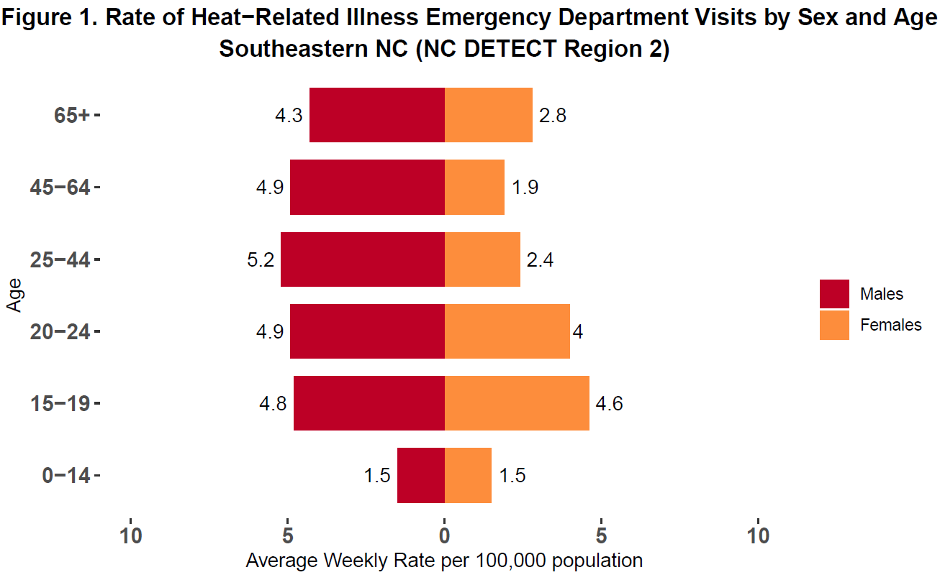
North Carolina Annual Heat-related Illness Surveillance Report: Southeastern NC (NC DETECT Region 2)
May 1-September 30, 2024
Southeastern NC (NC DETECT Region 2) Key Messages
There were 391 HRI ED visits (0.3% of total ED visits) in the summer of 2024, with an average weekly rate of HRI ED visits of 2.1 per 100,000 population.
The rate was highest among males aged 25-44 years at 5.2 HRI ED visits per 100,000 population (Figure 1).
The rate of HRI ED visits was highest in Pender County at 3.6 per 100,000 population (Figure 2).
The most frequent heat related diagnosis code was heat exhaustion (n =127) (Table 1).
The maximum heat index ranged from 69.5 to 111.4°F at Wilmington International Airport (Figure 3).
There were 76 days when the minimum temperature did not drop below 70°F.
Table 1. Heat-related illness ED visits by severity
Severity§ | Number (N = 225‡) | Percent†
Heat Cramps | 8 | 3.6
Heat Exhaustion | 127 | 56.4
Heat Stroke | 6 | 2.7
Heat Syncope | 26 | 11.6
Other Effects‖ | 58 | 25.8
§ Definitions of heat-related illness severity categories: https://www.cdc.gov/niosh/topics/heatstress/heatrelillness.html ‡ Missing severity data = 166 † May not total 100 due to rounding ‖ other effects include heat fatigue, heat edema, other effects of heat and light, and other effects unspecified

