Slide 1
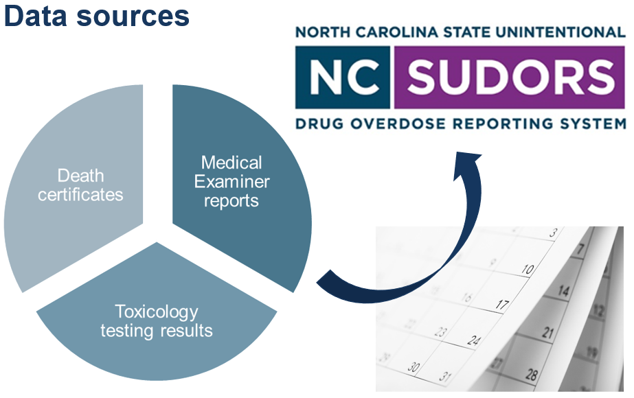
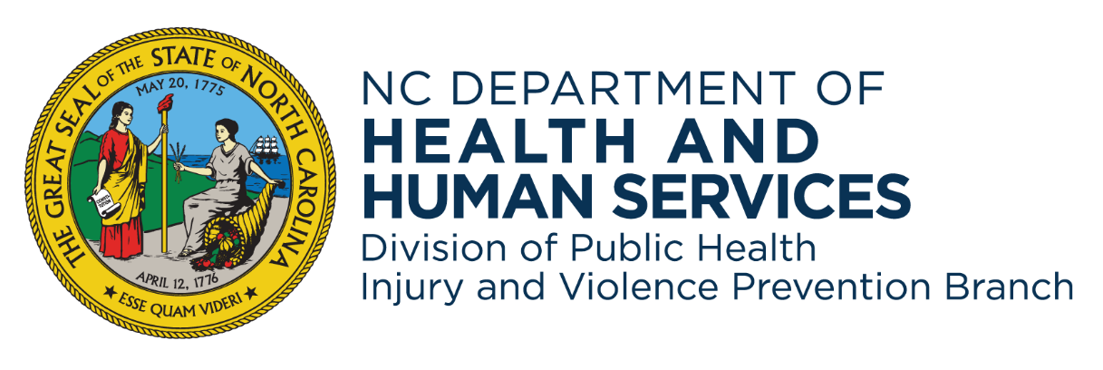
Leveraging North Carolina’s Fatal Overdose Data for Public Health Intervention Riley Eisler, MPH, Taylor Davis, MPH, April Allgood, MS, F-ABMDI, & Hailey Hartman, MPH NCDHHS, Division of Public Health, Chronic Disease and Injury Section, Injury and Violence Prevention Branch
Background
NC-SUDORS Process
Results
The North Carolina State Unintentional Drug Overdose Reporting System (NC-SUDORS) collects comprehensive data on overdose deaths of unintentional and undetermined intent in NC.
NC-SUDORS was funded by CDC in 2017 and began collecting data on fatal opioid-related overdoses in 2018. In 2019, SUDORS programs across the nation, including NC, expanded to collect data on all drug overdose deaths as part of CDC’s Overdose Data to Action (OD2A) program.
By integrating data from death certificates, medical examiner reports, autopsies, and toxicology results, NC-SUDORS informs targeted prevention efforts.
The wide variety of data collected provides valuable insights into the circumstances and substances contributing to NC’s overdose deaths.
NC-SUDORS abstracts approximately 4,000 eligible decedent deaths annually.
Analysis of NC-SUDORS data has identified variations in decedent demographics, overdose location and response, intervention opportunities, changes in routes of administration, and more!
NC-SUDORS data is shared with the CDC for inclusion in the national dataset, featured on the CDC dashboard, and incorporated into the Morbidity and Mortality Weekly Report (MMWR) published by the CDC.
These datasets are available upon request for further analysis by both state epidemiologists and external researchers.
These findings have been instrumental in informing NC’s state-level public health responses while contributing to national overdose prevention efforts.
Methods
Death Certificates
Conclusion
Demographics
Race/ethnicity, age, gender
Decedent Residence Information
City, county, type of residence
Cause and Manner of Death Information
Location, time, contributing conditions
Route of Administration
Data abstraction involves coding demographics, overdose circumstances, and toxicology results.
Our team is comprised of four abstractors who review an average of 30 cases per week, each taking up to two hours depending on its complexity.
Rigorous CDC protocols ensure consistent, accurate data collection of over 320 possible variables with detailed case narratives.
Due to the work's challenging and sensitive nature, abstractors are encouraged to practice self-care and step away when needed to maintain their well-being.
NC-SUDORS is a critical tool for understanding the overdose epidemic and providing high quality data to guide public health interventions.
Continued investment will enhance data timeliness and strengthen overdose prevention efforts in NC, ultimately saving lives.
Medical Examiner Reports
Scene evidence of Substance Use
Presence of substance(s) or paraphernalia
Timing and Context of Overdose
Narcan administered, bystander(s) present
Medical and Social History/Circumstances
History of overdose or mental illness
Acknowledgements: We are grateful to NC’s Office of the Chief Medical Examiner (OCME) and the State Center for Health Statistics (SCHS) for their invaluable role in providing the data that makes the SUDORS abstraction process possible.
Postmortem Toxicology
NC-SUDORS data saves lives by telling the stories of those lost to overdose – Together, we can turn the tide on overdose deaths in North Carolina.
All Substances Tested and Detected
Name and concentration of substances
Types of Substances Contributing to Death
Opioids, stimulants, benzodiazepines, etc.
Prescription Status of Substances
Prescribed to decedent or someone else
This work was supported by the Centers for Disease Control and Prevention (CDC) of the U.S. Department of Health and Human Services (HHS) as part of the Overdose Data to Action in States (CDC-RFA-CE-23-0002) cooperative agreement award totaling $4,950,273 with 100% funded by CDC/HHS. The contents are those of the author(s) and do not necessarily represent the official views of, nor an endorsement by, CDC/HHS or the U.S. Government.
Contact Information
Riley Eisler
Riley.Eisler @dhhs.nc.gov
SubstanceUseData@dhhs.nc.gov

