Slide 1
Hurricane Helene: Emergency Department Visits Associated with Clean-Up Injuries in North Carolina, 2024
Maria Del Mar Blanes Garcia, MPH; Meredith D. Luner, MPH; Hyunwoo K. Do, MPH; Katherine M. McDaniel, MPH; Scott Proescholdbell, MPH
North Carolina Public Health Leader’s Conference
CSTE Applied Epidemiology Fellow
March 13, 2025
Raleigh, NC

Slide 2
Evaluating the Impact of Hurricane Helene: Emergency Department Visits Associated with Clean-Up Injuries in North Carolina, 2024
Maria Del Mar Blanes Garcia, MPH; Meredith D. Luner, MPH; Hyunwoo K. Do, MPH; Katherine M. McDaniel, Scott Poescholdbell,MPH
NCDHHS, Division of Public Health, Chronic Disease and Injury Section, Injury and Violence Prevention Branch
Injuries Clean-up ED Visits: 2023 vs 2024, by Counts
NC Residents, 2023-2024
Injuries Clean-up ED Visits: by age
NC Residents, ages 0+, 2024
Background
Hurricane Helene, a Category 4 storm, made landfall in the Big Bend area of the Florida Gulf Coast late on September 26, 2024.
Helene's impacts were far-reaching, with severe and unprecedented flooding across the southern Appalachians resulting in hundreds of fatalities and billions in property damage (National Weather Service, 2024).
In North Carolina (NC) alone, the hurricane caused catastrophic damage and at least 102 reported fatalities. The full impact of Hurricane Helene on NC goes beyond immediate mortality and includes increased injuries after the initial landing related to clean-up efforts, as reflected in Emergency Department (ED) visits.
This study analyzes ED visit patterns and demographic trends associated with hurricane clean-up-related injuries, providing critical insights for disaster preparedness and public health interventions.
2023: 35 visits
From September 26 to November 10, 2024, a total of 155 ED visits meeting the hurricane clean-up-related injury custom definition were recorded in NC.
During the same period in 2023, a total of 35 ED visits, a substantial increase of 343%.
By age group, most ED visits consisted of those ages 18–34 years (23.9%), followed by ages 55–64 years (21.3%).
Injuries Clean-up ED Visits: by Insurance
NC Residents, ages 0+, 2024
Injuries Clean-up ED Visits: by sex, race and ethnicity
NC Residents, 2024
Methods
Data were extracted from the NC Disease Event Tracking and Epidemiologic Collection Tool (NC DETECT) from September 26 to November 10, 2024, using 2023 as a referent year.
Hurricane-related ED visits for injuries due to clean-up efforts were identified using a custom search of keyword terms in chief complaint and triage note fields in addition to relevant ICD-10-CM diagnosis codes. Comparative analysis was conducted to evaluate ED visit counts and demographics, including age, sex, ethnicity, race, and insurance coverage.
Among insurance types, the most common forms reported were private insurance (24.5%) and uninsured or self-pay (24.5%).
Conclusion
Results
The substantial increase in clean-up injury-related ED visits from 2023 to 2024 attributable to Hurricane Helene highlights the critical impact of Hurricane Helene on public health.
These findings provide a foundation for enhancing disaster response strategies and identifying potential barriers to equitable healthcare access.
Custom Event Definition
By sex, males accounted for most hurricane-related clean-up injury ED visits (84.5%).
By ethnicity, non-Hispanic patients comprised most ED visits (88.5%) compared to Hispanic patients (9.0%).
By race, whites comprised 89.0% of ED visits, with minimal representation from other racial groups.
Acknowledgements: Thank you to NC DETECT, for
providing invaluable surveillance data that supports
our public health efforts across North Carolina.
This project was supported by additional funds from the Injury and Violence Prevention Branch.
Contact Information
Maria Del Mar Blanes Garcia Maria.Blanes@dhhs.nc.gov

Slide 3
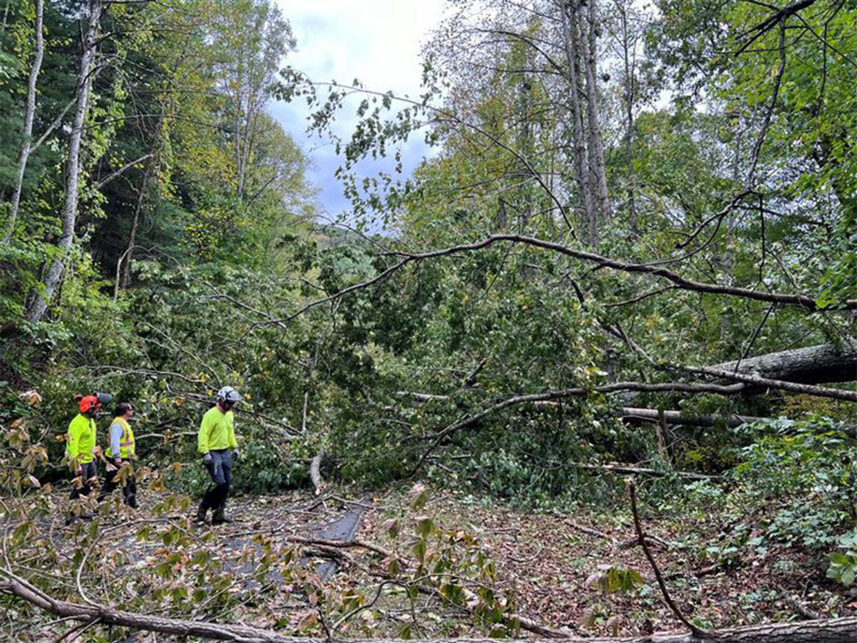
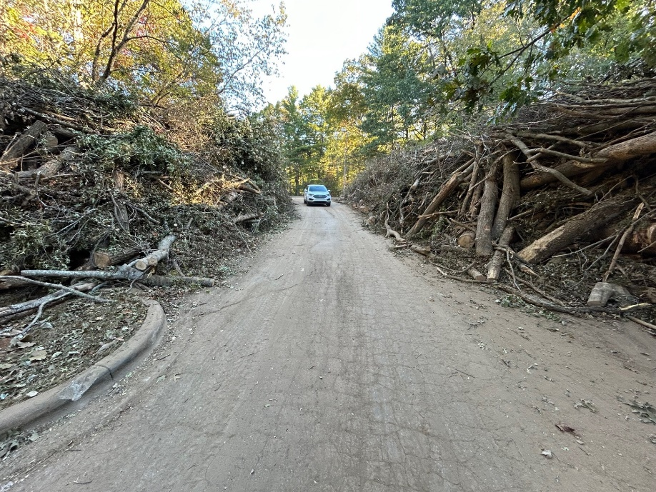
Background
Hurricane Helene, a Category 4 storm, made landfall in the Big Bend area of the Florida Gulf Coast late on September 26, 2024.
In North Carolina (NC) alone, the hurricane caused catastrophic damage and at least 102 reported fatalities. The full impact of Hurricane Helene on NC goes beyond immediate mortality and includes increased injuries after the initial landing related to clean-up efforts, as reflected in Emergency Department (ED) visits.
SOURCE: National Park Service. https://www.nps.gov/media/photo/gallery.htm?pg=7881101&id=15C1BFE1-E552-49FB-A38A-E71821BC762C

Slide 4
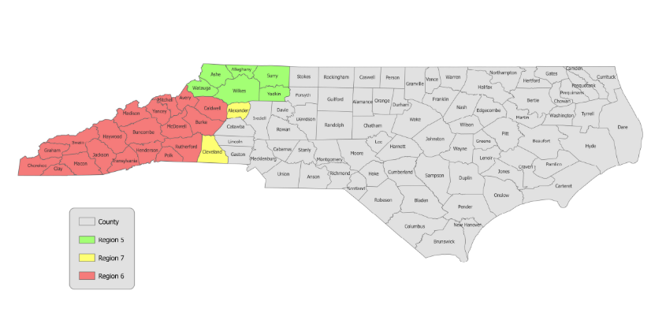
Methods
This study analyzes ED visit patterns and demographic trends associated with hurricane clean-up-related injuries, providing critical insights for disaster preparedness and public health interventions.
Data were extracted from the NC Disease Event Tracking and Epidemiologic Collection Tool (NC DETECT) from September 26 to November 10, 2024, using 2023 as a referent year.
Hurricane-related ED visits for injuries due to clean-up efforts were identified using a custom search of keyword terms in chief complaint and triage note fields in addition to relevant ICD-10-CM diagnosis codes. Comparative analysis was conducted to evaluate ED visit counts and demographics, including age, sex, ethnicity, race, and insurance coverage.
North Carolina Disease Event Tracking and Epidemiologic Collection Tool, 2024 *note: Limited to NC Residents. Case Definition: Hurricane Helene.

Slide 5
Injuries Clean-up ED Visits: by counts, sex, race and ethnicity NC Residents, 2024
ED Visits Counts
North Carolina Disease Event Tracking and Epidemiologic Collection Tool, 2024 *note: Limited to NC Residents. Case Definition: Hurricane Helene.

Slide 6
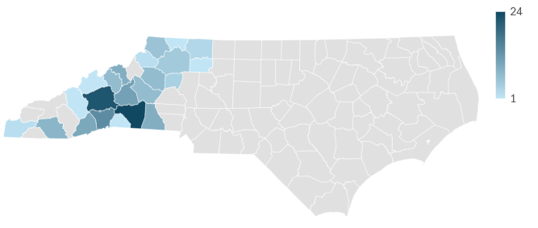
Injuries Clean-up ED Visits: by age NC Residents, ages 0+, 2024
Injuries Clean-up ED Visits: by County
NC Residents, ages 0+, 2024
Count of Visits
Injuries Clean-up ED Visits: by Insurance
NC Residents, ages 0+, 2024
Top two counties with the highest visit counts are:
Buncombe County
Henderson County
North Carolina Disease Event Tracking and Epidemiologic Collection Tool, 2024 *note: Limited to NC Residents. Case Definition: Hurricane Helene.

Slide 7
Conclusion
The substantial increase in clean-up injury-related ED visits from 2023 to 2024 attributable to Hurricane Helene highlights the critical impact of Hurricane Helene on public health.
These findings provide a foundation for enhancing disaster response strategies and identifying potential barriers to equitable healthcare access.
Maria Del Mar Blanes(she/her/hers)
Maria.Blanes@dhhs.nc.gov
CSTE Applied Epidemiology Fellow
Injury and Violence Prevention Branch, Division of Public Health
NC Department of Health and Human Services
This project was supported by additional funds from the Injury and Violence Prevention Branch.
Acknowledgements: Thank you to NC DETECT, for providing invaluable surveillance data that supports
our public health efforts across North Carolina.

