Slide 1
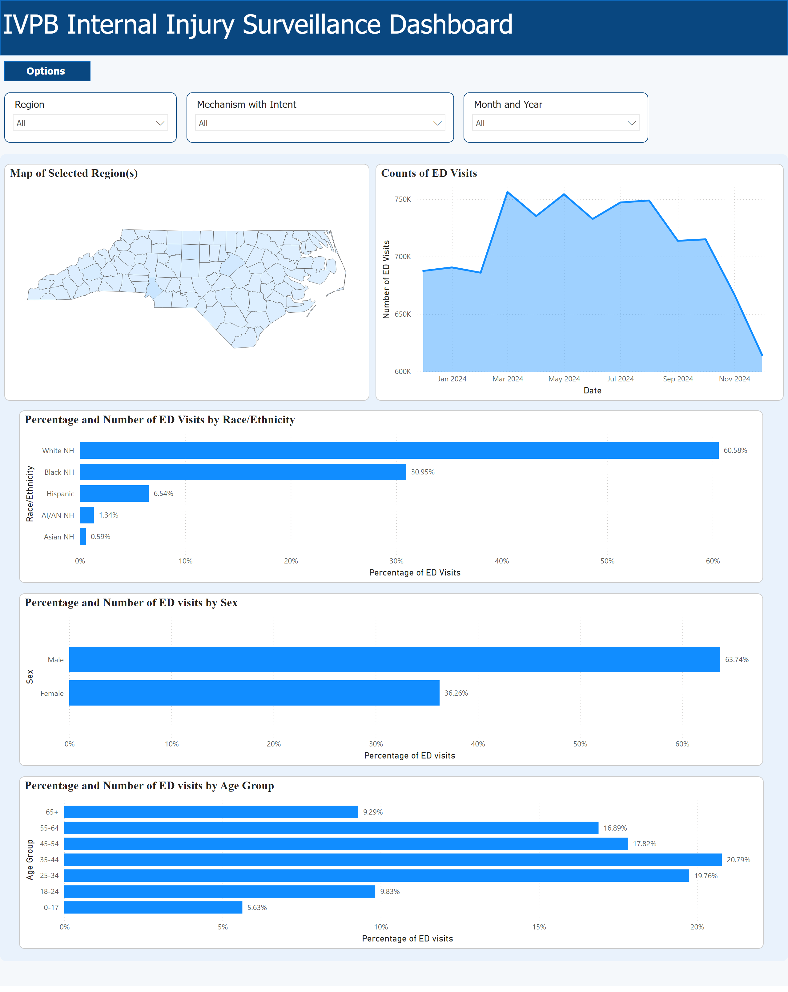
Hurricane Helene: Modernizing Injury Surveillance Technology
to Prepare for Public Health Emergencies
Anna Giudici, MPH¹, Bruce Nawrocki, MS, MBA¹, Scott Proescholdbell, MPH¹, Allison McElroy, MPH²
¹NCDHHS, Division of Public Health, Chronic Disease and Injury Section, Injury and Violence Prevention Branch
² NCDHHS, Division of Public Health, Epidemiology Section, Occupational and Environmental Epidemiology
Background
Figure 1. Home Page of the Injury Surveillance Dashboard
Results
Hurricane Helene’s unprecedented destruction hit Western North Carolina on September 26, 2024.
Our epidemiologists quickly set up a system to monitor and report disaster-related injuries using emergency department (ED) data from the North Carolina Disease Event Tracking and Epidemiologic Collection Tool (NC DETECT), NC’s syndromic surveillance system.
Daily, we had to manually pull, analyze, and create data visualizations, resulting in an additional burden.
The scalable dashboard features ED data through maps, graphs of injury counts, and demographics.
Users can customize parameters for geographical area, injury type, and date range.
Monitoring daily data before, during, and after an event allows us to establish a baseline and quickly detect increases in injury counts to inform response efforts.
Our system saves time by reducing manual data processing, analysis, and visualization.
Methods
Conclusions
As an alternative, we developed a streamlined surveillance system by modernizing our data pipeline.
We adapted our existing monthly import process to handle daily imports by coordinating with NC DETECT to send daily ED data.
Upon import, our informatics staff transformed the data for analysis.
We used Microsoft Power BI to build an internal dashboard with the capabilities to automate visualizations of daily injury tracking.
Hurricane Helene underscored the importance of modernizing our surveillance systems to prepare for future emergencies affecting NC communities.
Our enhanced processes allow for a more timely and effective response, as they can be easily adapted to fit our injury and violence surveillance needs.
This dashboard will also be useful as an ongoing, cost-effective, and accessible tool for everyday surveillance.
Data Sources: ED visit data from NC DETECT are provisional and should not be considered final. NC DETECT is a statewide public health syndromic surveillance system, funded by the NC Division of Public Health Federal Public Health Emergency Preparedness Grant and managed through collaboration between NC DPH and the UNC-CH Department of Emergency Medicine’s Carolina Center for Health Informatics. The NC DETECT Data Oversight Committee is not responsible for the scientific validity or accuracy of methodology, results, statistical analysis, or conclusions presented.
This presentation was supported in part by an appointment to the Applied Public Health Informatics Fellowship Program administered by the Council of State and Territorial Epidemiologists (CSTE) and funded by the Centers for Disease Control and Prevention (CDC) Cooperative Agreement Number 1NU38OT000297-03-00.
Contact Information
Anna Giudici, MPH anna.giudici@dhhs.nc.gov

Slide 2
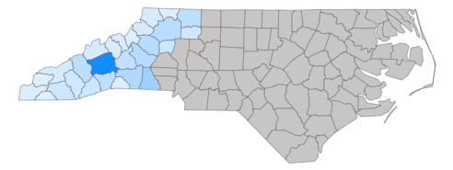
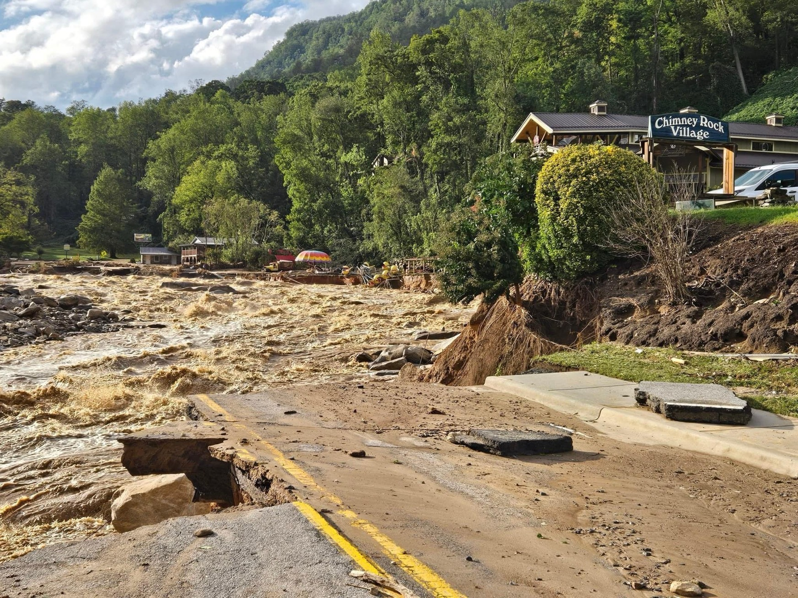
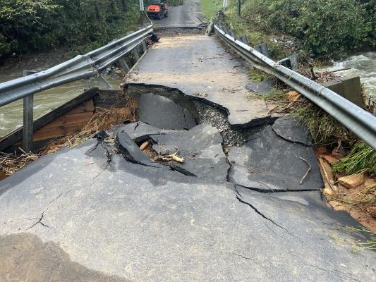
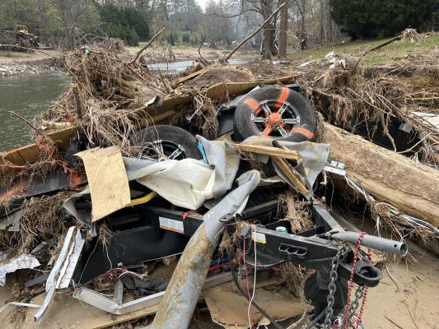
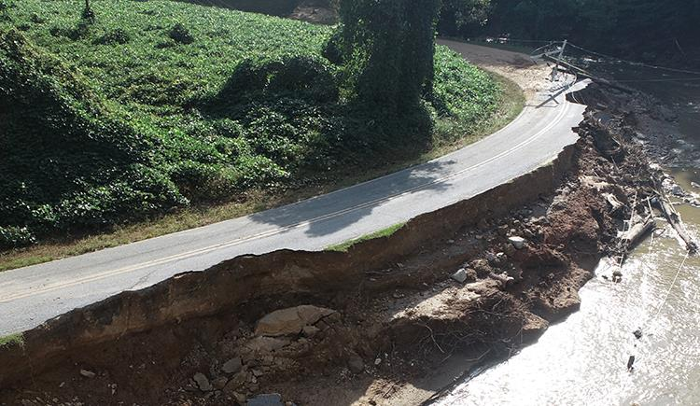
Background
Destruction
Hurricane Helene, downgraded to Tropical Storm Helene by the time it reached North Carolina, was the most destructive in state history.
Fatalities & Injuries
Heavy rainfall, landslides, flooding, damage, debris, and clean-up efforts caused 106 fatalities associated with Hurricane Helene, making it the deadliest in state history.²
Injury & Violence Prevention Branch
Epidemiologists were monitoring multiple conditions by manually pulling, analyzing, and creating visualizations of data from the NC DETECT website each day.
27 counties were severely impacted and are still recovering from $59.6 billion in damages.¹
An increase in storm-related injuries were observed by monitoring ED visit data from NC DETECT.
These reports were critical for informing state leadership to aid in their response efforts.
3
References: 1. Walker K. State Budget Director; 2025:1-67. https://www.osbm.nc.gov/ncga-report-helene-funds-q2-2024/download?attachment. 2. NCDHHS. Hurricane Helene Storm related fatalities. NCDHHS. 2025. https://www.ncdhhs.gov/assistance/hurricane-helene-recovery-resources/hurricane-helene-storm-related-fatalities. 3. NC DPS. Disaster Recovery Centers. NC DPS. February 3, 2025. https://www.ncdps.gov/our-organization/emergency-management/hurricane-helene.

Slide 3
Methods
Existing MONTHLY ED Data Import
New DAILY ED Data Import
Dashboard Creation
We currently have procedures in place to receive and process monthly ED data from NC DETECT for injury surveillance with a streamlined coding process.
We added demographic data to our monthly files to feed our new dashboard idea.
We need daily ED data to feed our dashboard in order to keep up to date with injury surveillance monitoring during a disaster.
We worked with our partners at NC DETECT to temporarily send us ED data on a daily basis.
We adapted our existing code structure to handle a new rolling 90-day file.
This allows us to compare data from before, during, and after an event to establish a baseline for quick detection of increases in injuries.
We strategized an outline for our dashboard and began exploring Microsoft Power BI, a software already included in our government license.
The dashboard utilizes both the monthly and daily files to create visualizations.
The daily file feeds the visualizations for injury counts, while the monthly file feeds demographic visualizations due to the potential for small case counts on a daily basis.

Slide 4
Results

