Slide 1
Utilizing Quality Improvement Methods to Address Immunization Health Equity
Rachael Baartmans, MPH
March 13th, 2025

Slide 2
Immunization Quality Improvement for Providers
Vaccines for Children provider-level quality improvement program
Identifies opportunities to increase vaccine uptake
Providers select at least 2 strategies to implement over 12 month
4 core CDC-defined strategies:
Facilitate return for vaccination
Leverage IIS functionality
Give Strong Vaccine Recommendation
Strengthen Vaccine Communication

Slide 3
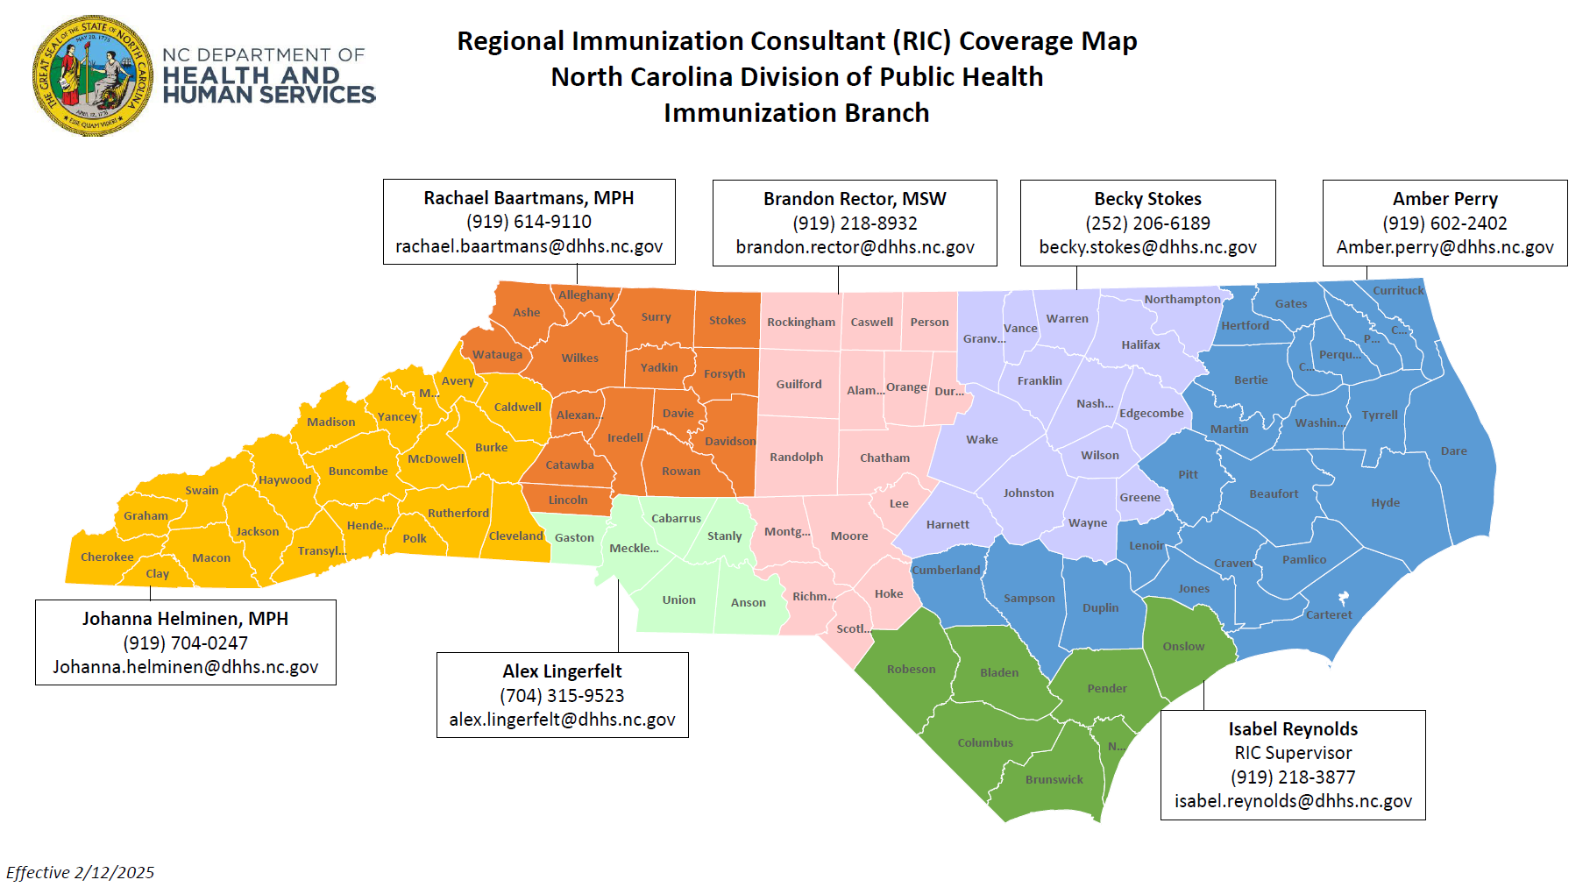
IQIP in North Carolina

Slide 4
Broad Quality Improvement Actions
Facilitate Return for Vaccination
Contact for missed appointment
Schedule next appointment at check out
Leverage NCIR Functionality
Measure coverage levels
Inactivate patients
Establish reminder process
Give Strong Vaccine Recommendation
Recommend same way same day
Recommend at age 9
Strengthen Vaccination Communications
Disseminate practice vaccination policy
Include vaccine materials in welcome packets

Slide 5
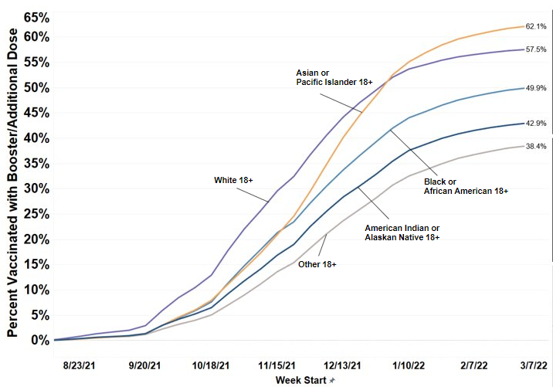
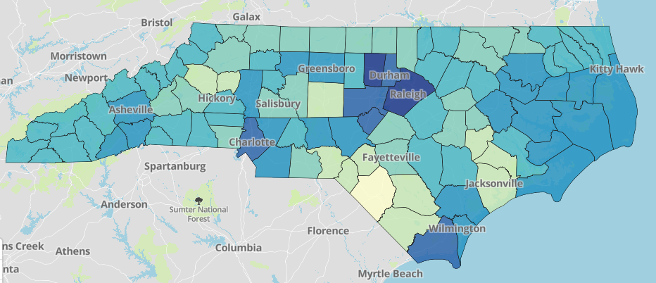
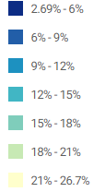
NC COVID-19 Vaccination Disparities
NC COVID Vaccination Coverage by Race
Estimated COVID-19 Vaccine Hesitancy
SOURCE: CDC Estimates of Vaccine Hesitancy for COVID-19 Vaccine; https://data.cdc.gov/stories/s/Vaccine-Hesitancy-for-COVID-19/cnd2-a6zw
NC COVID Vaccination Trends Data (internal use only; not publicly available)

Slide 6
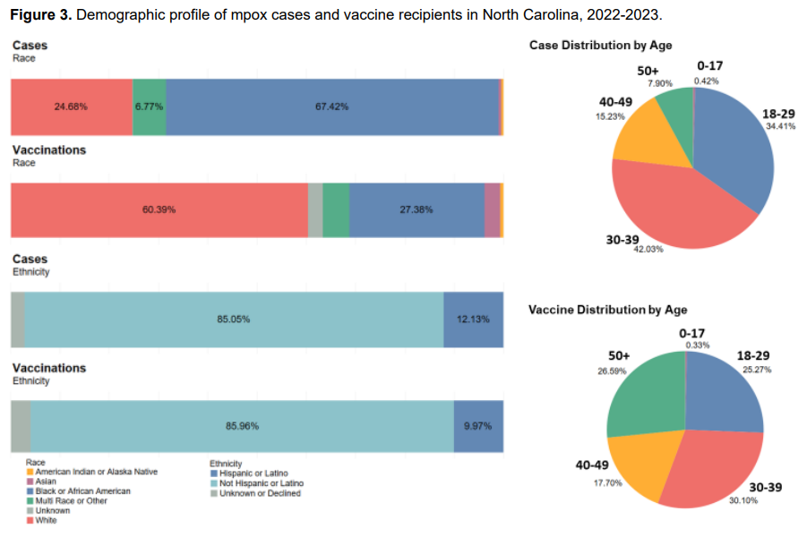
Disparities in mpox vaccination coverage
SOURCE: NCDHHS Mpox Equity Update Report: https://www.ncdhhs.gov/mpox-equity-report-update/download?attachment

Slide 7
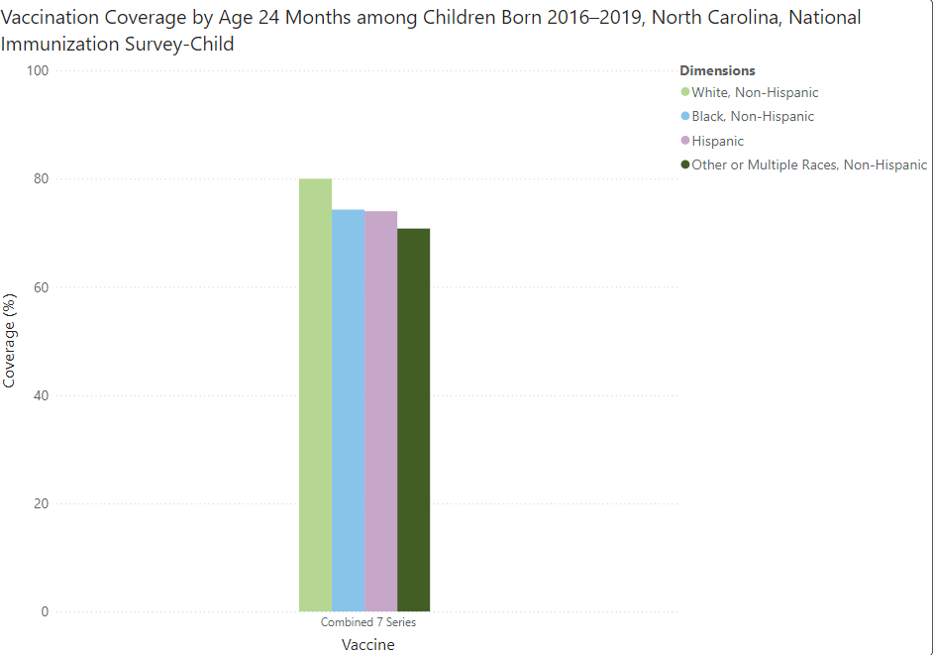
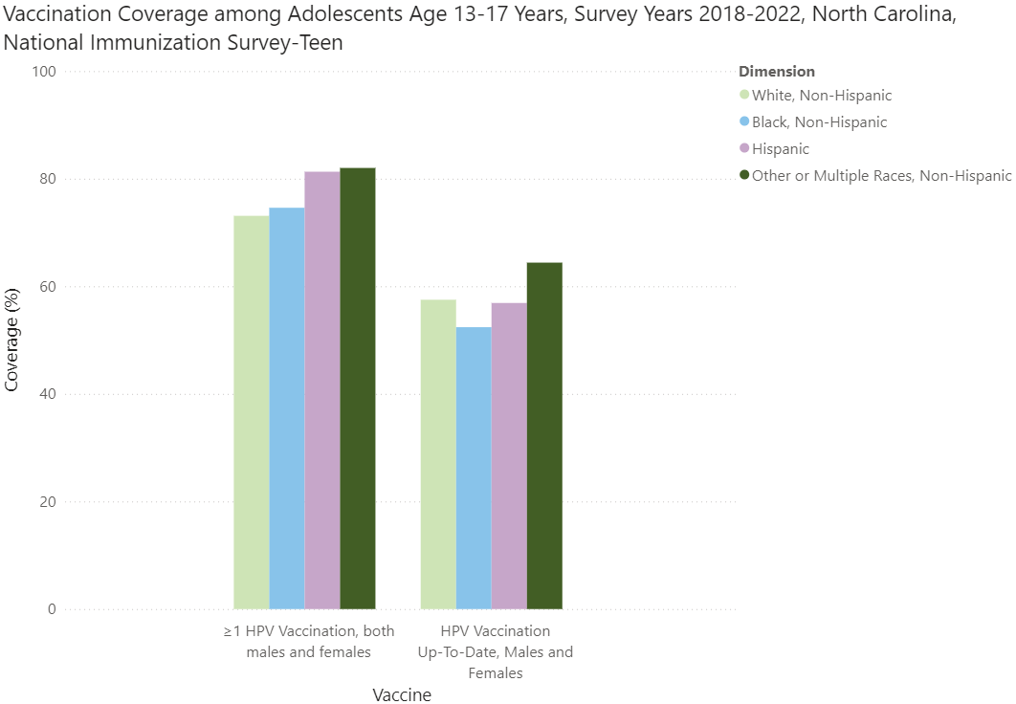
Disparities in Routine Immunization Coverage
SOURCE:CDC ChildVaxView and TeenVaxView - https://www.cdc.gov/vaccines/vaxview/index.html

Slide 8
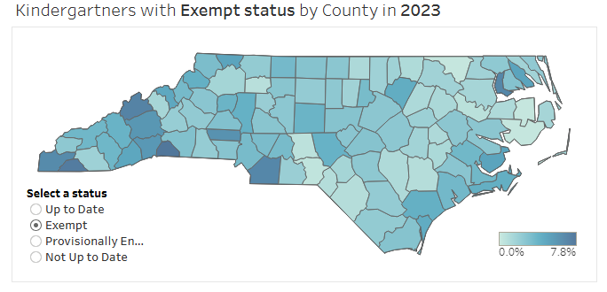
Exemptions in Immunization Coverage
Kindergarteners with exempt status by county in 2023
SOURCE: NC Kindergarten Immunization Dashboard: https://immunization.dph.ncdhhs.gov/schools/kindergartendashboard.htm

Slide 9
Lessons Learned
Data-driven outreach and communication is a vital component of a vaccine strategy
Identifying and engaging populations with lower rates of vaccination coverage is a critical step in eliminating health disparities
Demographic surveillance data:
Shines light on susceptible populations and communities
Draws attention to health disparities
Mobilizes action to inform and protect those most at risk
Creates ongoing accountability
State-level data is not sufficient for driving action. Availability of more granular data is critical.
The most successful public health interventions happen at the local level.
Advancing health equity is now the first goal of NCDHHS’ 2024-2026 Strategic Plan.

Slide 10
Custom Strategy Development
Development Efforts:
Cross-referenced lessons learned from COVID and mpox vaccine response efforts, CDC NIS MMWRs, and IQIP core strategies and action steps
Conducted an in-depth literature review and gap analysis
Creation of custom county-level vaccine coverage reports by demographic
Creation of vaccine equity toolkit to train IQIP consultants and provider staff
Custom strategy proposal to CDC IQIP Team
Extensive training with IQIP consultants on health equity concepts and SOG for implementing this custom strategy
Formally approved by CDC for implementation in NC IQIP Program in Spring 2023.

Slide 11
Address Health Disparities in Immunization Coverage

Slide 12
Custom Strategy Action Items
Educate staff on the principles of health equity and raise awareness of county-specific disparities in immunization coverage
Implement processes to routinely and uniformly collect race and ethnicity data from patients and document in the NCIR
Actively explore barriers to immunization with patients and provide resources if available
Ensure that resources available to patients represent demographics of your patient population
Partner with community organizations (including your LHD) to recruit unvaccinated patients in underserved populations
Seek to have an inclusive workforce representative of your patient’s community (build trust, understanding of target population)
Other

Slide 13
Educate Staff on Principles of Health Equity
Acknowledge and mitigate gaps within the system
Transportation
Accessibility
Food insecurity
Language education

Slide 14
Routinely and Uniformly Collect Race and Ethnicity
Guides equity discussion and challenges related to patient subpopulations within the office
Allows for focused efforts in unvaccinated populations
Effective use of resources targeted towards unvaccinated populations
Allows for preparedness
Self reporting is more accurate than staff observation

Slide 15
Explore Barriers and Provide Resources
Screen for health disparities when patients are in the office
Food insecurity
Housing insecurity
Interpersonal violence
NCDHHS has questions in 8 languages
Share a list of community organizations with resources

Slide 16
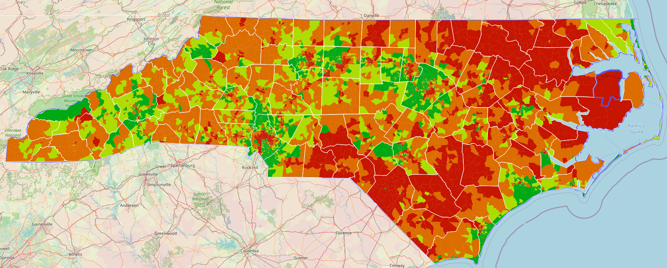
Resources represent patient population
Considerations:
Reading level
Technology access
Language barriers
Health literacy level
SOURCE: http://healthliteracymap.unc.edu/#

Slide 17
Partner with community organizations
Food banks
Grab bags of food in office
Referrals for services
Bill pay assistance
Adult vaccination services
Medicaid enrollment
Use trusted community organizations
Churches
Nonprofits
Local businesses

Slide 18
Recruit unvaccinated patients in underserved populations
Engage within the community
Social events, parades, and festivals
Understand what gaps are present within the community
Show up consistently
Utilize social media
Focus on vaccine hesitant individuals
Spread factual and cited information
Use terms that non-medical persons can understand

Slide 19
Inclusive workforce representative of patient community
Reduce language barriers
Increase levels of trust
Greater understanding of patient population

Slide 20
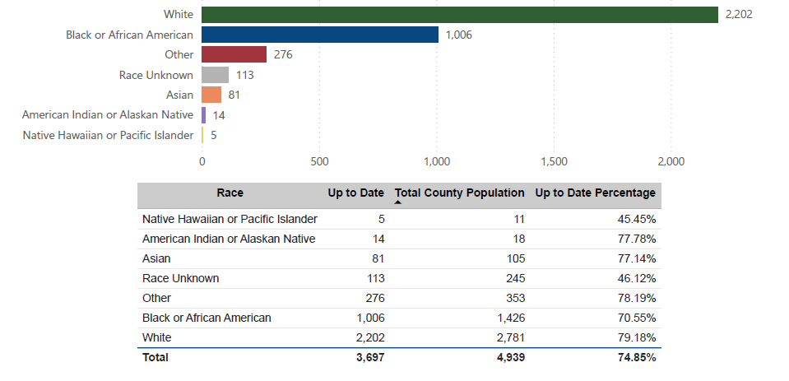
County Specific Vaccine Coverage Reports
County-specific coverage reports guide discussion with providers about how health equity data can be applied in their practice

Slide 21
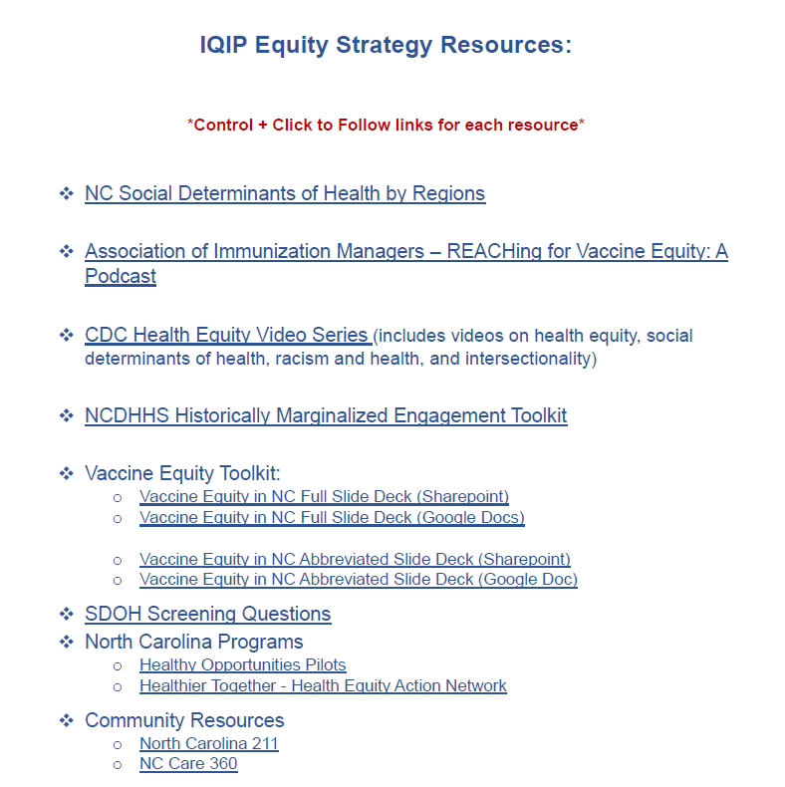
Vaccine Equity Toolkit and Resources

Slide 22
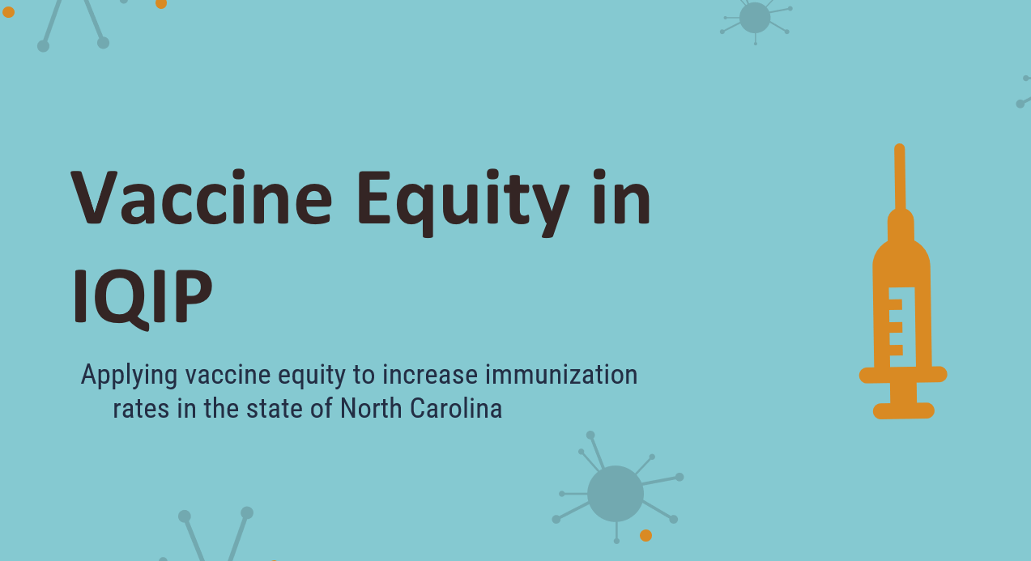
Equity Slide Deck

Slide 23
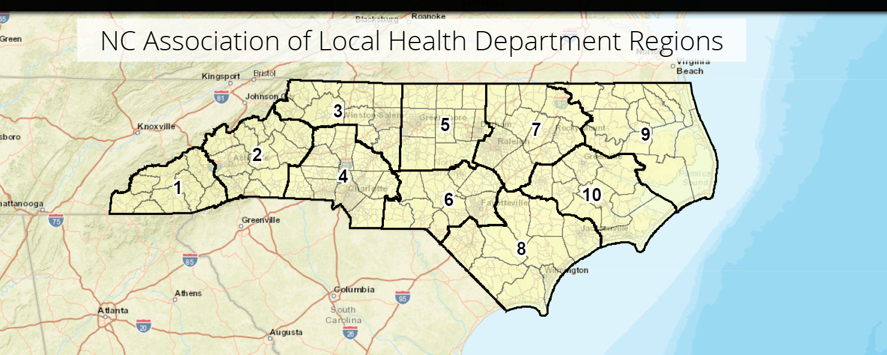
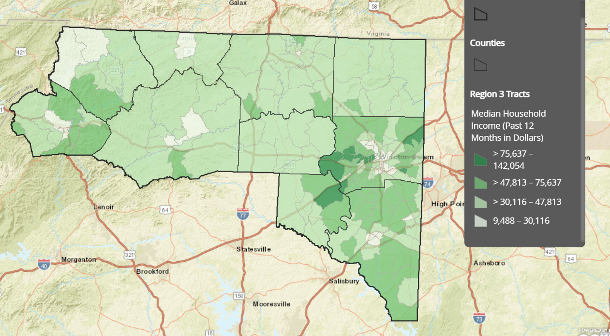
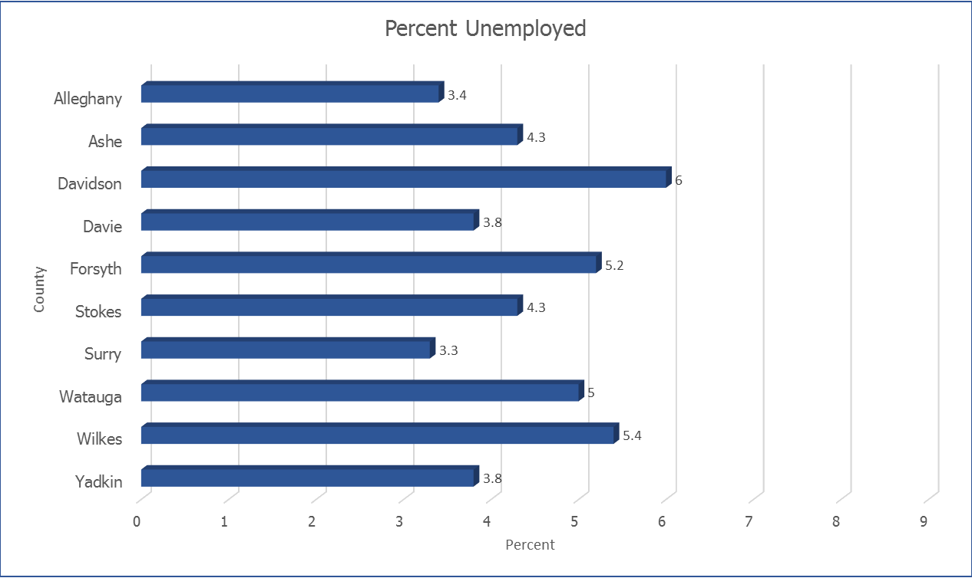
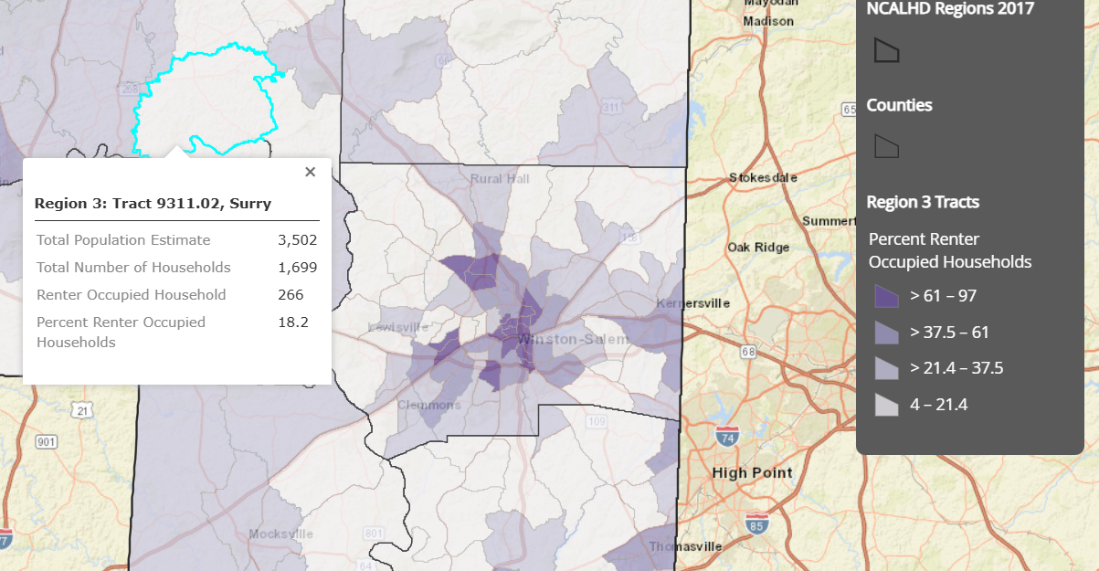
North Carolina Social Determinants of Health by Regions
SOURCE: https://nc.maps.arcgis.com/apps/MapSeries/index.html?appid=def612b7025b44eaa1e0d7af43f4702b

Slide 24
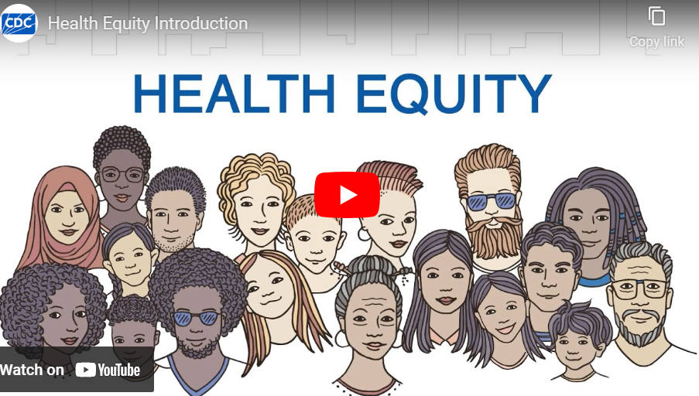
Educational Materials

Slide 25
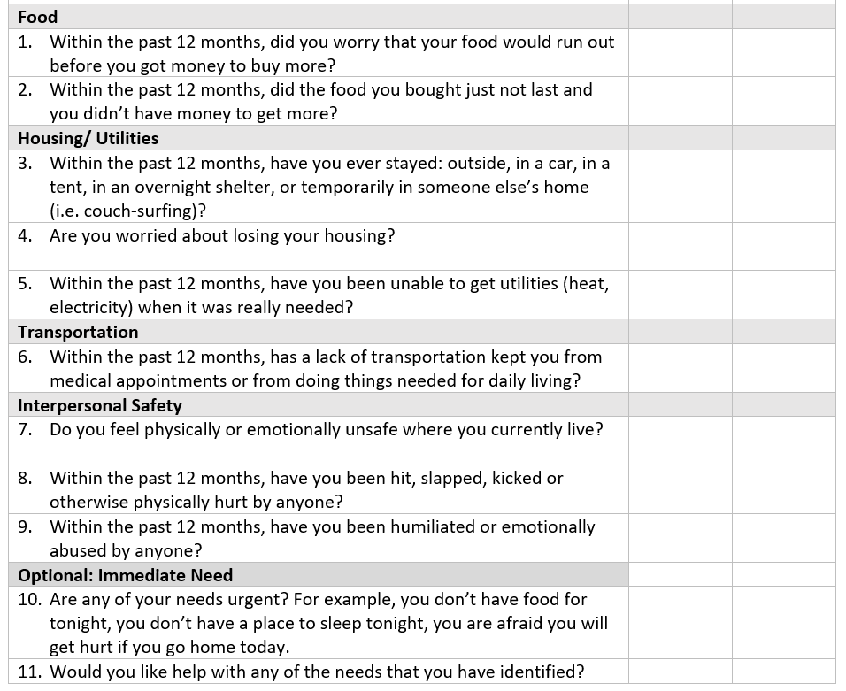
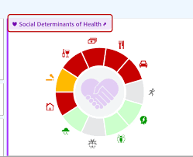
SDOH Screening

Slide 26
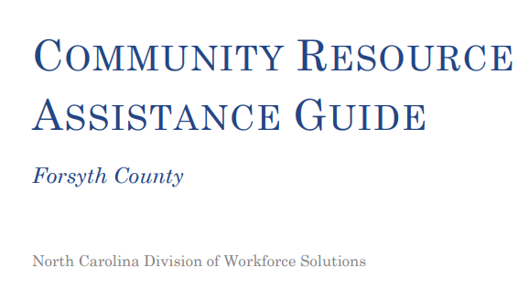
Providing Resources

Slide 27
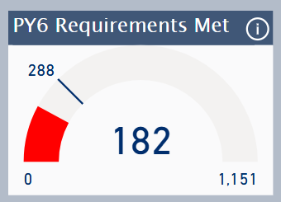
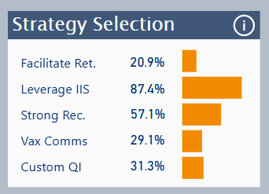
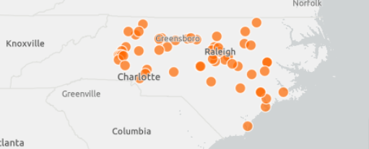
PY6 Custom Strategy Uptake
57 of the 182 (31%) VFC providers visited during this project year (ending 6/30/25) selected the custom strategy as part of their IQIP QI Plan.
As of 2/12/25, at least one provider in 27 counties selected custom strategy as part of their QI Plan.
High uptake among LHDs and private pediatric and family/primary care practices.
Custom strategy was most frequently selected strategy after "Leverage IIS" and "Provide a Strong Recommendation".

Slide 28
Custom Strategy Evaluation
Administered to all providers regardless of strategy selection
PY6 Post-then-pre questionnaire
Survey Questions
How familiar is your practice with the term “health equity” and how it relates to immunization services and coverage levels?
How comfortable is your practice discussing health equity with staff and colleagues?
How knowledgeable is your practice about existing health disparities in your community and their contributing factors?
How equipped is your practice at locating resources to support underserved populations in your community?
How motivated/willing is your practice to address health disparities in your practice and community?

Slide 29
Partner Engagement and Interest
Significant interest in this strategy and health equity in general among VFC providers
High demand for local equity data to better understand challenges/barriers in communities
High interest among stakeholders and partner organizations to collaborate on strategies to address health equity
Health equity is a high priority for NCDHHS and Epidemiology Section (where Immunization Branch is housed)

Slide 30
Contact Info:
Rachael Baartmans, MPH
Regional Immunization Consultant
NC Immunization Branch
Rachael.Baartmans@dhhs.nc.gov
Acknowledgements:
Carrie Blanchard, PharmD, MPH - NC Immunization Branch Director
Catherine Guerrero, MPA - NC Immunization Branch Equity Lead
Isabel Reynolds – Regional Immunization Consultant Supervisor
Jenny Myers, MPH- Continuous Improvement and Data Analytics Manager

