Slide 1
Wellness & Self-Care “Finding Your Oxygen Mask”
April Cline, System of Care Director, Sandhills Center
Eric S. Kilmer, System of Care Coordinator, Sandhills Center
​
Created: August 2023; Updated:

Slide 2
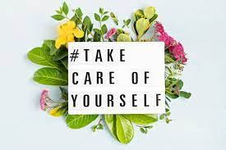
Agenda
What is Wellness/Self-Care?
Reflection Exercise Activity
Myths about Self-Care
Stress Response & Effects of Stress
SKILL ONE- How Positive Emotions Can Improve Stress Resilience
Full Plate Activity- VIDEO- Mayonnaise Jar
Discuss Oxygen Mask Analogy.
8 Dimensions of Wellness-Putting It All Together Activity
Self-care activities related to 8 Dimensions of Wellness.
Compassion Fatigue in Healthcare Workers
What is Compassion Fatigue/Secondary Trauma?
Causes of Compassion Fatigue in Healthcare Workers.
Prevention & Treatment.
Self-Care Ideas for Healthcare Workers.
Other Self-Care Activities
SKILL TWO- Relaxation Techniques
SKILL THREE- Setting Personal Boundaries- VIDEO- Setting Boundaries
Challenges to Practicing Self-Care
Maladaptive Coping Skills
VIDEO- Understanding Unhealthy Coping
Creating your Self-Care Plan
Writing your Manifesto- Activity

Slide 3
Ground Rules
Relax- Taking care of yourself should be enjoyable!
Don’t be afraid to look or act silly!
No questions are “stupid.”
Be respectful of others.
Please silence all cell phones.
Take care of YOU!

Slide 4
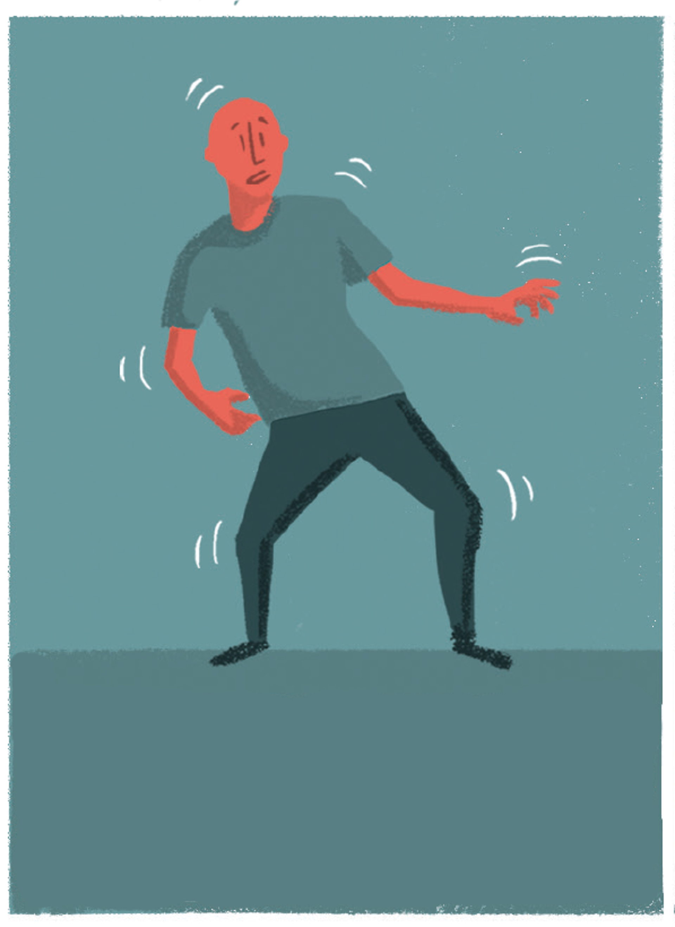
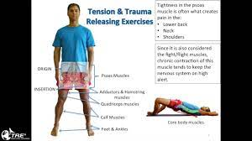
Shake It Off How To Release Tension, Stress or Trauma
Shaking is the natural way to release tension and return the body to its normal homeostasis. It is a primal impulse to a stressful situation. Animals naturally shake to release tension after a life-threatening event.
However, we human's have been socially conditioned to stoically grin and bear. We pretend that all is fine, play the cool guy. Show the world that we are unfazed by life's events. Sadly, this unnatural demeanor that we adopt traps the stress in our bodies. This negatively influences our physical and emotional health.
Shaking can help regulate the nervous system and calm the body when it's overstimulated. Trauma and tension releasing exercises (TRE), like shaking, may be beneficial in managing and relieving stress.
Difficult experiences, including trauma, can build up energy in the nervous system. There's some evidence to suggest that shaking can help release it. This is also known as therapeutic or neurogenic tremoring.
Kim Eng - Shaking Practice
https://youtu.be/_DhwJoylC28?si=wOlru6VfA8XUEeLg
Ping Shuai Gong - Swing Hands Exercise https://youtu.be/v5qts5Xu5_Q?si=bKGy84UXNYXBkh_b

Slide 5
ACTIVITY- Reflection Exercise
THEN:
Reflect in your mind to when you entered the field in which you currently work. What words/pictures/symbols would you use to describe how you felt as you started your journey in your current field of work? List them on one side of a sheet.
NOW:
Take a moment to think about how you feel about how you feel about the field in which you work now. What words/pictures/symbols would you use to describe how you feel now about your field of work? List them on the other side of the sheet.
Bring Back the Honeymoon!!
Activities or things you can do to revive or put new spin on how you feel about your field of work.

Slide 6
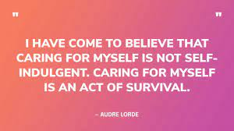
What is Self-Care and Wellness
Self-Care is the Journey
Wellness is the Destination
Self-care consists of the specific choices and behaviors that over time lead to improved wellness.

Slide 7
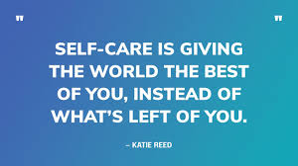
Self-Care; FACT OR MYTH

Slide 8
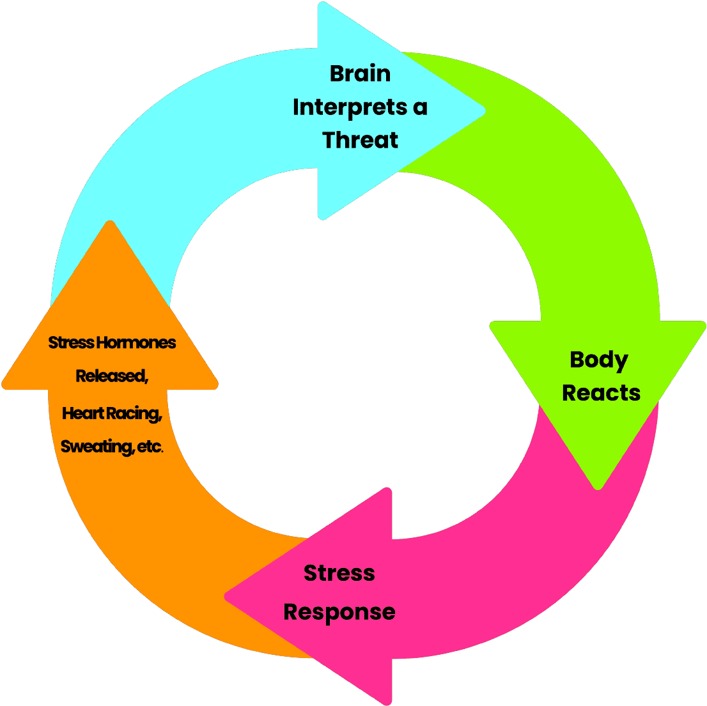
The Stress Response:
Stress is our systems way of responding to any kind of demand:
Stress is caused by both positive & negative experiences.
Our body reacts by releasing cortisol & adrenaline to give us more energy and strength to cope.
Triggered by a physical danger; however, response occurs from any type of stress.
Stress can be debilitating when there is no outlet for this extra energy or when we find ourselves in a chronic stress response.

Slide 9
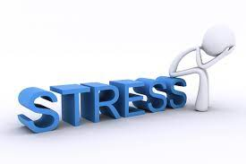
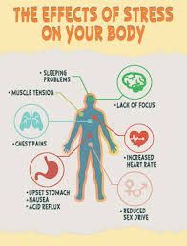
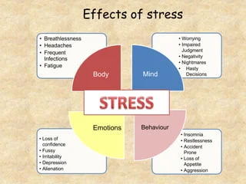
The Effects of Stress:
How Does Stress Effect You?

Slide 10
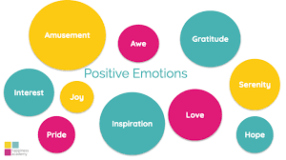
SKILL ONE- How Positive Emotions Can Improve Stress Resilience
Do this:
Plan Positive events
Deal with stress
Find Meaning
Be Social!
Exercise, sleep
Nature- “Forest Bathing”- Shinrin yoku
Positive reappraisal, distraction, anticipation
Not that:
Constantly obsess with whether you are happy or not
Avoid important negative emotions/stress
Search for Meaning
Worry about bothering people
Eat/drink to feel good
Spend your life indoors
Avoidance, rumination

Slide 11
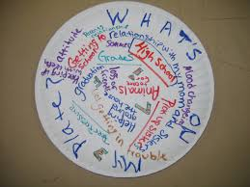
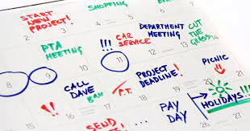
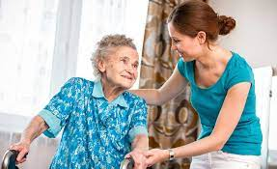
What’s On Your Plate?
What kinds of Activities/Stressors do you encounter on a typical day?

Slide 12
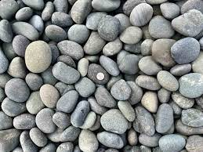
What’s On Your Plate?
VIDEO- Mayonnaise Jar https://youtu.be/SqGRnlXplx0?si=noAo5qaal76YwbZy
Pebbles
Golf Balls
Sand
What kinds of Activities/Stressors do you encounter on a typical day?

Slide 13
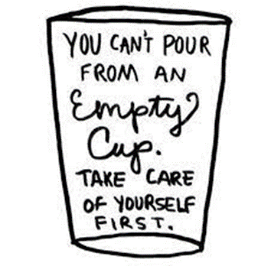
The Oxygen Mask METAPHOR
When you fly on an airplane, the flight attendant instructs you to “put your oxygen mask on first,” before helping others. Why is this an important rule for ensuring survival? Because if you run out of oxygen yourself, you can't help anyone else with their oxygen mask.

Slide 14
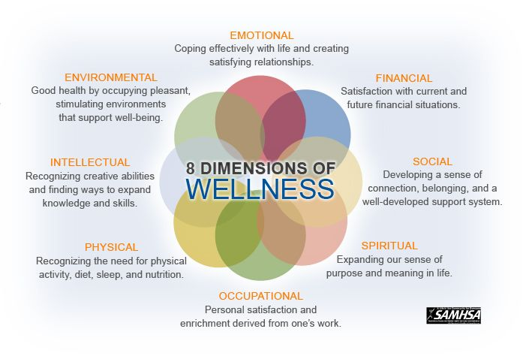
8 Dimensions of Wellness
ACTIVITY- Putting It All Together:
For each Dimension of Wellness Name at least ONE Corresponding Self-Care Activity.

Slide 15
What is Your Oxygen-Mask?
Self- Care Options
Take a Bubble Bath | Donate to a cause you care about | Host a Party | Recycling
Forgive Yourself | Read something inspiring | Invest in a stand desk | Save for a specific goal
Brunch with a friend | Declutter Personal Spaces | Maintain Healthy Boundaries | Join a Support group
Track your spending | Take a class (on-line) | Read a book | Plant for your workspace
Take Exercise breaks | Journal Financial Goals | Eat a Healthy Meal | Practice forgiveness
Practice Tai Chi | Be in Nature | Practice Gratitude | Create a Sacred Space
Plant a Garden | Take a cooking class | Play a Brain Game | Get enough sleep

Slide 16
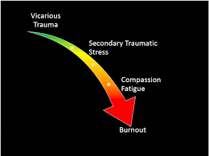
Compassion Fatigue/Secondary Trauma in Healthcare Workers
What is Compassion Fatigue/Secondary Trauma Stress?
Alternatively called secondary trauma, secondary traumatic stress (STS), or vicarious trauma, compassion fatigue is an overwhelming mental and physical exhaustion brought on by feeling the pain, stress, and other emotions of the people they are helping. The more empathetic and open they are to the suffering of others, the more likely they are to feel that suffering themselves.
“The Cost of Caring…”

Slide 17
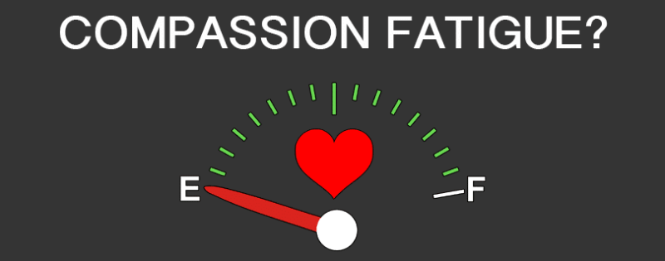
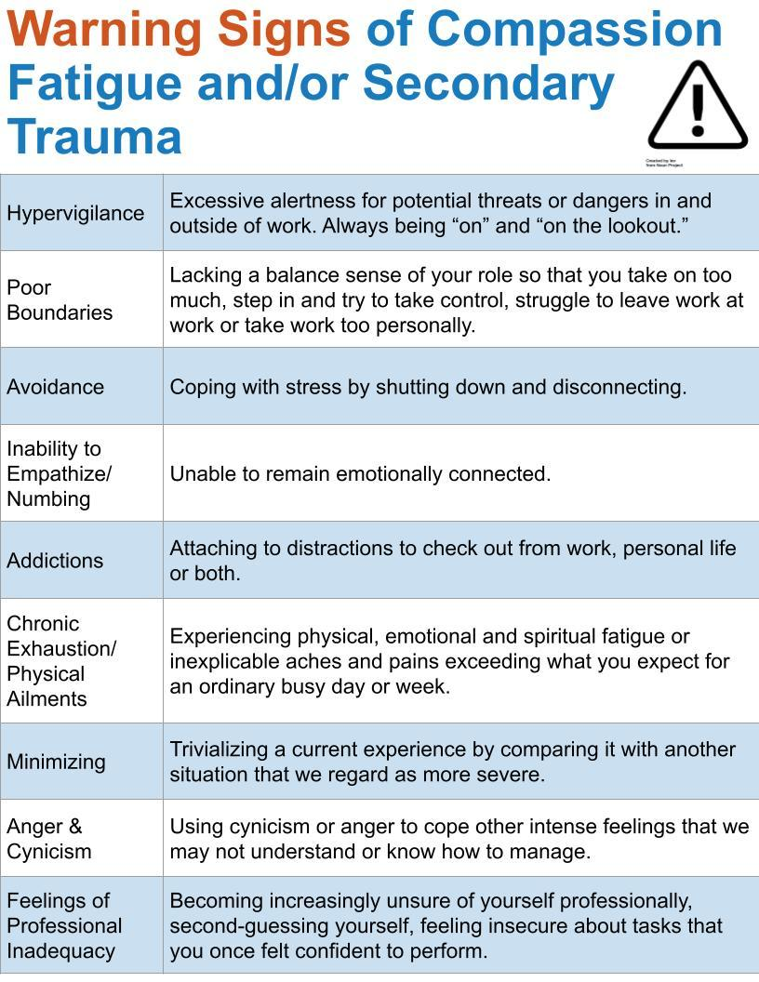

Slide 18
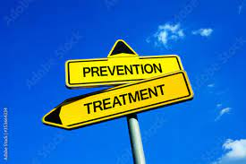
Prevention & Treatment of Compassion Fatigue
Educate yourself on the signs & symptoms of Compassion Fatigue.
Learn signs & symptoms, coping strategies, etc.
Practice Self-Care.
Diet, exercise, sleep, work/life balance
Set Emotional Boundaries.
Selfless/selfish
Engage in outside hobbies.
Cultivate healthy friendships outside of work.
Talking “shop” with co-workers doesn’t count.
Keep a journal.
Way to process and release emotions.
Boost your resiliency.
Resilience can be thought of as the ability to adapt to and become stronger through adversity.
Use Positive Coping Strategies.
Identify Workplace Strategies.
Support groups/Open discussions, Regular breaks, routine check-ins, mental health days, on-sight counseling, relaxation rooms.
Seek Personal therapy.
Process feelings & implement coping strategies.

Slide 19
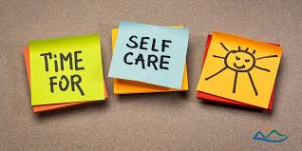
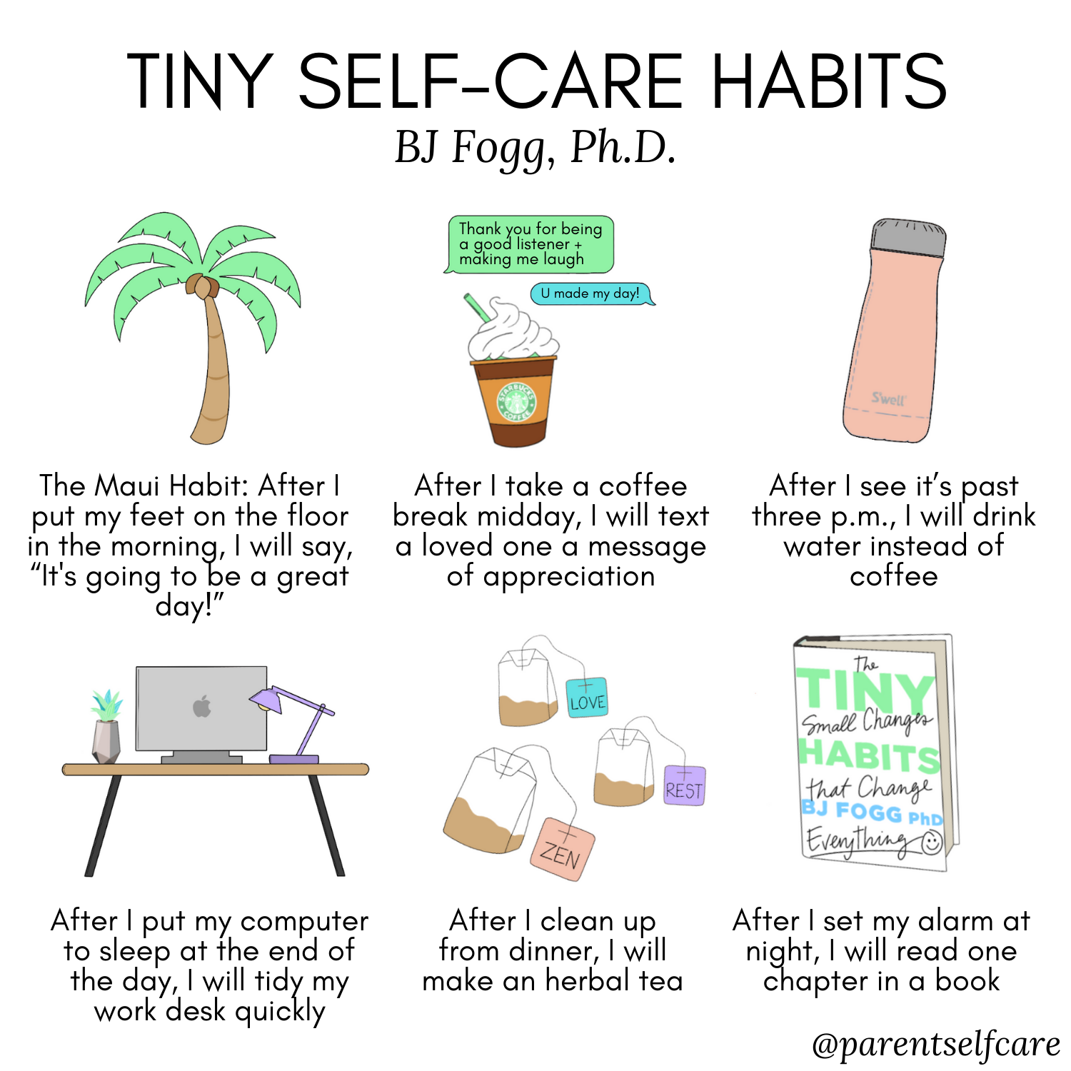
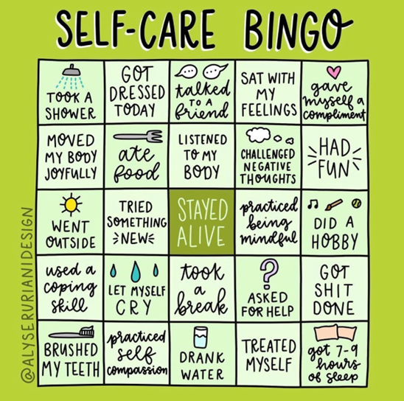
Self-Care Ideas for Healthcare Workers

Slide 20
SKILL TWO- Relaxation Techniques
Belly Breathing
Progressive Muscle Relaxation
Practice Tai-Chi
Helps you RELAX, Reduces Blood Pressure, Reduces Heart Rate https://youtu.be/qTN_MtV5TFw
“Candle, Flower Breathing”
Anxiety reducing technique
Tense & Relaxation of all Major Muscle Groups in the body
A 6 Minute Mindful Progressive Muscle Relaxation
https://youtu.be/9x3tl81NW3w
Originally developed for self-defense, tai chi has evolved into a graceful form of exercise that's now used for stress reduction and a variety of other health conditions. Often described as meditation in motion, tai chi promotes serenity through gentle, flowing movements.
https://youtu.be/cEOS2zoyQw4
Tai Chi 5 Minutes a Day Module 01

Slide 21
SKILL THREE- Setting Personal Boundaries
Step ONE - Identify the boundaries you need to set.
Step TWO- Think about how & when to set the boundary.
Step THREE- Stick to the boundaries you set!
VIDEO- Your 3-Step Guide to Setting Better Boundaries at Work | The Way We Work- https://youtu.be/4SCrXqbhmCY?si=eb14gdVnyZhRPZOa

Slide 22
Challenges to Practicing Self-Care
Lack of time- self-care can take mere minutes each day.
Feelings of Guilt & Selfishness- if you don’t take care of you who will?
Not understanding how to practice Self-Care
Perfectionism/Wanting to be perfect- no strict or exact routine
Believing Self-Care is expensive
Not setting boundaries- selfless/selfish
People Pleasing- placing the needs of others before your own
Believing you don’t need or deserve self-care- believe in yourself

Slide 23
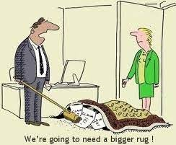
Maladaptive Coping Skills
When confronted with stressful situations that leave us with feelings of anxiety, panic, and extreme stress, we often resort to maladaptive behaviors.
And yet the range in human response is vast. For some, it may be relatively harmless – occasional daydreaming or procrastination – for others, it could be self-harm or drug use.
Such maladaptive behavior may temporarily relieve stress or anxiety, but the underlying thoughts, fears, and concerns are not being addressed. Short-term relief may result in a longer term psychological upset.

Slide 24
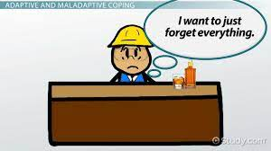
Maladaptive Coping Skills “Problems are not the problem; coping is the problem.”
Substance abuse- Consumption of excessive amounts of alcohol and taking legal and illegal drugs.
Rumination- Extreme and ongoing focus on “depressive symptoms and on the implications of those symptoms”.
Emotional numbing- Shutting down feelings to provide relief from stress and anxiety.
Escape- Changing behavior to avoid the situation and difficult feelings.
Intrusive thoughts- Unwelcome or involuntary ideas and thoughts that may be upsetting and difficult to manage.
Daydreaming- While occasional daydreaming may result in a loss of focus and delayed task completion, in its extreme, maladaptive daydreaming is a form of addiction to daydreaming that can last for hours at a time.
Procrastination- Procrastination, like rumination, can lead to the conscious or unconscious avoidance of difficult issues or tasks that require completion.
Self-harm & binge eating- Both can be ways of dealing with difficult feelings and usually need specialist support.

Slide 25
Maladaptive Coping Skills “Life begins at the end of your comfort zone”- Neale Donald Walsch
Blaming & self-blaming- These form cognitive strategies that affect how an individual relates to difficult circumstances.
Behavioral disengagement/Social withdrawal- Under challenging situations, individuals may disengage or reduce the effort in a task or social situation.
Risk-taking behavior- Another form of behavioral disengagement used to alleviate the adverse effects of a situation.
Sensitization- Overly rehearsing a future event, excessive worrying, and hyper-vigilance.
Safety behaviors- The tendency to rely on someone or something to help cope with extreme anxiety. The person may seek continual reassurance that things will be okay.
Anxious avoidance- Avoiding situations or events that may cause upset. Unfortunately, this causes the person never to confront their fears or unlearn their faulty beliefs. Removing or avoiding such unpleasant experiences may cause the behavior to worsen.
VIDEO- Am I Broken? | Understanding Unhealthy Coping- https://youtu.be/dYKdUFz2hw4?si=2wdcZ9s1xqgwqv-X

Slide 26
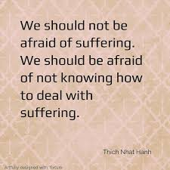
Maladaptive Coping Skills “A River cuts through rock, not because of its power, but because of its persistence.”
Avoidance | Generalized Anxiety Disorder, Social Phobia, PTSD, Panic Disorder
Self-Sabotage | Depression
Detachment | Depression
Externalizing | Substance Use Disorder, Binge Eating, Gambling
Displacement | Obsessive-Compulsive Disorder, Eating Disorders, Perfectionism, Workaholic
Somatization | Psychological factors that impact medical decisions, Somatoform Disorder
Worry/Rumination | Generalized Anxiety Disorder, Social Phobia, PTSD, Panic Disorder
Helplessness | Suicidal Ideation, Self-Harm

Slide 27
Creating Your Self-Care Plan
What is your Oxygen Mask?

Slide 28
Write Your Own Manifesto A written statement to publicly declare your intentions, motives, or beliefs.
1.) I BELIEVE …Just tell us what you believe. Simple as that. One sentence, a bullet-point list, or a whole commencement address. You can also include what you no longer believe for an interesting twist! Example: “I believe in the power of love.” “I believe in karma”
2.) I WANT TO LIVE IN A WORLD WHERE…….. Paint a vision of the world you want to live in. What’s different? What’s better? What’s easier?
Example: “I want to live in a world where people care about one another.”
3.) HERE’S WHAT I KNOW FOR SURE…….Reveal a few undeniable truths here.
Example: “If I don’t take care of myself, I am no good to anyone else.”
4.) ALWAYS WEAR SUNSCREEN……Share a collection of straight-shooting tips & advice, from the perspective of someone who’s not “perfect.”
Example: “Trust your instincts. Be yourself. Believe the clichés. They’re usually true.”
5.) THE “MICRO-MANIFESTO”…….. If you were at the world’s biggest open mic night, and had fifteen seconds on the microphone, what would you holler out into the crowd?
Example: “No one on earth can do what I do, in precisely the way that I do it.”

Slide 29
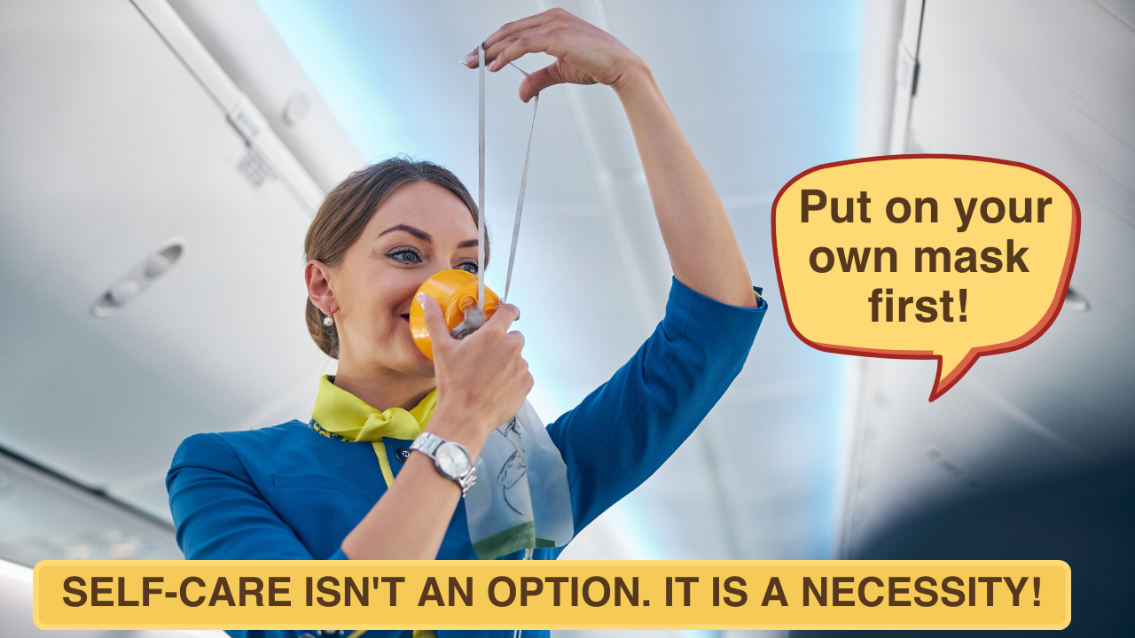
Not the END, but your new BEGINNING..
April Cline, Director of System of Care, Sandhills Center
AprilC@Sandhillscenter.org
Eric S. Kilmer, System of Care Coordinator, Sandhills Center
Erick@Sandhillscenter.org
Your Self-Care Weekend Playlist- 15 Songs for Self-Care- https://www.thelilyjoproject.com/2021/08/13/your-self-care-weekend-playlist-15-songs-for-self-care/

Slide 30
References
“Am I Broken? Understanding Unhealthy Coping,” Inspired Living Medical, YouTube, 19th of October 2018, https://youtu.be/dYKdUFz2hw4?si=3iwTAhYlJejJaOfH
Berceli, Dr. David. “Therapeutic Tremoring - Shake Off Stress And Trauma.” Pace Connection, 15th of September 2018, https://www.pacesconnection.com/blog/therapeutic-tremoring-shake-off-stress-and-trauma Accessed 24th of August 2023.
Cocker, Fiona & Joss, Nerida, “Compassion Fatigue among Healthcare, Emergency and Community Service Workers: A Systematic Review.” National Library of Medicine, 22 of June 2016, https://www.ncbi.nlm.nih.gov/pmc/articles/PMC4924075/ Accessed 28th of August 2023.
“How Can Medical Professionals Avoid Compassion Fatigue?” University of Central Florida Online, https://www.ucf.edu/online/healthcare/news/can-medical-professionals-avoid-compassion-fatigue/ Accessed 25th of August 2023.
Humphries, Anne. “7 SELF CARE BARRIERS THAT STOPS YOU FROM LIVING YOUR BEST LIFE.” Rack Up Moments, https://rackupmoments.com/barriers-to-self-care/ Accessed 29th of August 2023.
Jones, Heather. “Understanding the Body’s Stress Response.” Very Well Health, 21st of June 2022, https://www.verywellhealth.com/stress-hormones-5224662 Accessed 21st of August 2023.
Kay, Meir, “A Valuable Lesson for a Happier Life,” YouTube, July 31, 2014, https://youtu.be/SqGRnlXplx0
Sutton Ph.D., Jeremy. “Maladaptive Coping: 15 Examples & How to Break the Cycle.” Positive Psychology, 28th of October 2020, https://positivepsychology.com/maladaptive-coping/#google_vignette Accessed 5th of September 2023.
Tawwab, Nedra, “Your 3-Step Guide to Setting Better Boundaries at Work | The Way We Work.” YouTube, 29th of August 2023, https://youtu.be/4SCrXqbhmCY?si=Rp4cH8G8j_hLny5w
“The Cost of Caring: 10 Ways to Prevent Compassion Fatigue.” Good Therapy, 26th of March 2020, https://www.goodtherapy.org/for-professionals/business-management/human-resources/article/cost-of-caring-10-ways-to-prevent-compassion-fatigue Accessed 30th of August 2023.
Terrence, Beth. “Supporting Success & Sustainability for Peer Recovery Specialists.” May 2017 https://health.maryland.gov/bha/Documents/SelfCare%20Workshop.pptx Accessed June 2023.

