Slide 1
Addressing violence as a public health issue
David Johnson Bull City United Supervisor
Sept 20, 2021
Notes:
Lindsey starts

Slide 2
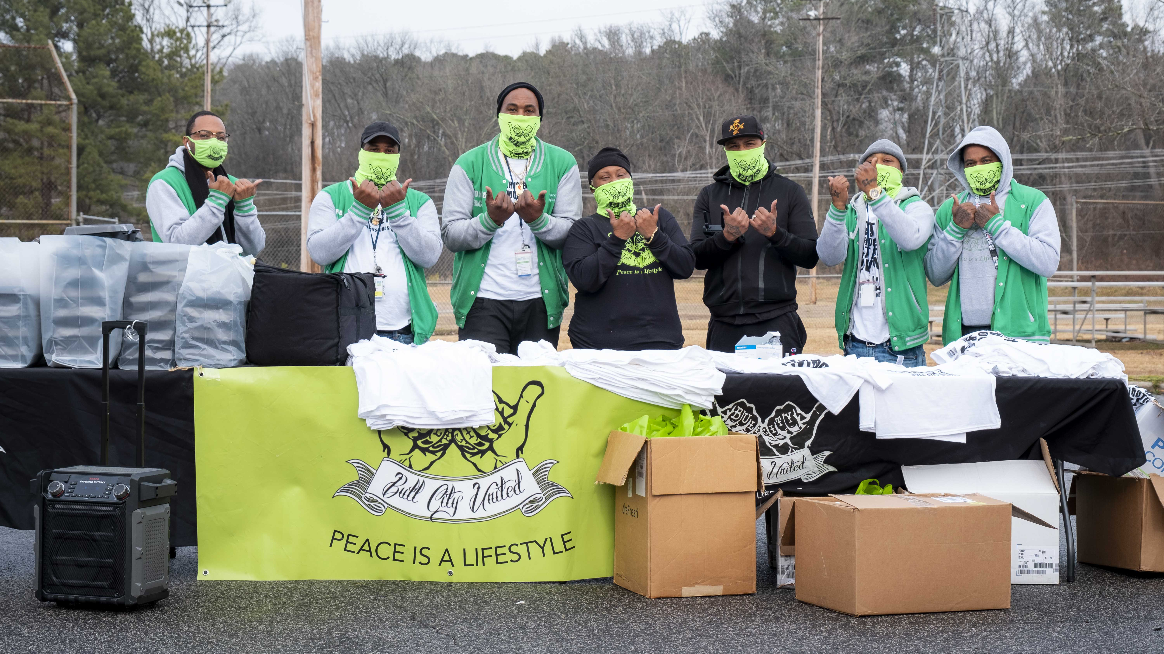
Bull City United is Durham County’s community based , violence prevention and intervention program. That focusing on violence through a public health lens that treats violence as a treatable disease using the Cure Violence model.

Slide 3
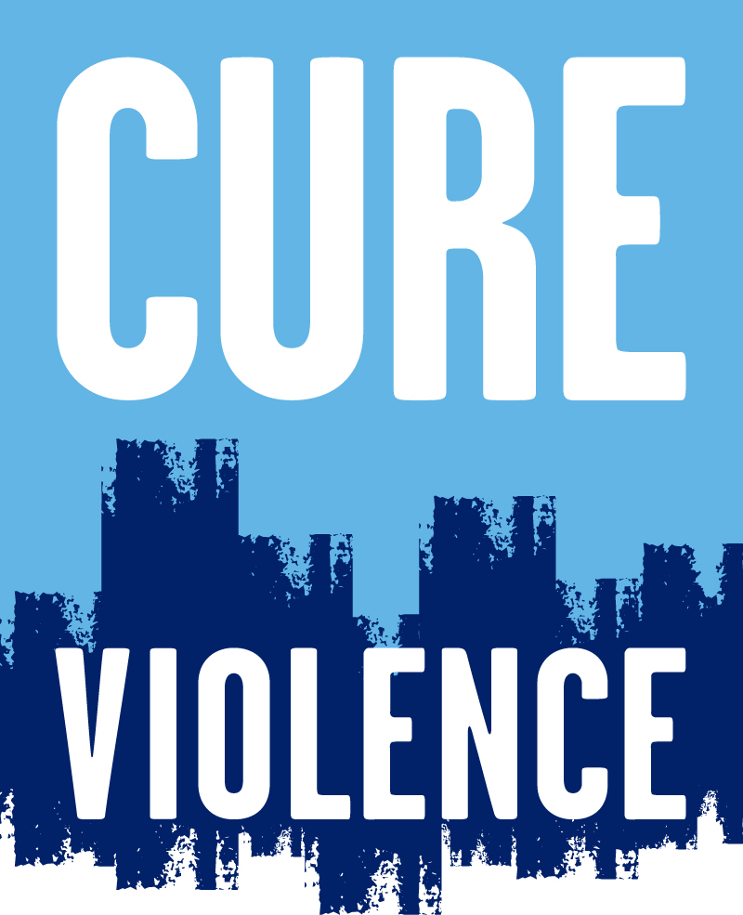
CURE VIOLENCE MODEL
Detect and interrupt potentially violent conflicts
Prevent retaliations
Mediate ongoing conflicts
Keep conflicts ‘cool’
Identify and treat highest risk
Access highest risk individuals
Change behaviors
Help obtain needed social services
Mobilize the community to change norms
Respond to every shooting
Spread positive norms

Slide 4
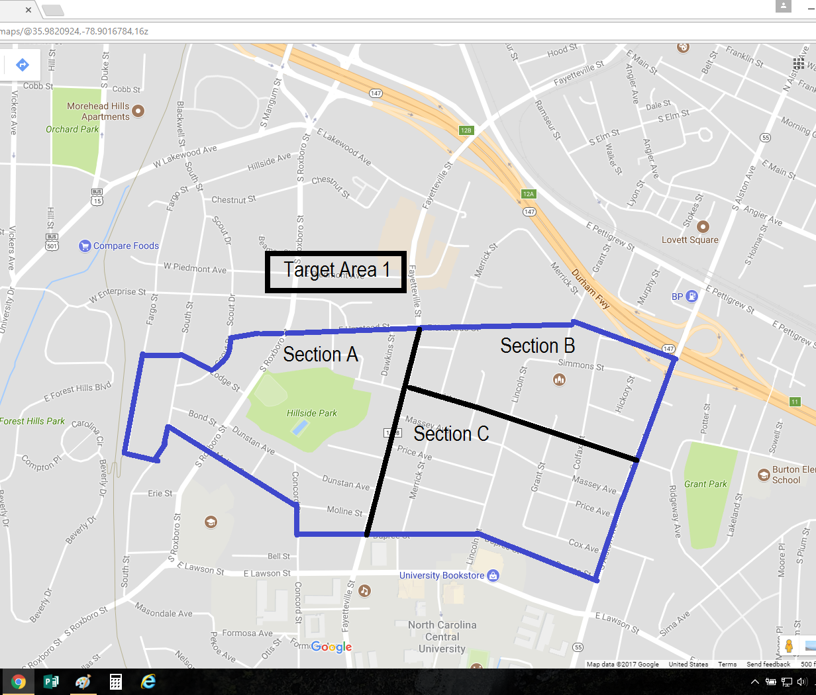
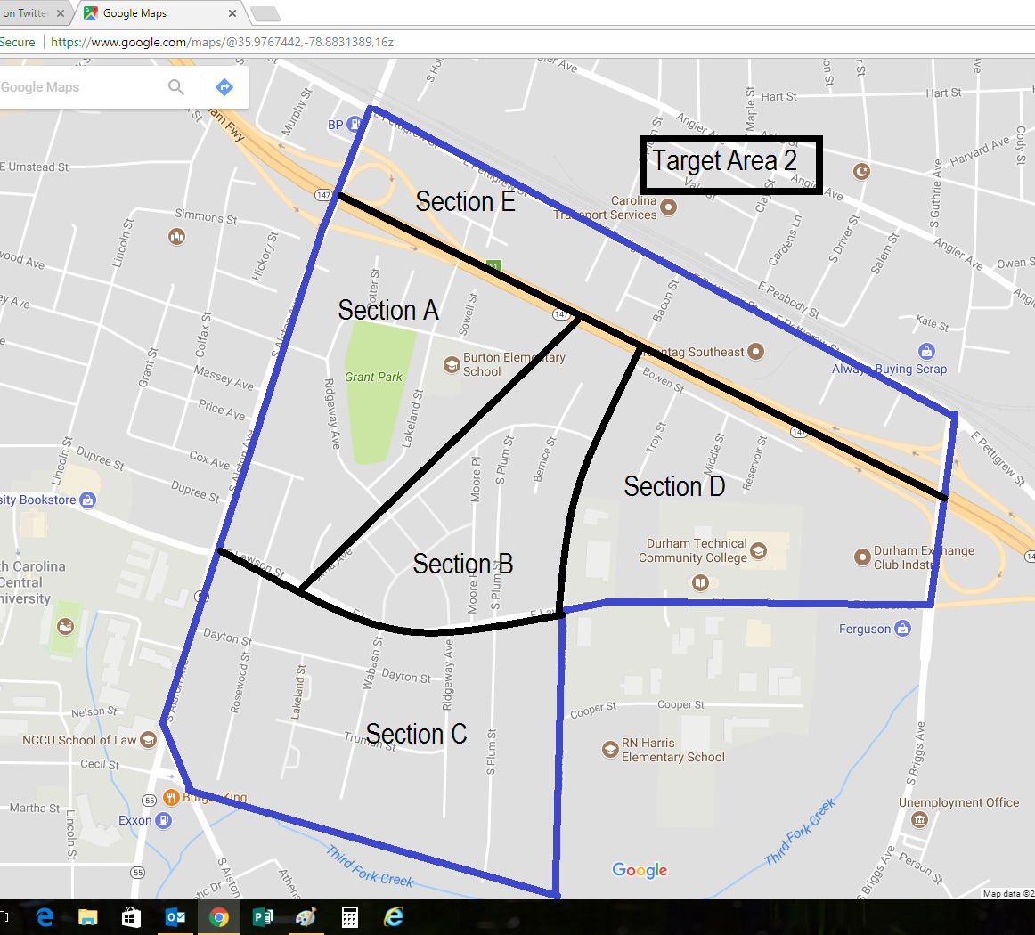
Targeting Our Focus
Examining the data in 2015:
Census tract 1400 0.0191 violent crimes per person (highest in the city of Durham)
Census tract 1301 0.0177 violent crimes per person (2nd highest in the city of Durham)

Slide 5
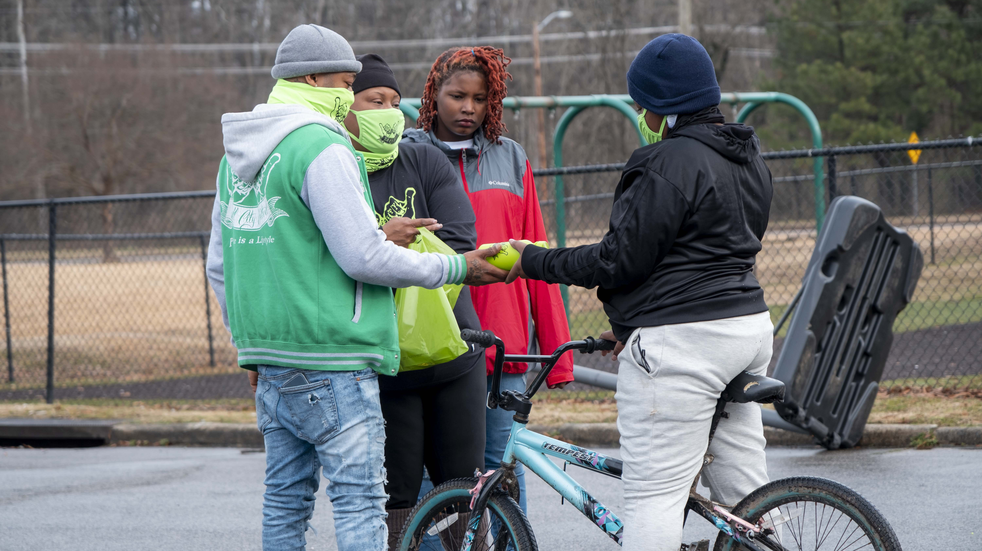
COMMUNITY ENGAGEMENT & EVENTS WEEK OF PEACE SAFE SUMMER CELEBRATION OF PEACE CELEBRATION OF LFE PEACE VIGILS

Slide 6
COMMUNITY PARTNERS
CITY OF DURHAM – INVESTMENT $935,000 TO EXPAND TO FOUR ADDITIONAL CENSUS TRACKS
DURHAM TECH COMMUNITY COLLEGE- TRADE SKILL AND ADULT HIGH SCHOOL CLASSES
DUKE UNIVERSITY HOSPITAL- VIOLENCE RECOVERY PROGRAM

Slide 7
QUESTIONS???

