Slide 1
Pitt County Firearm Safety Coalition
Sue Anne Pilgreen, MSN, RN, CPN Eastern Carolina Injury Prevention Program Vidant Medical Center

Slide 2
History
Pitt County Firearm Safety Coalition
Why?
- Reduce injury and death from firearm violence
- Increase in firearm injuries/death in Pitt County
Who?
- Co-chairs from VA and Injury Prevention at VMC
- Multi-sector team of community stakeholders
What?
- Preventive strategies to promote firearm safety
- Safe storage and resource connection
Where?
- Community and agency/organization events
- Physician offices, schools, Council on Aging
Notes:
Purpose: Nonpartisan, apolitical, multi-sector coalition aimed at the reduction of injury and death from firearm violence using public health strategies through the identification of solutions and impactful interventions.
Mission: To reduce death and injury related to firearms through broad based and preventive strategies to promote a safe and violence free environment.
Vision: A community where every citizen feels safe from firearm violence.

Slide 3
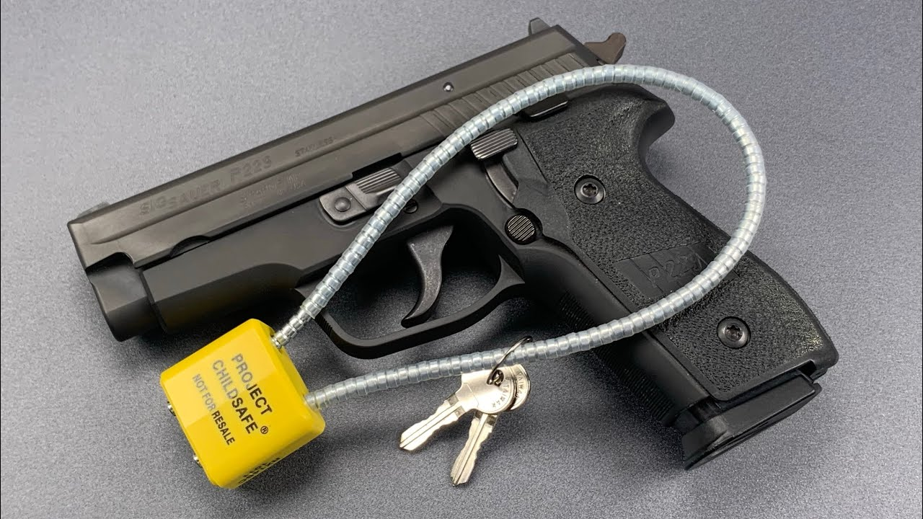
Key Components
Education
- Facts and data - Safe storage - Safety Campaigns
Dissemination
Coalition members serve as liaison between their networks and the coalition
Intervention
- Gunlock distribution - Easy-to-access resources - Safety Campaigns - Education

Slide 4
Coalition Successes
Logo development
Press Release
Safety Campaign
People are talking!
Notes:
Press release and media coverage in partnership with Greenville PD and Veterans Administration
Campaign at the Greenville Mall that included banners, and clings on doors, tables and mirrors, with over 400,000 impressions
Banners up at two pediatrician offices, and these offices now distributing firearm safety materials and gun locks

Slide 5
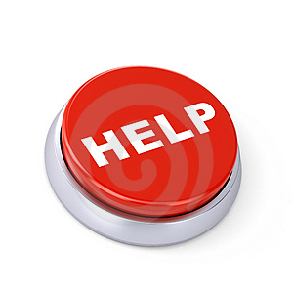
Get Started!
Know YOUR Community
Partnerships Are Key
Know YOUR Resources
Ask For Help! Sue Anne Pilgreen, ECIPP at VMC sfipps@vidanthealth.com
Notes:
Know your community – Is it a hunting community?
Partnerships are huge
Resources
Ask for help

Slide 6
Resources
Durham County Gun Safety Team
https://www.dcopublichealth.org/services/health-education/health-promotion-and-wellness/gun-safety-program
NCDHHS Injury and Violence Prevention Branch (guide for starting a gun safety team)
https://www.injuryfreenc.ncdhhs.gov/safestorage/
North Carolina Violent Death Reporting System
https://www.injuryfreenc.ncdhhs.gov
The ASK (Asking Saves Kids) Campaign
http://www.askingsaveskids.org
Project ChildSafe: National Shooting Sports Foundation (gunlocks and printable education)
http://projectchildsafe.org/safety/get-a-safety-kit
North Carolinians Against Gun Violence
http://www.ncgv.org
Means Matters : Harvard T.H. Chan School of Public Health
https://www.hsph.harvard.edu/meansmatter
American Academy of Pediatrics (online safe storage module for pediatric providers)
https://shop.aap.org/safer-storing-firearms-prevents-harm/
American College of Surgeons (activities and printable brochures)
https://www.facs.org/quality-programs/trauma/advocacy/ipc/firearm-injury
Safe Kids Worldwide (printable education)
https://www.safekids.org/tip/gun-safety-tips
Local Veterans Administration (gunlocks and printable education)

